Slide 1
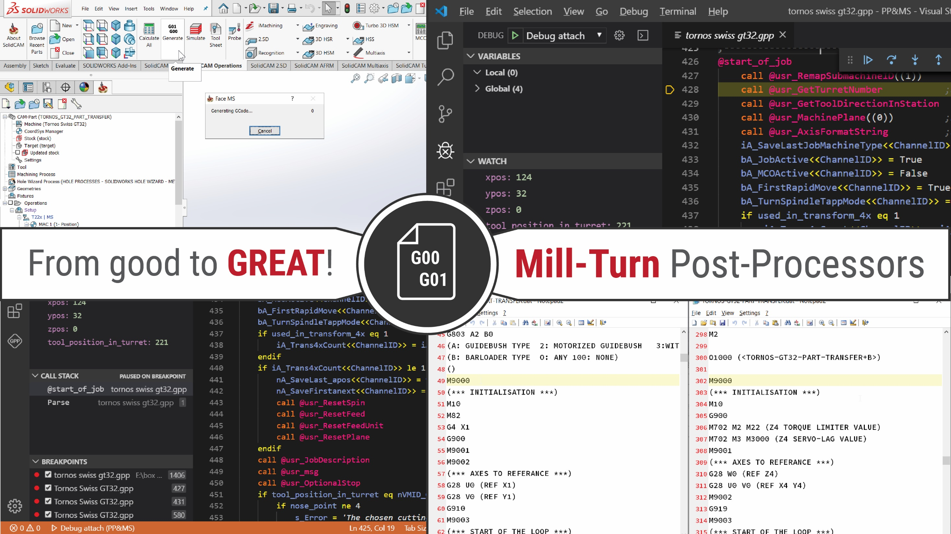
GPP&VMID - Tips and tricks
SolidCAM 2020
Danijel Đurica
SolidCAM International Support Manager

Slide 2
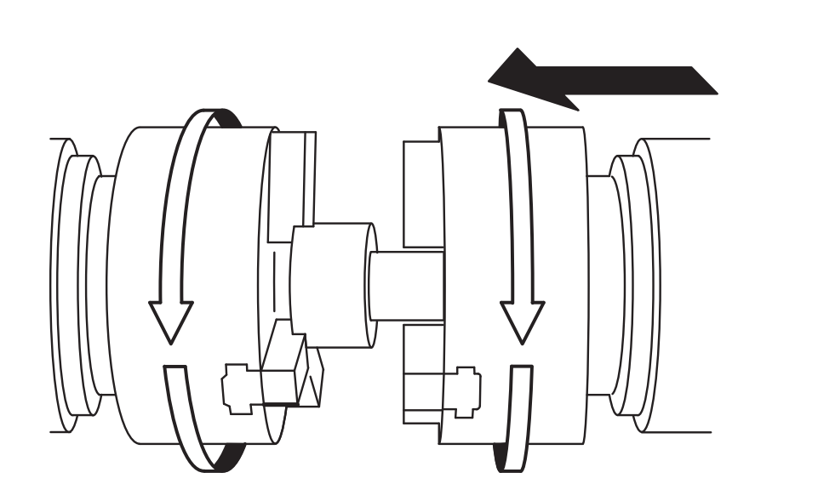
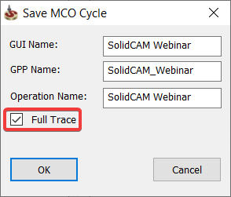
Using “Full Trace” in MCO’s
SolidCAM 2020

Slide 3
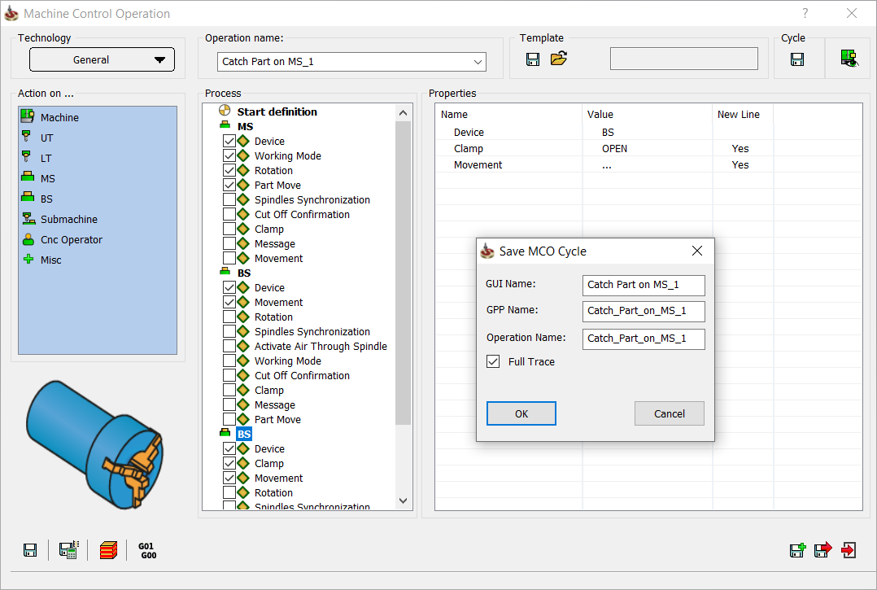
Output trace differences – “Full Trace”
@start_mach_ctrl
@start_obj_act
@working_mode
@spin
@move_object
@start_obj_act
@move_object
@start_obj_act
@open_close_obj
@move_object
@end_mach_ctrl

Slide 4
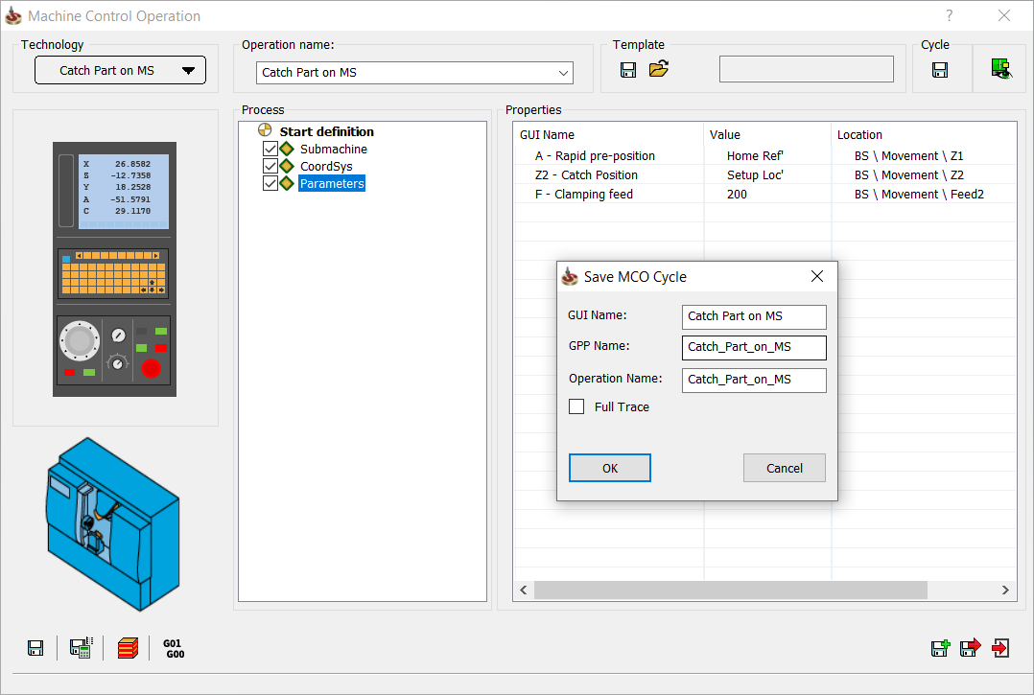
Output trace differences – None “Full Trace”
@start_mach_ctrl
@mco_cycle
@end_mach_ctrl

Slide 5
Pros and cons
None “Full trace”
“Full trace”
Easier definition
Post-Processor revisions
Trace output sensitive
Output cycle flexibility

