Slide 1
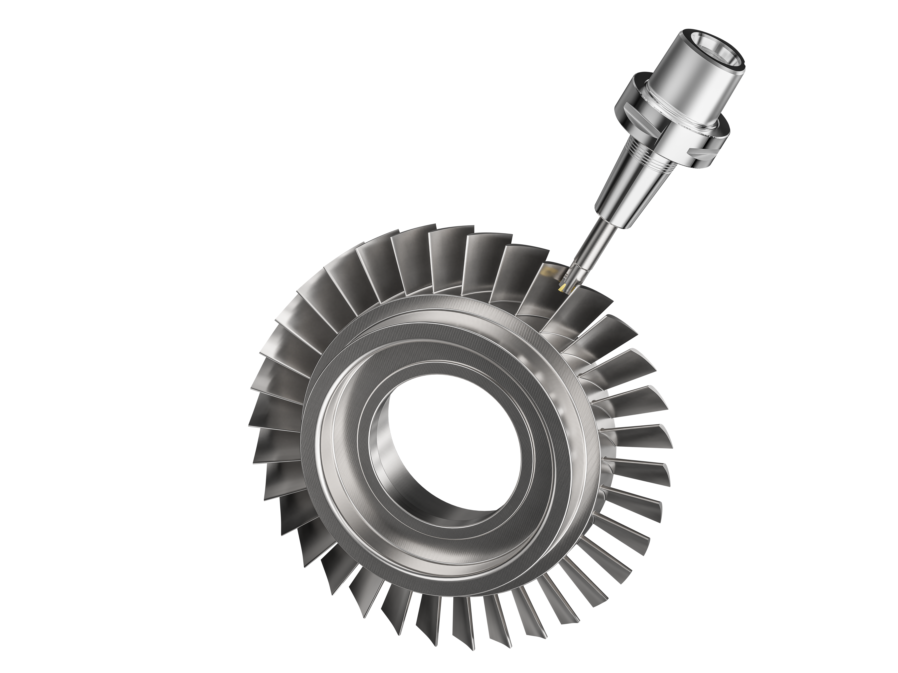
Blisk Machining in SolidCAM

Slide 2
What is a Blisk ?
A Blisk (blade-integrated disk) is a type of advanced turbomachinery component that combines the functions of a rotor disk and its attached blades into a single part.
In Aerospace Industry, Blisks are commonly used in aircraft engines, where they offer several advantages over traditional assemblies, including reduced weight, improved efficiency, and lower maintenance costs.
In Power Generation Industry,Blisks are also used in gas turbine power plants, where they play a crucial role in energy production. They help to convert the kinetic energy of the working fluid into mechanical energy that can be used to drive a generator or other equipment.

Slide 3
Blisk Machining - Challenges
Complex Geometries: Blisks have intricate and often asymmetrical blade designs that require precise machining to achieve the desired shape and surface finish. The complex geometries of blisks make them difficult to machine using traditional machining methods.
High Precision Requirements: The tight tolerances and high precision requirements of blisks demand advanced machining techniques that can maintain accuracy and consistency throughout the machining process. Achieving high precision in blisk machining requires sophisticated CAM software and cutting tools.
Difficult-to-Machine Materials: Blisks are often made from high-strength, high-temperature alloys that are difficult to machine, such as titanium and nickel-based alloys.

Slide 4
SolidCAM Generic 5 Axis Milling
SolidCAM Generic 5 Axis Milling is most tested and proven 5-Axis machining engine in the industry, with a user-friendly interface, collision checking and the most advanced control over all aspects of the tool path.
Each 5-Axis machining strategy provides sophisticated options for approach/link control and tool axis control.
SolidCAM provides Automatic collision avoidance strategies that check each part of both the tool and holder. The software detects potential collisions between the tool and the workpiece, toolholder and automatically adjusts the toolpath to avoid collisions.
SolidCAM Generic 5 Axis Milling includes realistic machine simulation, which allows for visualization of the entire machining process.

Slide 5
Circle End Mills - Advantages
Reduced Cycle Time : Circle End Mills with Large Radius enable to take bigger depth of Cut /Side Step in comparison with a Ball Nose Tool thereby enabling faster machining.
Improved Surface Finish: Circle End Mills are designed with a large radius on the cutting edge, which helps to achieve a smoother surface finish. The larger radius distributes the cutting forces more evenly, reducing the risk of tool marks and chatter.
Greater Stability: Circle End Mills have a larger diameter and shorter flute length compared to traditional end mills, which increases their stability during cutting. This feature helps to reduce deflection and vibrations, resulting in more precise and accurate machining.

Slide 6
SolidCAM Blisk Demo

