Slide 1
Up-to-date
Post-Processors - Part 7
Daniel Đurica
SolidCAM International Support manager

Slide 2
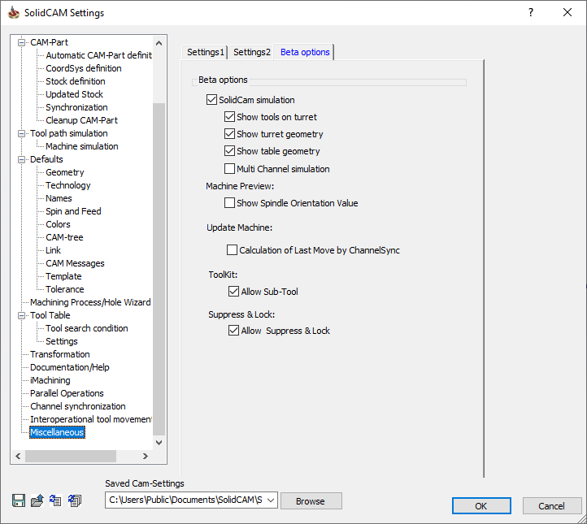
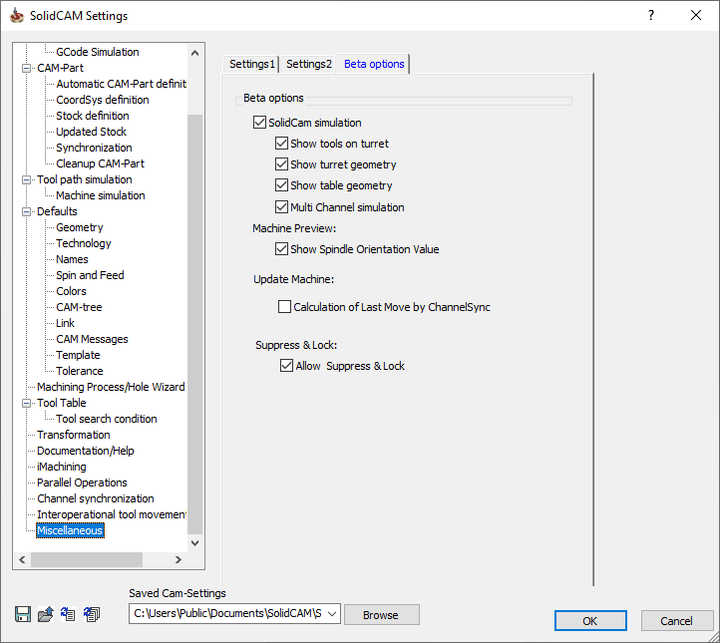
Sub-Tool: Fully integrated in SP5
SC2021 SP4
SC2021 SP5

Slide 3
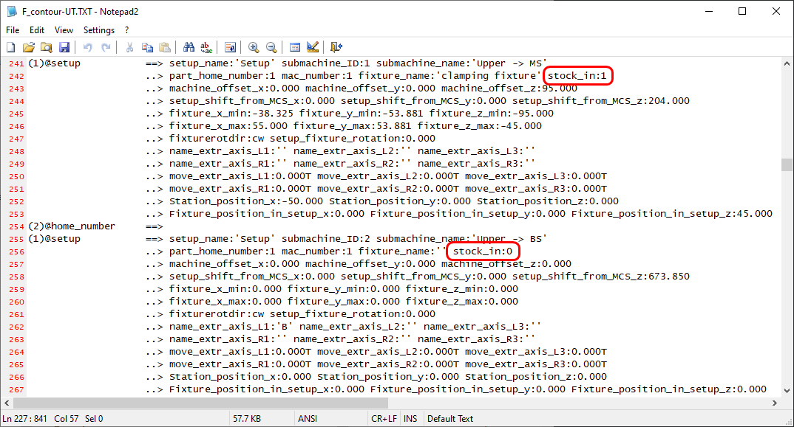
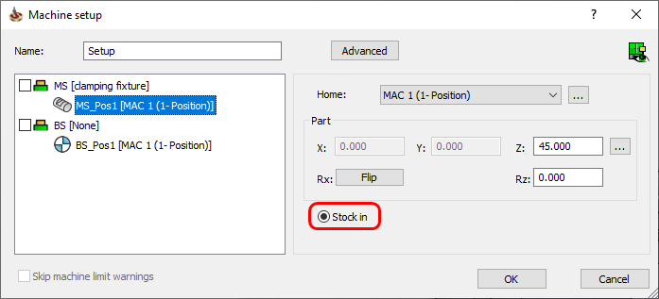
New variable: Added stock_in in @setup

Slide 4
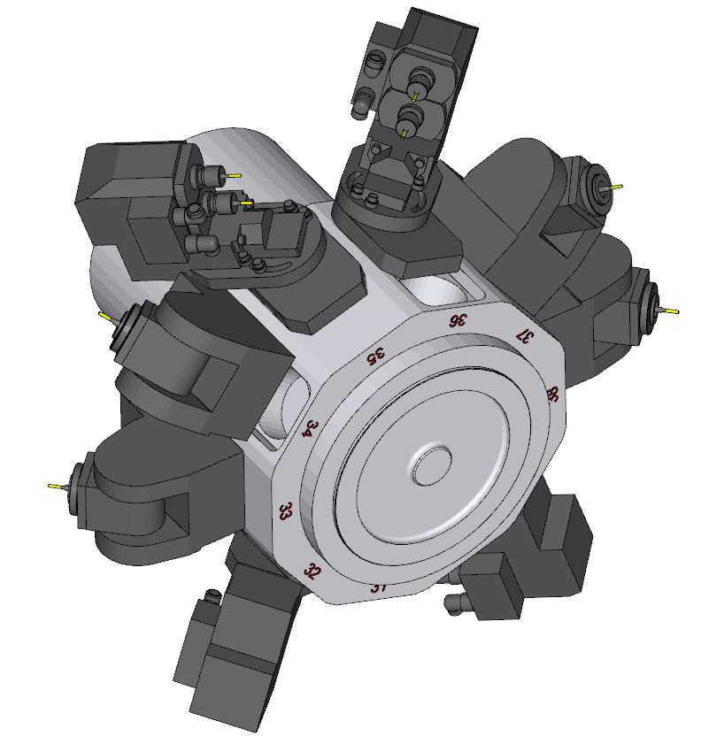
Angular Holders: Guidelines for Post-Processor implementation

Slide 5
Angular Holders: Guidelines for Post-Processor implementation
Does the machine controller have
a tilting cycle?
Fanuc - G68.1
Siemens – TRANS + ROT
Okuma – G127
Changes in GPP and VMID
is required
Changes in GPP
is required

Slide 6
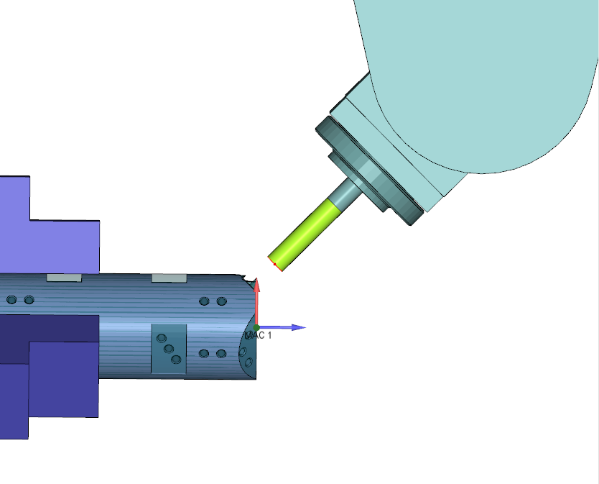
Angular Holders: On machines without tilting cycle
Machining possible on main planes (XY, YZ, ZX)
Arcs
Compensation
Drilling cycles
In non-parallel planes machining
Arcs must be interpolated!
Compensation can’t be used!
Drilling cycles are not possible!

Slide 7
Angular Holders: On machines without tilting cycle
In non-parallel planes machining
Arcs are interpolated automatically by SolidCAM
Compensation output generates “Error” in trace (-9999)
Machine plane generates “no_plane” in trace
Drilling cycles must be set to “No Cycle”

Slide 8
Angular Holders: On machines without tilting cycle
Changes in GPP – Implement rules
if omachine_plane eq no_plane
print 'Error plane!'
abort
endif
if side_o eq -9999
print 'Using compensation is not possible!'
endif
if omachine_plane ne xy or omachine_plane ne yz
print 'Drilling cycle can not be executed!'
endif

Slide 9
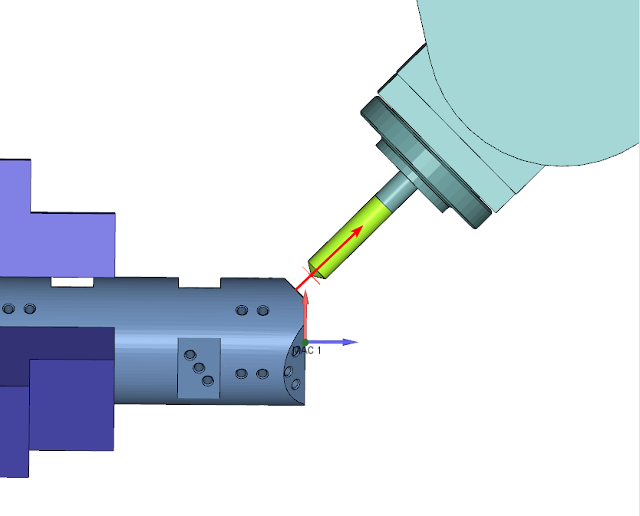
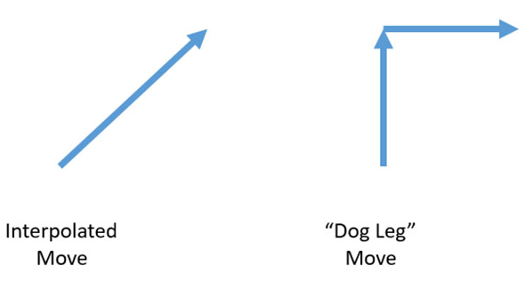
Angular Holders: On machines without tilting cycle
Changes in GPP – Implement rules
!
For “dog leg” machine settings, the rapid movements should be avoided and converted into a cutting feed rate motion!

Slide 10
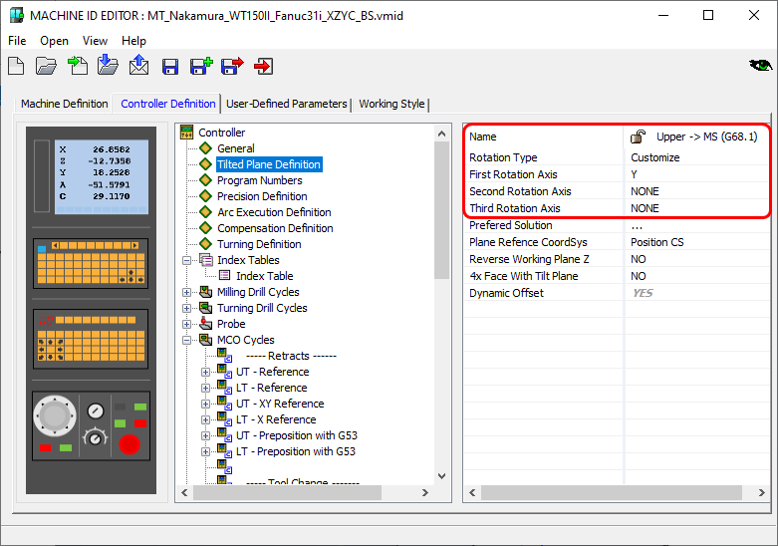
Angular Holders: On machines with tilting cycle
Changes in VMID
Add Submachine with Custom Plane rotation (around X or Y)

Slide 11
Angular Holders: On machines with tilting cycle
Changes in GPP
Implement local coordinate set output to:
@line
@rapid_move
@arc
@machine_plane
@compensation
@drill
@drill_point
Implement plane rotation cycle (G68.1, G127, ROT+TRANS,..etc)

