Slide 1
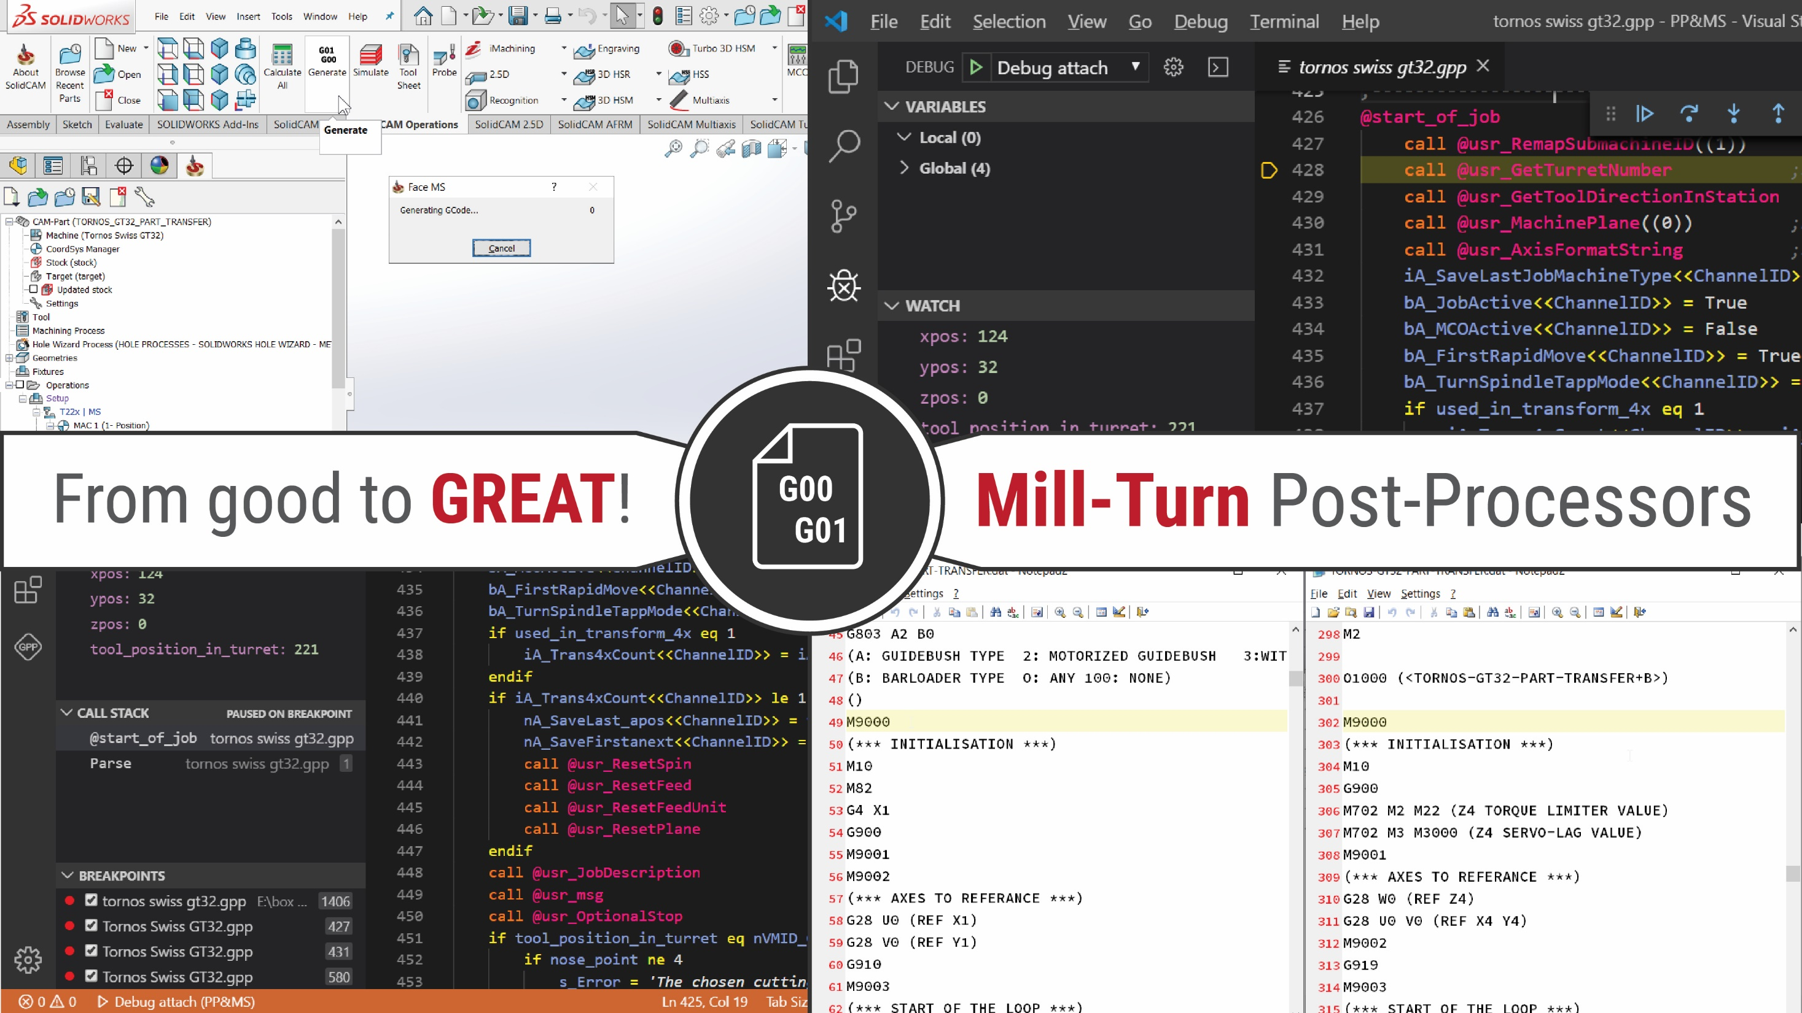
GPP&VMID - Tips and tricks
SolidCAM 2020
Danijel Đurica
SolidCAM International Support Manager

Slide 2
Writing standardization of GPP and VMID
SolidCAM 2020

Slide 3
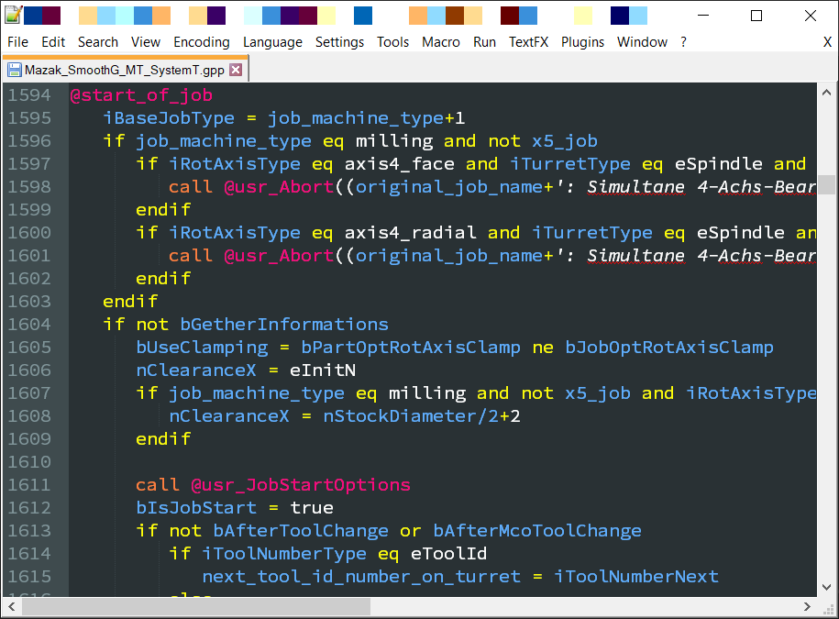
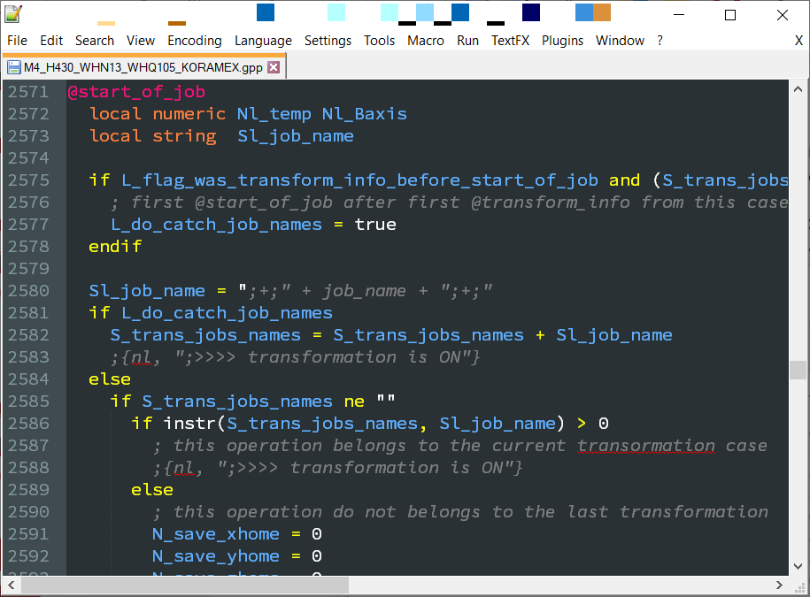
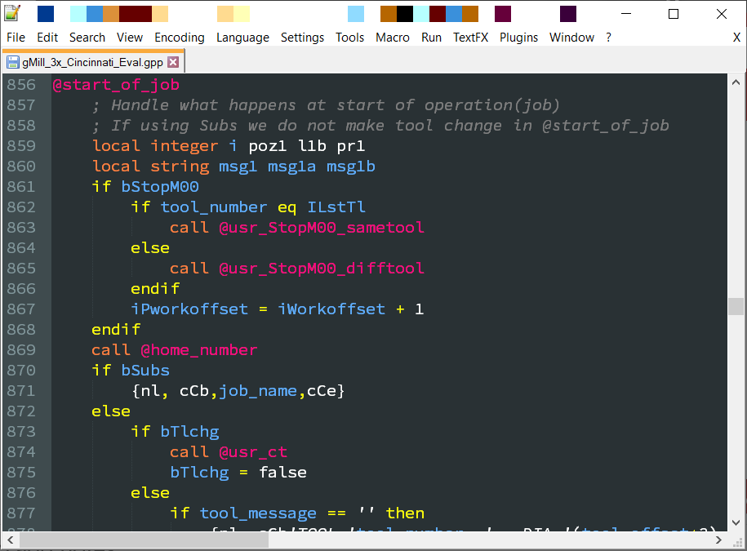
Why we need convention
Convention of GPP writing

Slide 4
Why we need convention
Convention of GPP writing
In SolidCAM GPPL none of the convention was declared so far
Allowing sharing Post-Processors within developers
Easier and effective debugging of other codes
When working in teams, it is very important to keep the coding style consistent and allow others easy debugging of your code and wise-versa.

Slide 5
Add prefix to variable types
Naming the user-defined variables
n – numeric
After prefix, insert the underscore. After underscore, start naming the variable with capital letter.
b – logical
i – integer
s – string
n_Xpos n_XposSave n_FirstAxisAngle | b_FirstRapid b_StartOfJob b_ChangeTool | i_IndexJob i_ChannelID | s_JobName s_DrillCycleName

Slide 6
Add prefix to variable types
Naming the user-defined variables
n – numeric
Note: Definition of the strings for formatting system variables should be defined without prefix.
b – logical
i – integer
s – string
apos_f xlpos_f feed_f | xopos_f xcenter_rel_f bpos_f | spin_f xlnext_f radius_f | first_axis_angle_f second_axis_angle_f third_plane_angle_f

Slide 7
Add additional „L“ to local variable types
Naming the local variables
nL – numeric
Prefix for local user-defined variables have capital "L" letter next to prefix for variable type.
bL – logical
iL – integer
sL – string
nL_Xpos nL_XposSave nL_FirstAxisAngle | bL_FirstRapid bL_StartOfJob bL_ChangeTool | iL_IndexJob iL_ChannelID | sL_JobName sL_DrillCycleName
@usr_RotateToPlane (numeric nL_FirstAxisAngle numeric nL_SecondAxisAngle)

Slide 8
Add additional „A“ to arrays
Naming the user-defined arrays
nA – numeric
nLA – numeric
Prefix for user-defined arrays have capital “A" letter next to prefix for variable type.
bA – logical
bLA – logical
iA – integer
iLA – integer
sA – string
sLA – string
nLA_Xpos<<2>> | nA_XposSave<<2>> | bA_FirstRapid<<2>> | bLA_StartOfJob<<2>>

Slide 9
Add prefix “@usr_” to procedures
Naming user-defined @procedure/routine
Prefix for procedure/routine starts with "@usr_"
@usr_RapidMove
@usr_RotatePlane(numeric nL_FirstAngle, numeric nL_SecondAngle)

Slide 10
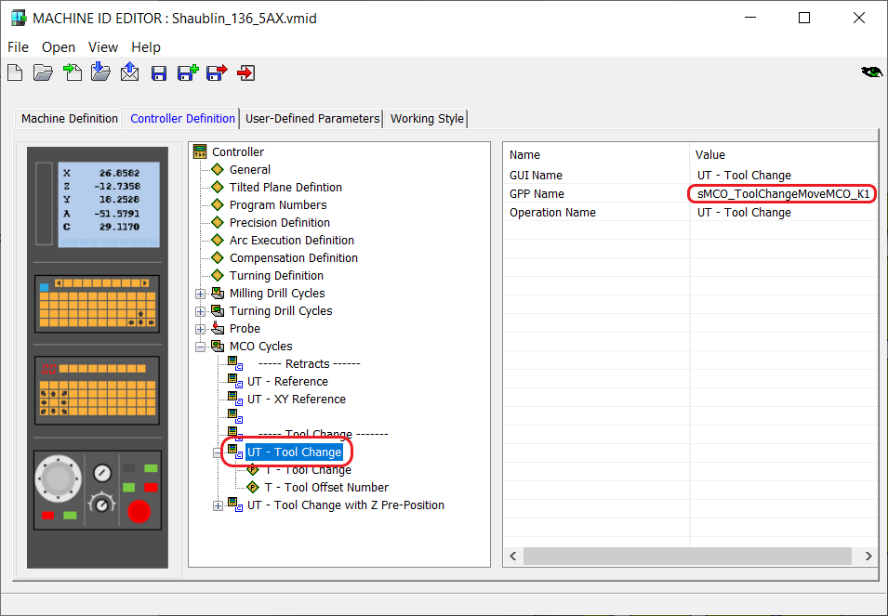
Add prefix “MCO_” to MCO cycles/variables
Naming the MCO cycles/parameters/variables
nMCO – numeric
Prefix for user-defined MCO variables should have capital "MCO" letters next to prefix for variable type followed with the underscore.
bMCO – logical
iMCO – integer
sMCO – string
nMCO_Z1_PrePositioning nMCO_Spin bMCO_Synchronisation bMCO_UsePressure

Slide 11
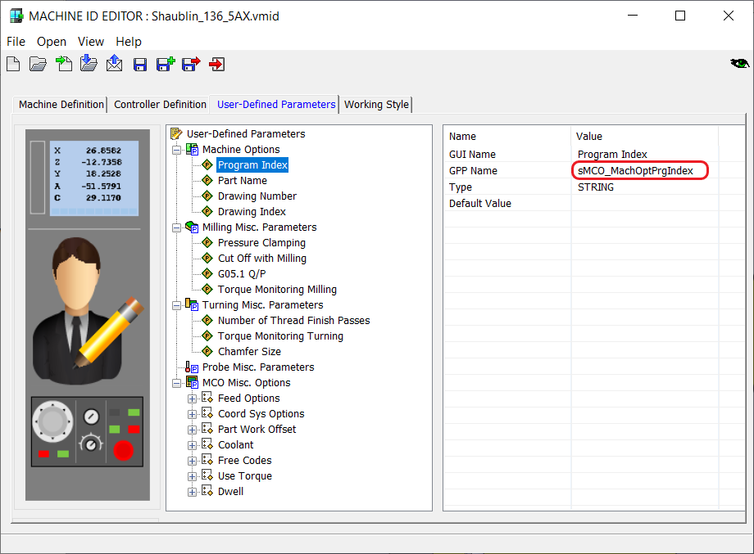
Add prefix “VMID_” to VMID variables
Naming the VMID parameters
nVMID – numeric
bVMID – logical
iVMID – integer
sVMID – string

Slide 12
Add prefix “VMID_” to VMID variables
Naming the VMID parameters
In VMID we can declare the following parameters:
Machine options -------------------- (e.g. sVMID_MO_DrawingNum)
Milling Drill parameters --------- (e.g. nVMID_DM_DwellTime)
Turning Drill parameters ----------- (e.g. nVMID_DT_PeckDepth)
Probe parameters ------------------- (e.g. nVMID_P_ApproachZ)
Misc. Milling parameters ---------- (e.g. nVMID_M_HSCMode)
Misc. Turning parameters --------- (e.g. nVMID_T_ExactStop) (e.g. nVMID_TT_NumOfPasses)
(e.g. iVMID_TG_CustomCycle)

Slide 13
Where new format should be used
General rules
Existing post-processor should be edited using used format
Use new format to new post-processors
Convert templates to new format

Slide 14
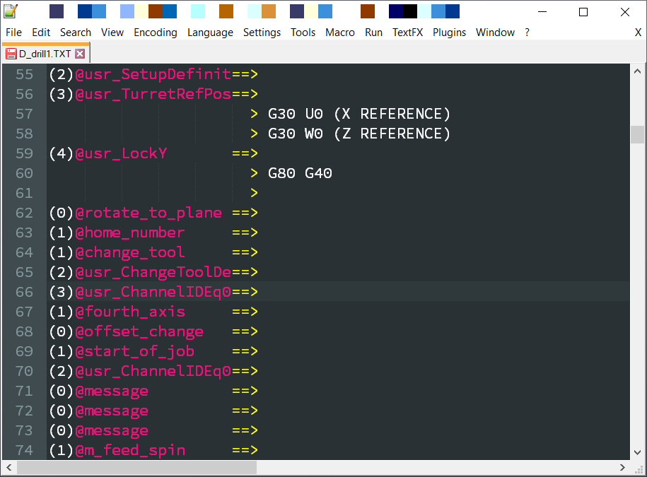
Avoid calling the procedures more than 3 Levels!
General GPP rules
Debugging other codes are more difficult with post-processor whose structure have a call funtions on more than 3 Levels! Calling more than 3 Levels should be avoided if possible.

Slide 15
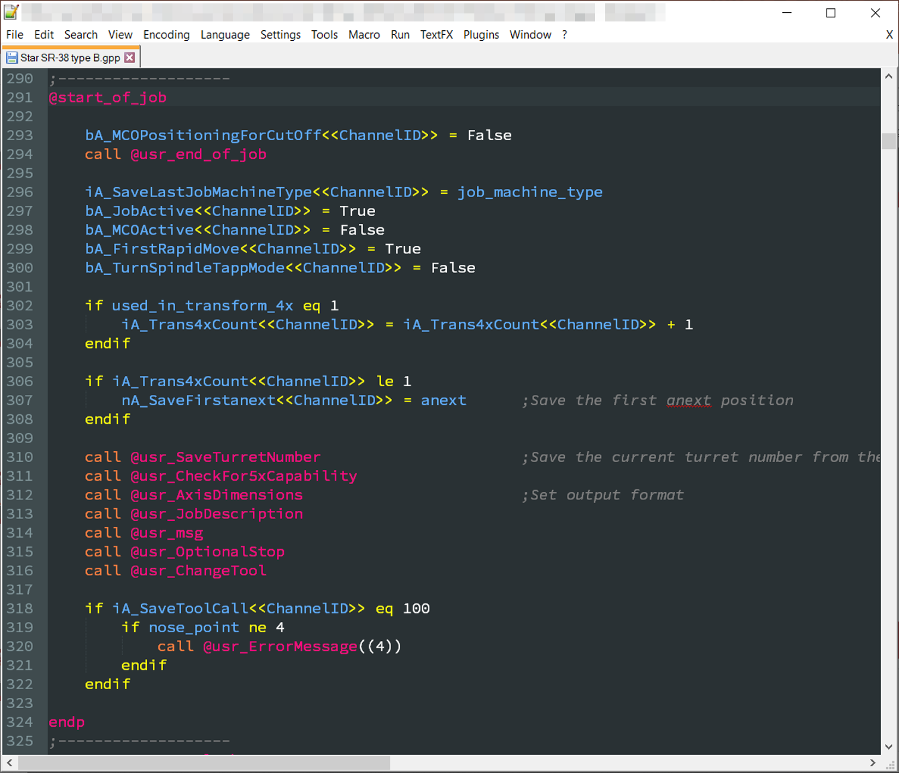
Use Tabs and Spaces
General GPP rules
Use Tabs of indentation of your code
To improve reading of the code use Enter to split the sections of your code:
At beginning of procedure
Before and after main if/while statement

Slide 16
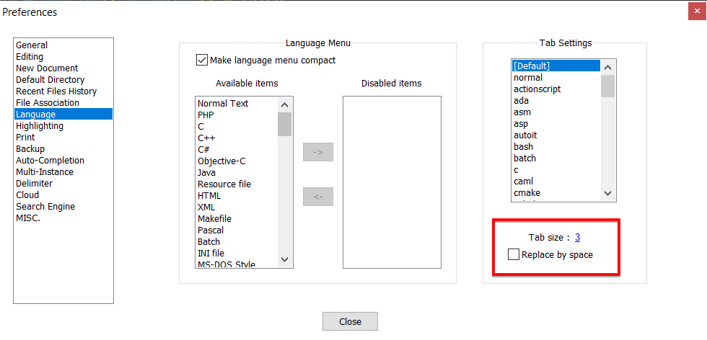
General GPP rules

Slide 17
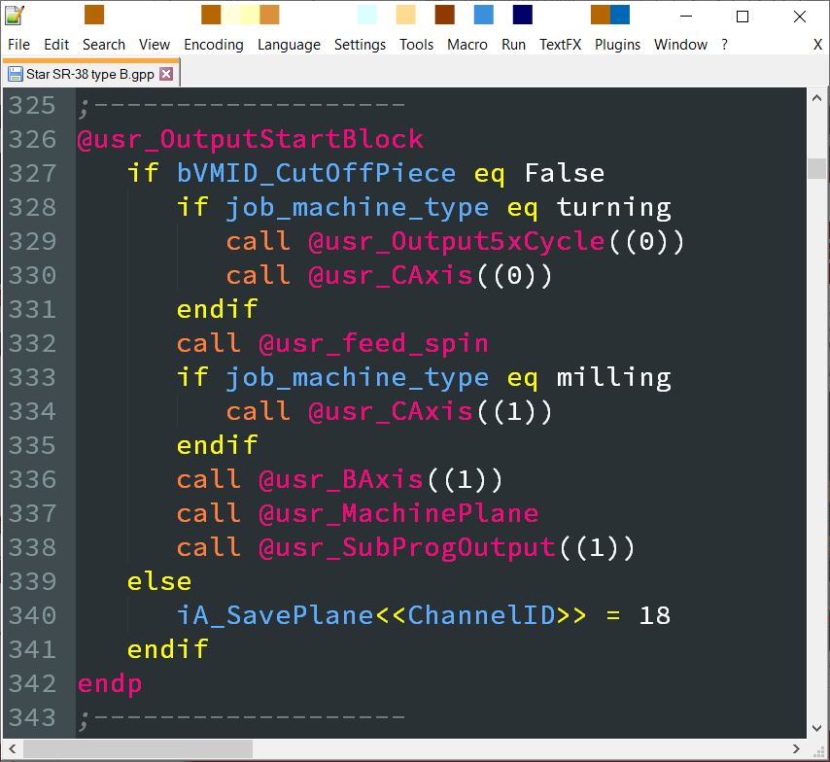
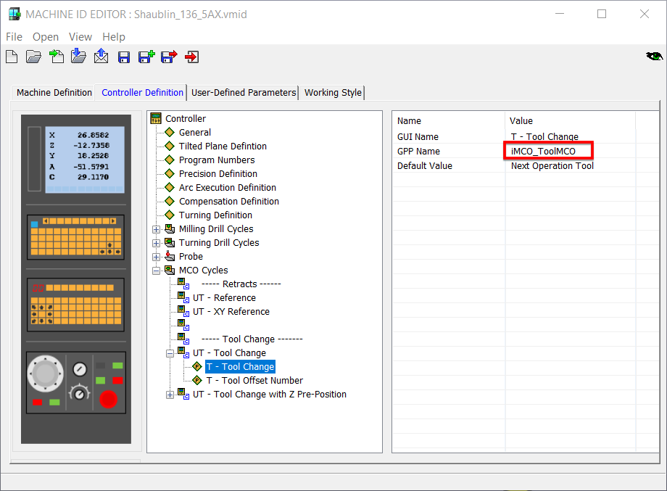
Write GPP on English
General GPP rules
GUI – use local language
GPP – use English language

Slide 18
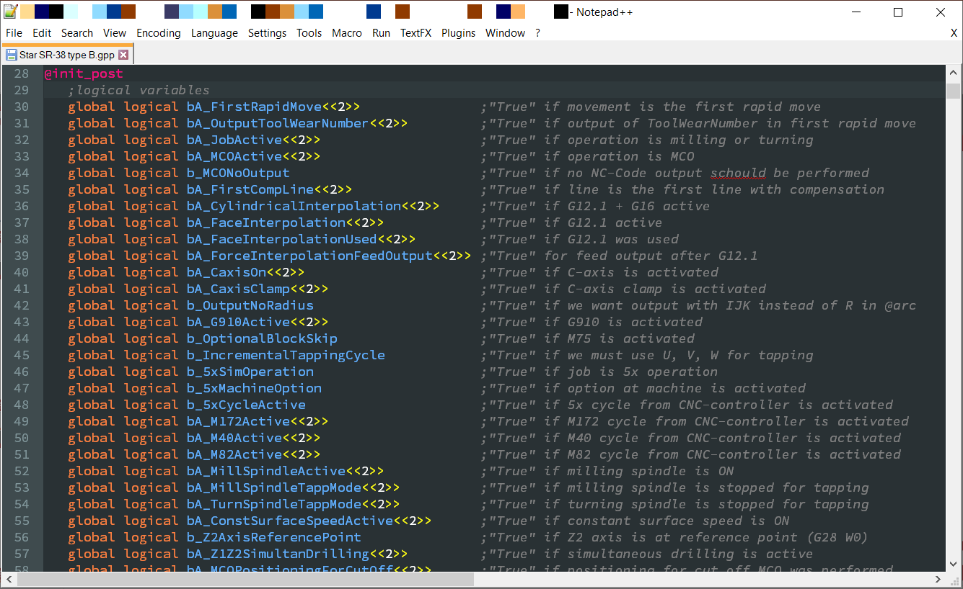
Declare the variables in a row with explanation
General GPP rules

Slide 19
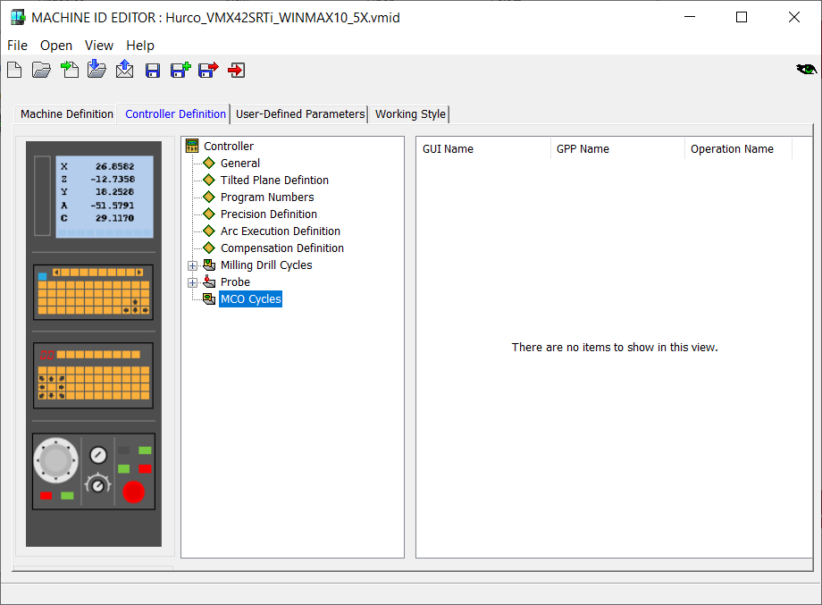
Default for Milling VMID
Default MCO cycles based on machine kinematic

Slide 20
Default Mill-Turn MCO cycles based on its kinematic
MCO cycles
Turret 1 – Retract X(Y) to reference
Turret 1 – Retract X(Y), Z to reference (left/right limit)
Retracts
Turret 1 – Retract XY, Z, B to reference
Turret n – Retract X(Y) to reference
Turret n – Retract X(Y), Z to reference (left/right limit)
Turret n – Retract XY, Z, B to reference
Turret 1 – Tool Change (with XY,Z,B retract)
Tool Change
Turret 1 – Tool Change and Z-preposition (with XY,Z,B retract)
Turret n – Tool Change (with XY,Z,B retract)
Turret n – Tool Change and Z-preposition (with XY,Z,B retract)
Catch Part on MS and Synch On
Catch Part on BS and Synch On
Part Transfer
Pull Part in MS (BS)
Retract Back Spindle with Part
Retract Back Spindle without Part
Part Release

Slide 21
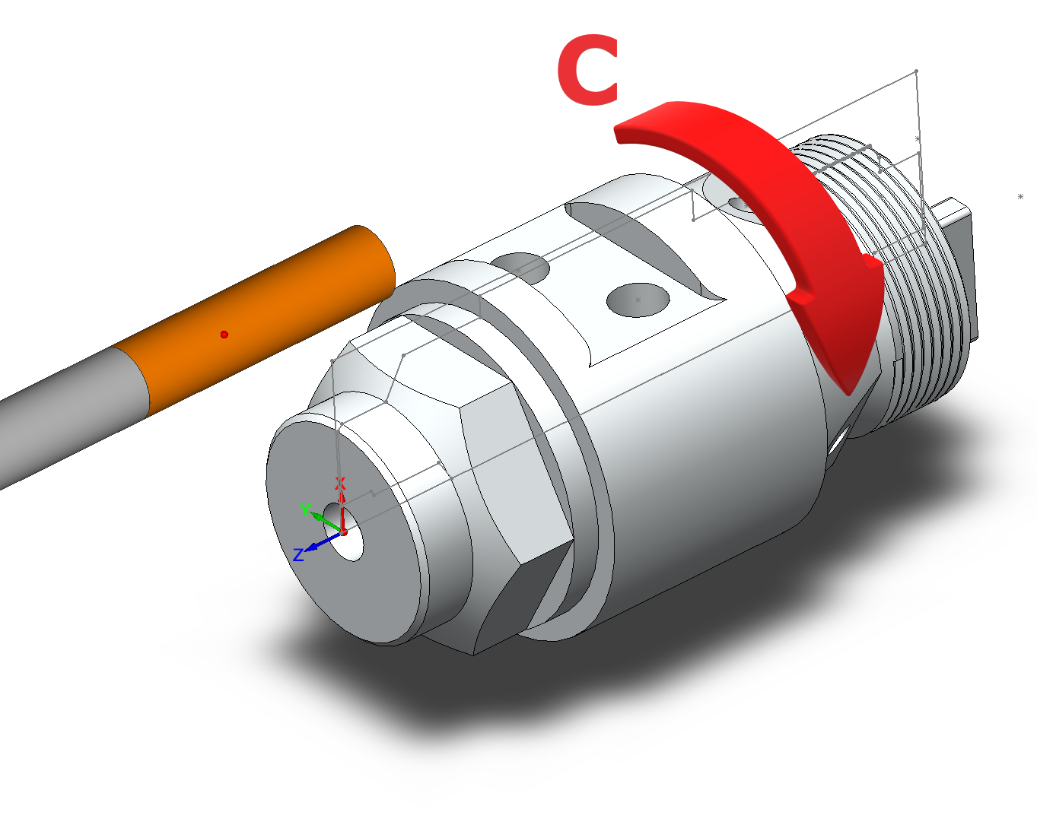
Implementation of C-axis interpolation cycle
SolidCAM 2020

Slide 22
Everything you should know about it
G12.1/G112/TRANSPIT/…
Arc interpolation G02/G03 can be used
Radius Compensation can be used
XZY programming instead of XZC
Shorter Gcode in comparing to XZC
Better surface quality
Operator friendly for manual GCode programming/adjustments
For large parts with limited Y-axis stroke or narrow linear turret stations

Slide 23
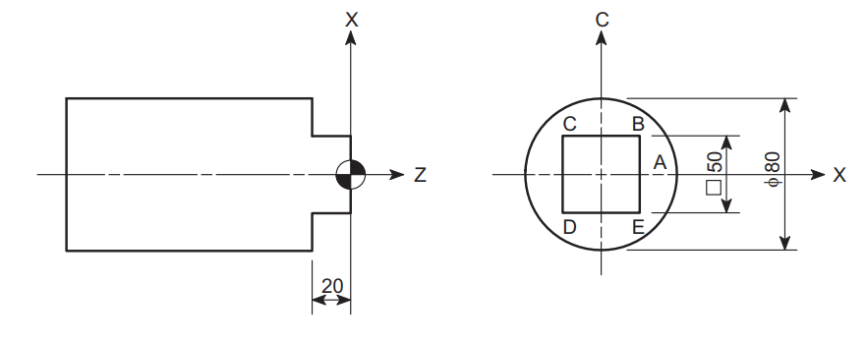
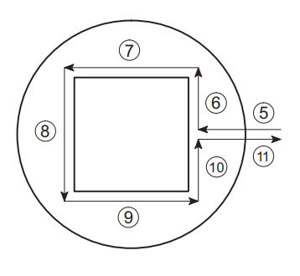
Example of manual programming
O0001; G54; T1010; M45; G28 H0; G97 S100 M13; G00 Z30.0; X80.0 Y0 C0; G98 G01 Z-20.0 F100; G18; G12.1(G112); .......... (4)
G42 X50.0; .............. (5) C25.0; ..................... (6) X-50.0;..................... (7) C-25.0; ................... (8) X50.0; .................... (9) C0; ......................... (10) G40 X100.0; ............ (11) G13.1(G113); …

Slide 24
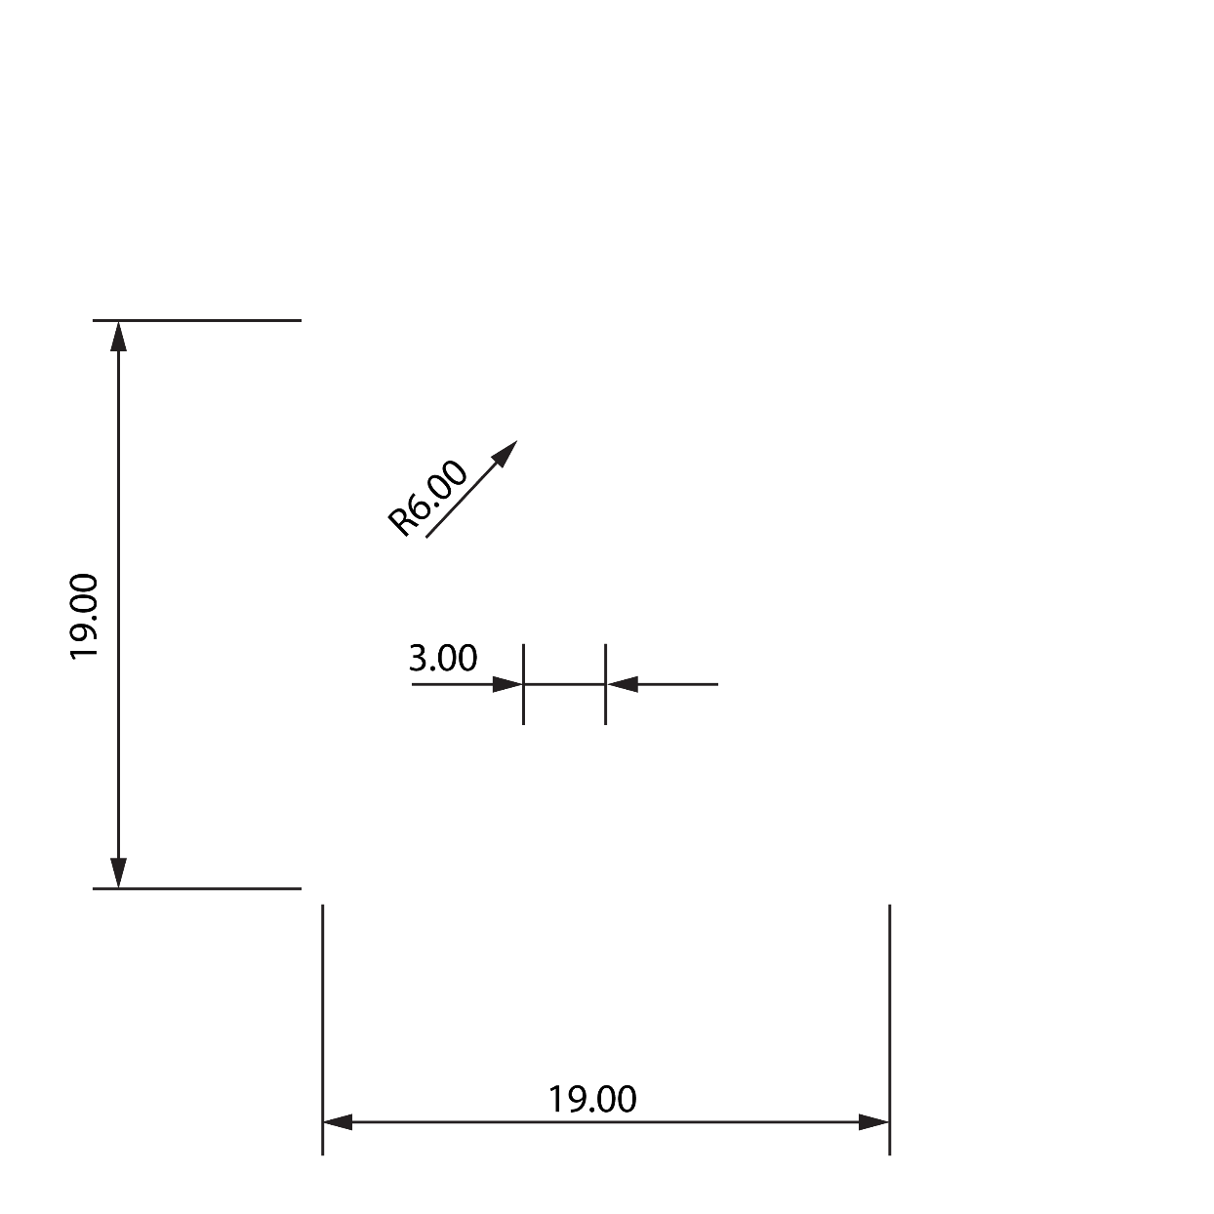
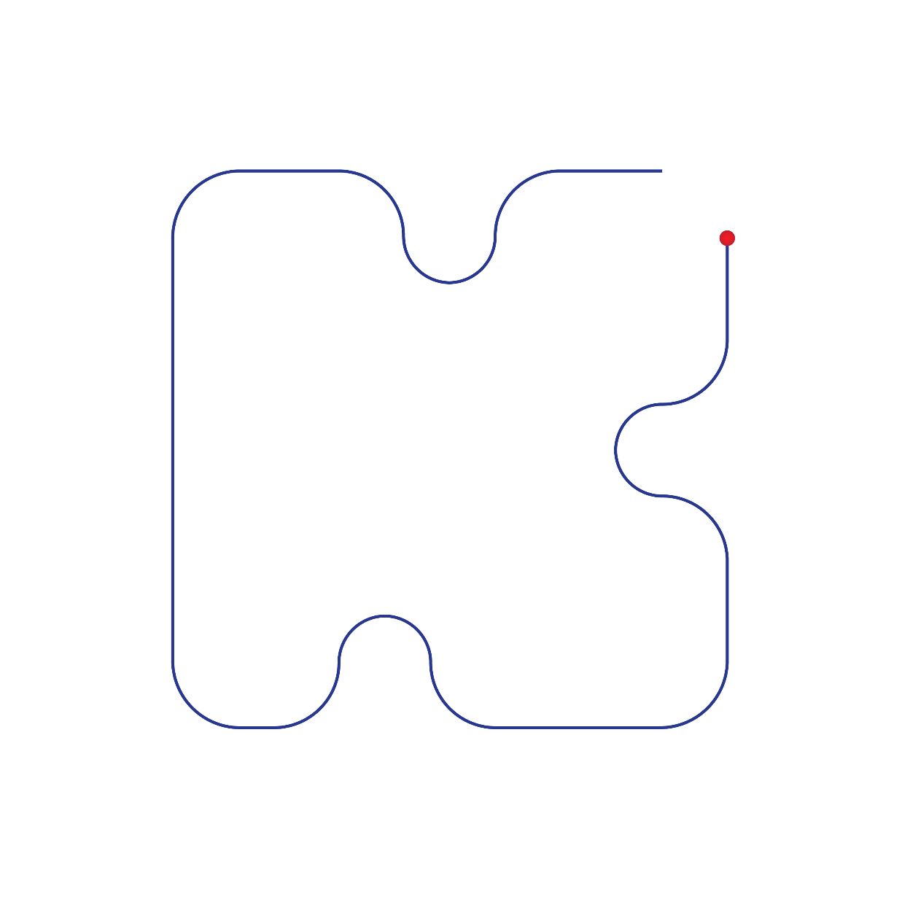
Programming habits
O0001;
…
M45 (C-AXIS ON)
G28 H0 (C-AXIS REFERENCE)
G0 C0
G00 X31.4038 Y0. Z10. (Pre-position with OPOS set)
G01 F5000 (General feed for rapid move)
G05.1 Q1
G12.1 (START POLAR INTERPOLATION)
G01 X19. Z10. C-12.502 (Linear interpolation with HPOS set)
G01 Z2.
G01 Z-5. F300
G41 G01 C-9.5 F800
G01 X10.
G03 X-10. C-9.5 R-5. (Arc interpolation with HPOS set)
G01 X-19.
G01 C-2.
G03 X-15.9886 C7.7679 R5.
G03 X-19. C8. R5.
G01 C9.5
G01 X19.
G01 C5.
G03 X19. C-5. R-5.
G01 C-9.5
G40 G01 X25.004
G01 Z10. F5000
G13.1 (END POLAR INTERPOLATION)
G05.1 Q0
…
Programming drawing

Slide 25
Programming habits
O0001;
…
M45 (C-AXIS ON)
G28 H0 (C-AXIS REFERENCE)
G0 C0
G00 X31.4038 Y0. Z10. (@start_of_job)
G01 F5000
G05.1 Q1
G12.1 (START POLAR INTERPOLATION)
G01 X19. Z10. C-12.502 (@move_5x)
G01 Z2.
G01 Z-5. F300
G41 G01 C-9.5 F800 (@line_5x)
G01 X10.
G03 X-10. C-9.5 R-5. (@arc_5x)
G01 X-19.
G01 C-2.
G03 X-15.9886 C7.7679 R5.
G03 X-19. C8. R5.
G01 C9.5
G01 X19.
G01 C5.
G03 X19. C-5. R-5.
G01 C-9.5
G40 G01 X25.004
G01 Z10. F5000
G13.1 (END POLAR INTERPOLATION) (@end_of_job)
G05.1 Q0
…
Programming results on the machine
Prepositioning take unnecessary movements
Rapids are overwritten with G1 F5000
Successively jobs will reset C-axis to 0. each time
4th Axis Transform will reset C-axis to 0. after each transform

Slide 26
Programming habits
O0001;
…
M45 (C-AXIS ON)
G28 H0 (C-AXIS REFERENCE)
G00 X31.4038 Y0. Z10. C-52.7696
G00 Z2.
G54
G05.1 Q1
G12.1 (START POLAR INTERPOLATION) (@move_5x)
G01 X31.4038 Z-5. C0. F300 (@line_5x)
G41 G01 X26.6234 C1.8163 F800
G01 X21.1782 C-1.7667
G03 X9.0778 C-9.7288 R-5.
G01 X3.6326 C-13.3117
G01 X-8.3106 C-8.774
G03 X-22.0432 C-1.6654 R5.
G03 X-24.2348 C-2.7238 R5.
G01 X-26.6234 C-1.8163
G01 X-3.6326 C13.3117
G01 X3.5333 C10.5891
G03 X19.4575 C4.5389 R-5.
G01 X26.6234 C1.8163
G40 G01 X30.2559 C4.2065
G13.1 (END POLAR INTERPOLATION) (@move_5x)
G00 Z10.
G05.1 Q0
…
Programming drawing and the results on the machine

Slide 27
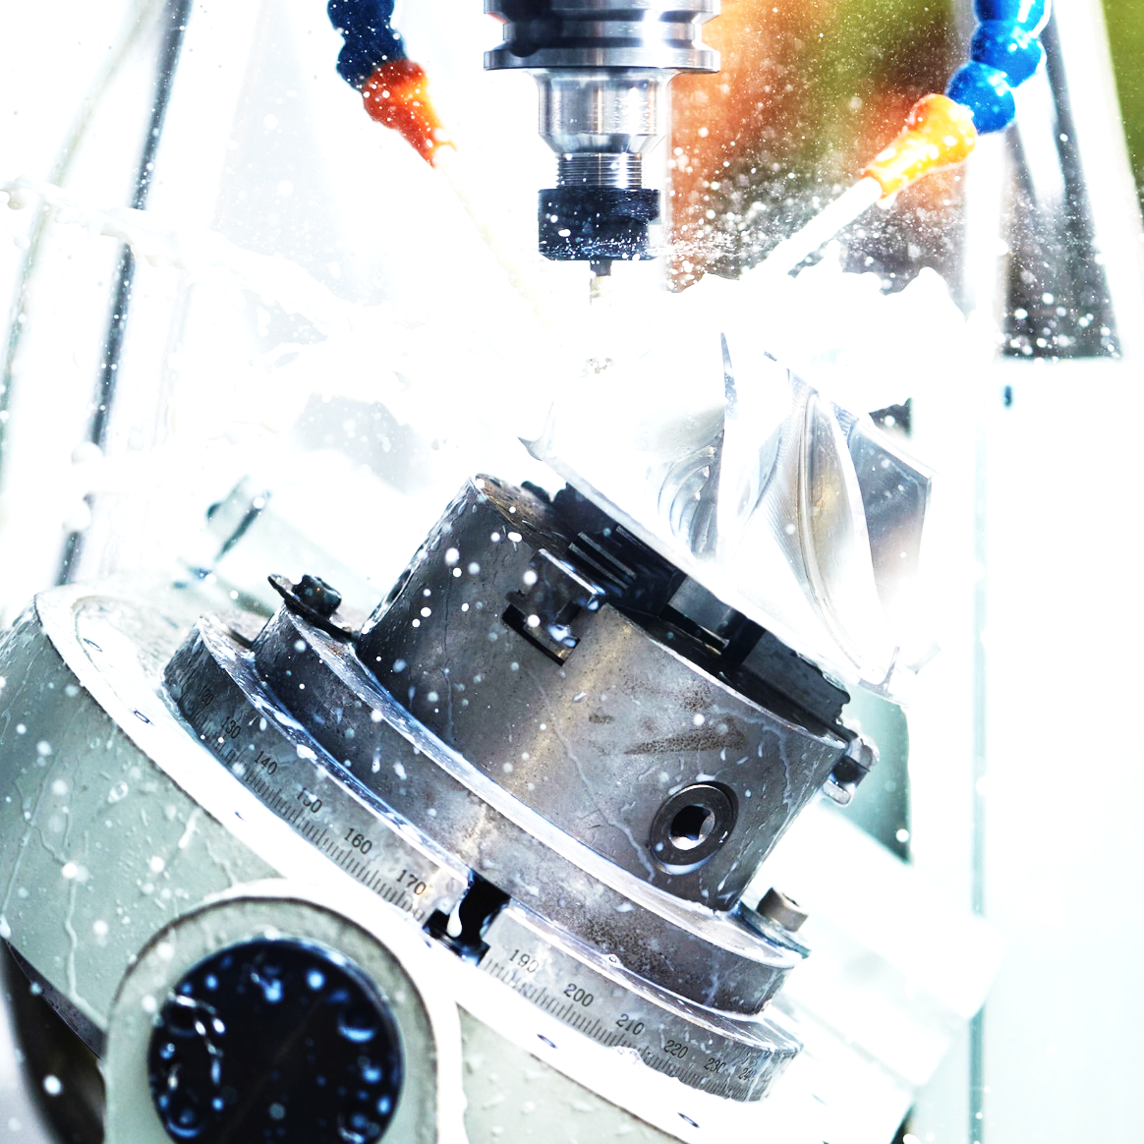
Implementation of coolant options
SolidCAM 2020

Slide 28
Coolant code
@usr_coolingOnOFF(integer iL_OnOFF)
;iL_OnOff: 0=Explicit OFF | 1=Definition from CAM-Part
local integer iL_CoolantCorrFactor iL_MaxNoOfCooolantMCodes iL_MCodeCounter
iL_MaxNoOfCooolantMCodes = 4 ;MAX Number of M-Codes for Coolant in one Sentance
if (iL_OnOff eq 1 and flood_coolant eq 1 and !bA_CoolantActive<<i_TurretID,1>>) or (iL_OnOff eq 0 and bA_CoolantActive<<i_TurretID,1>>)
iL_MCodeCounter = iL_MCodeCounter + 1
if iL_MCodeCounter > iL_MaxNoOfCooolantMCodes or iL_OnOff eq 0
{nb,''}
endif
if flood_coolant > 0
iL_CoolantCorrFactor = -1
endif
{(9 - iL_OnOff+iL_CoolantCorrFactor):mcode_f} ;High Pressure=M07/M09 | Low Pressure M08/M09
bA_CoolantActive<<i_TurretID,1>>=iL_OnOff
endif
endp

