Slide 1
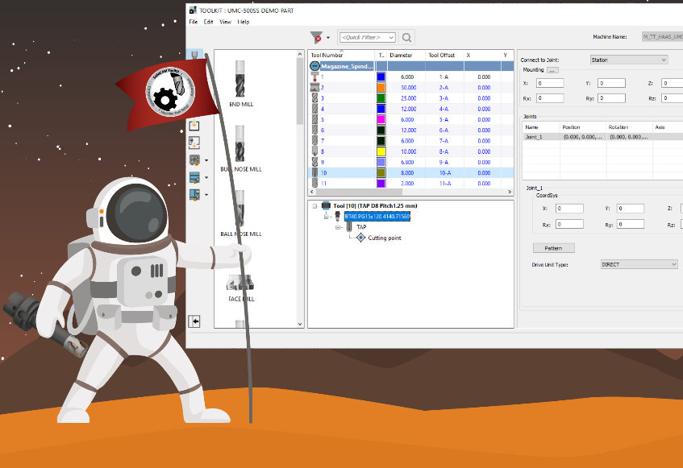
Importing ANY Tool Component in ToolKit
Daniel Đurica
SolidCAM International Support manager

Slide 2
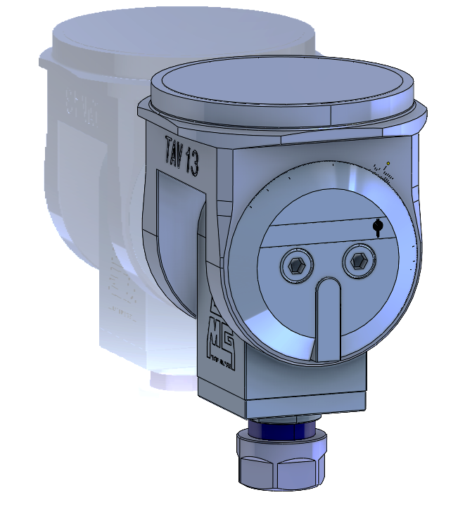
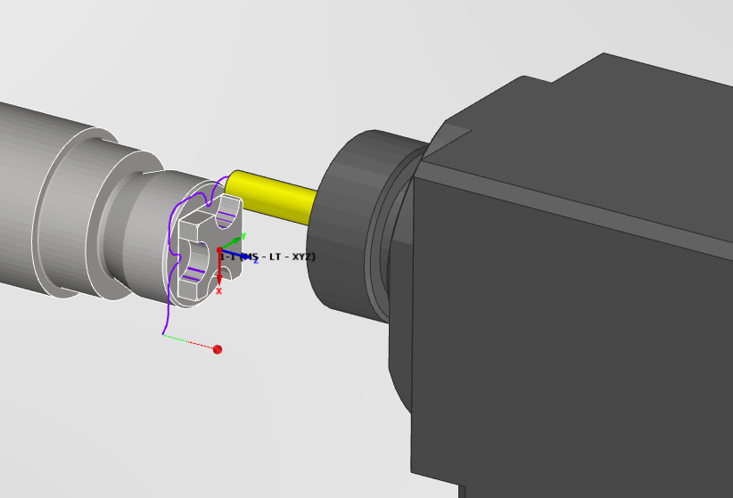
Benefits of importing tool components?
Ability to use tools directly imported from tool manufacturers database
Managing different tool component for the same tool item in ToolKit
Easy Definition of Complex shaped cutters
Simulation - Precise collision detection and rest material calculation

Slide 3
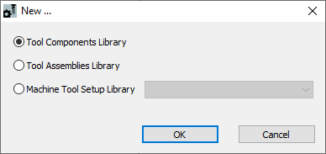
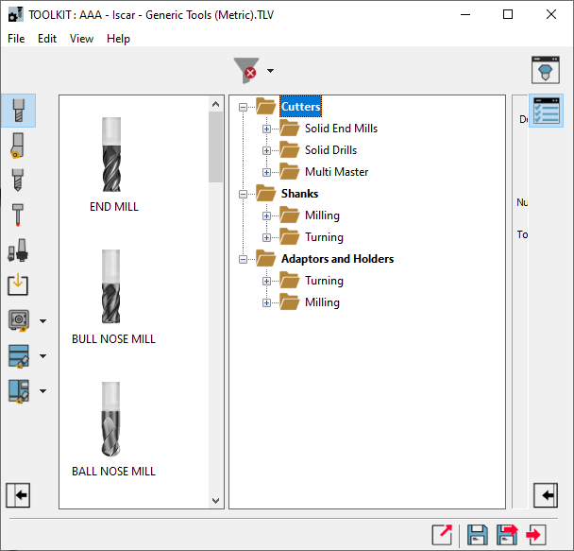
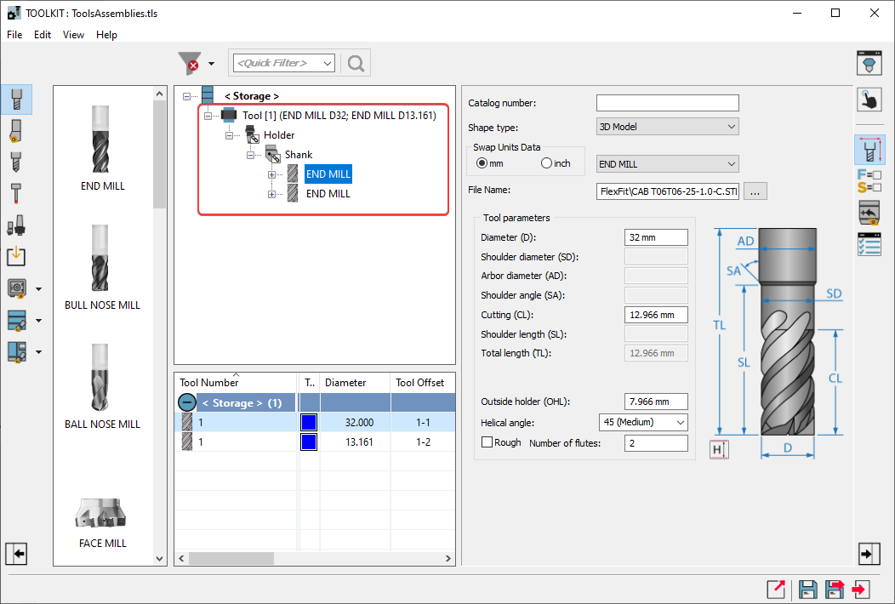
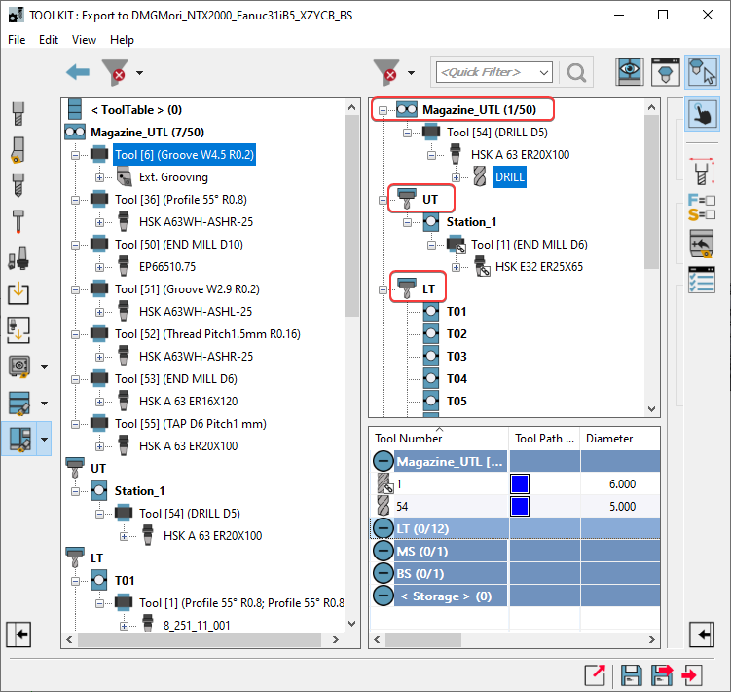
How about ToolKit libraries ?

Slide 4
How about ToolKit libraries ?

Slide 5
How about ToolKit libraries ?

Slide 6
How about ToolKit libraries ?

Slide 7
How about ToolKit libraries ?
Tool components lib. (.tls)
Tool Assemblies lib. (.tla)
Machine Tool Setup lib. (.tlm)

Slide 8
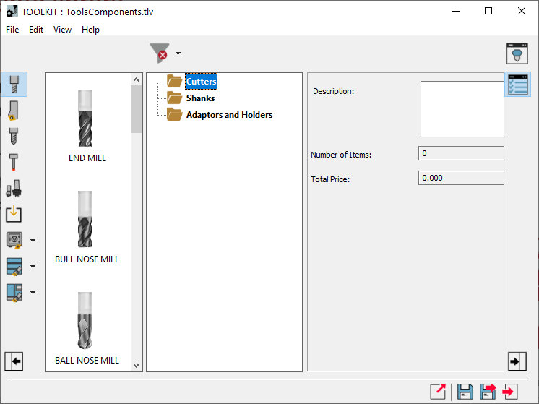
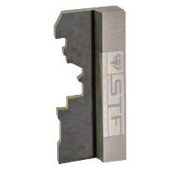
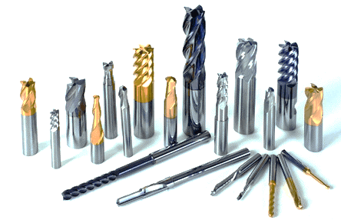
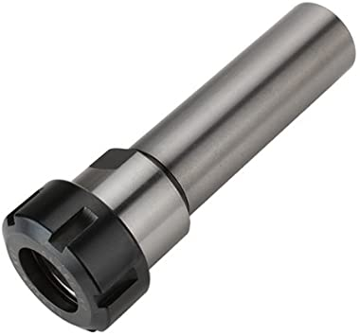
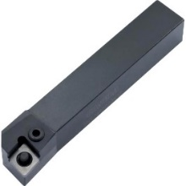
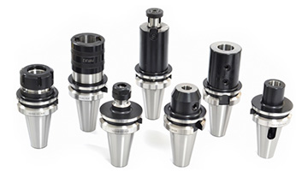
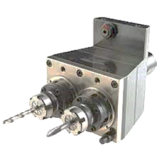
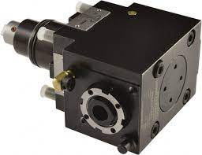
Tool components library

Slide 9
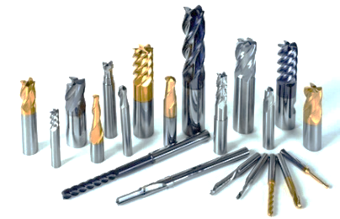
Tool components library

Slide 10
Tool components library

Slide 11
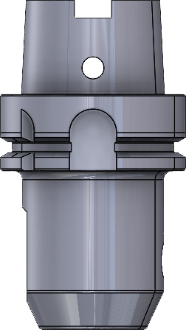
Tool components library
Mounting point – connection to higher component
Spindle
Z – goes up!
Station
Joint point - connection to lower component

Slide 12
Tool assemblies library

Slide 13
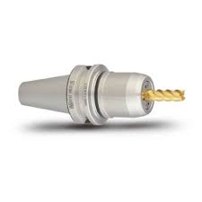
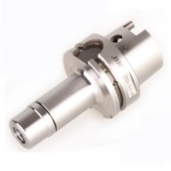
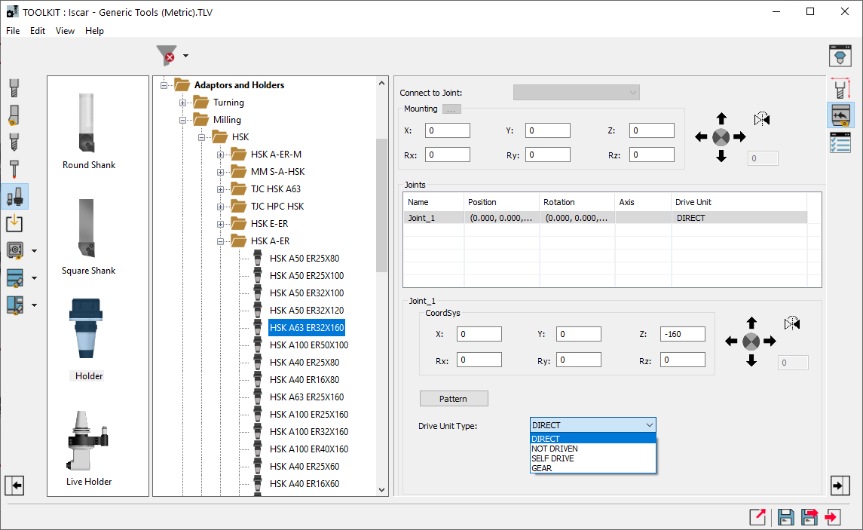
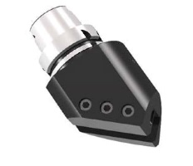
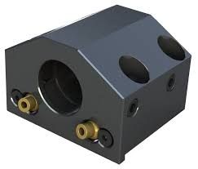
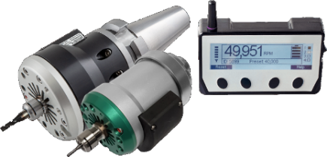
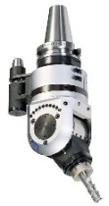
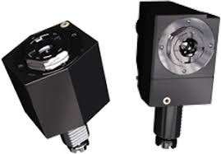
Drive Unit Type

