Slide 1
Up-to-date Post-Processors - What’s new in SC2021 SP4 -
Daniel Đurica
SolidCAM International Support manager

Slide 2
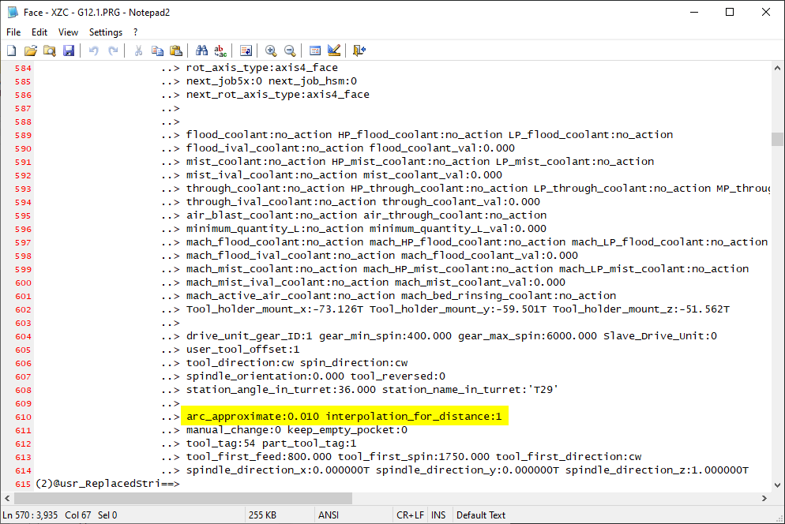
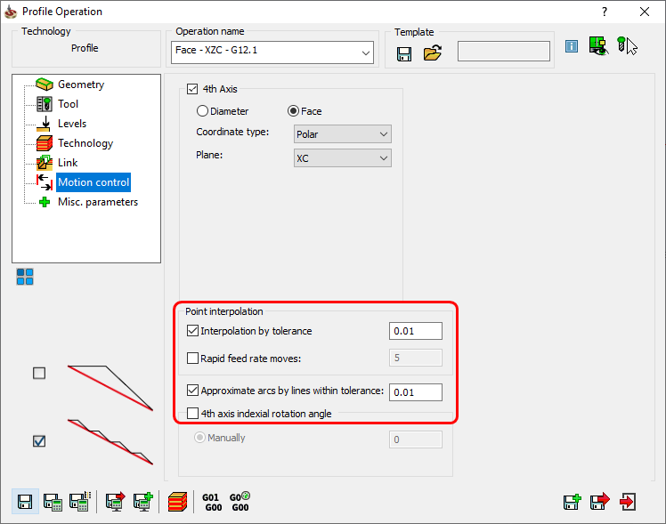
Mill-Turn: Complete output control over interpolated 4th axis
arc_approximate and interpolation_for_distance in @start_of_job

Slide 3
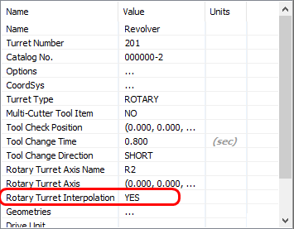
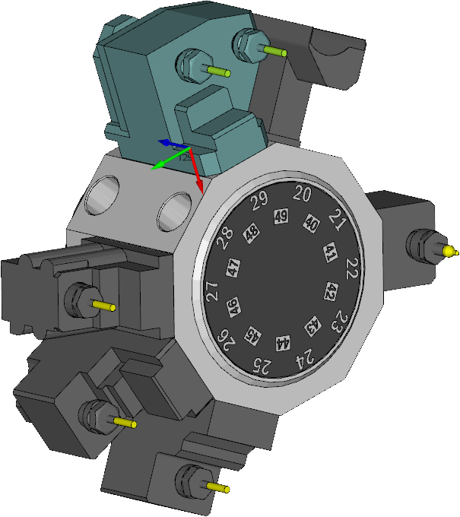
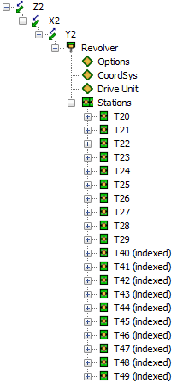
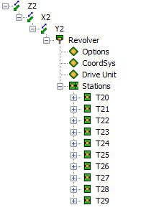
VMID: Support of Indexed Tool Stations
SC<=2020
SC2021
Real number of physical stations
Smaller .xml mach sim data
Easier Tool management

Slide 4
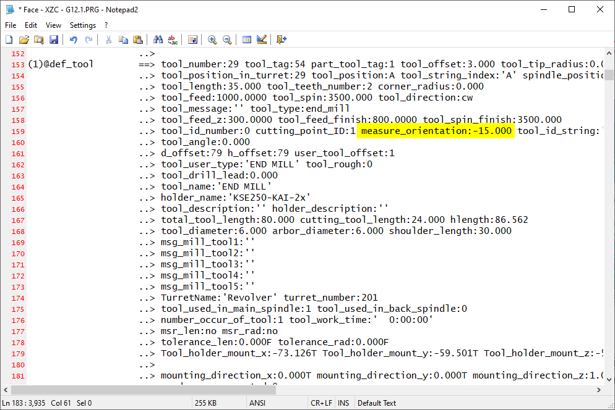
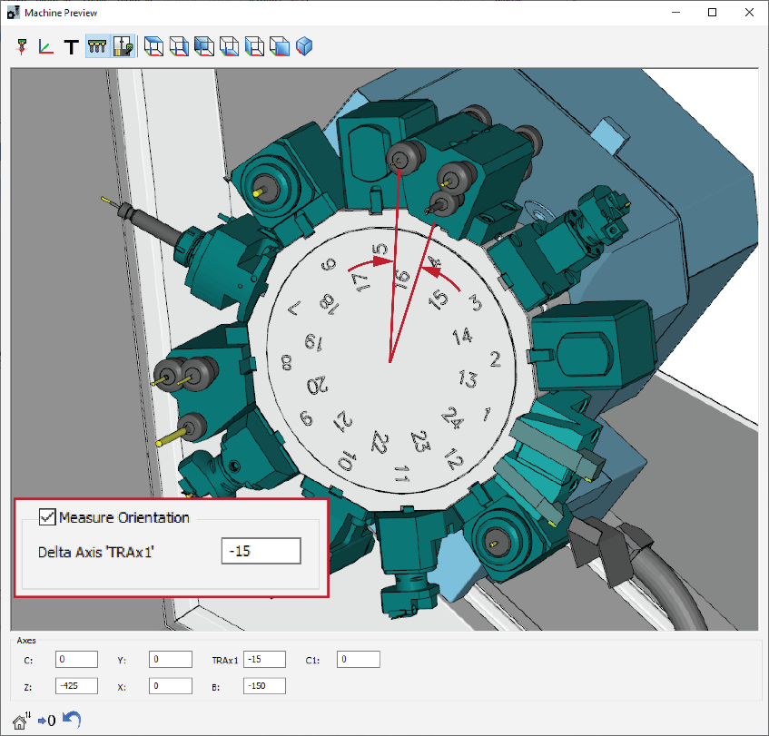
Mill-Turn/Swiss-Type: Support of Indexed Tool Stations
“measure_orientation” in @def_turn, @def_turn_tool, @change_tool, @change_turn_tool, @start_of_job

Slide 5
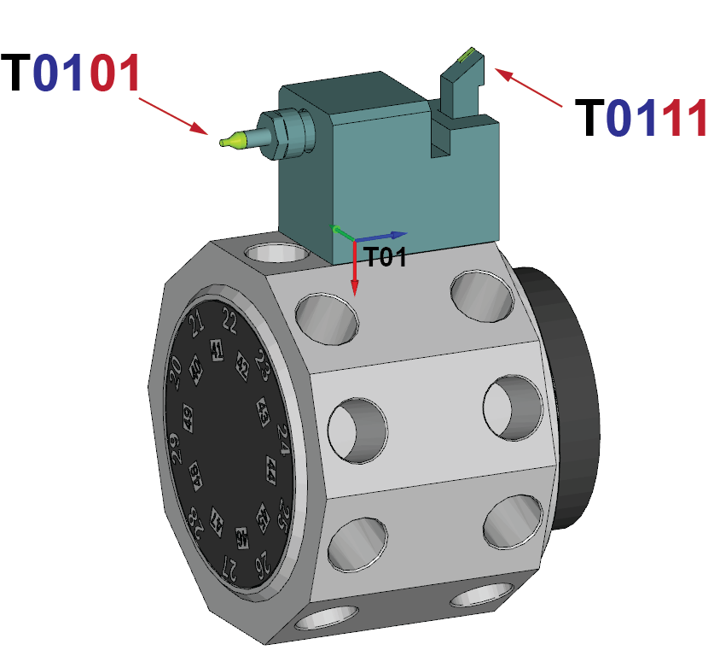
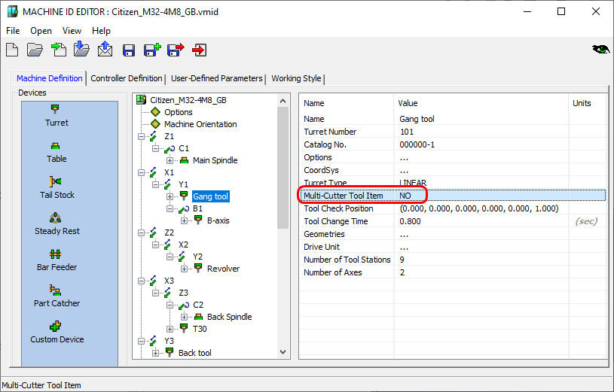
ToolKit: Sub-Tool support (Multi-Cutter Tool Item)
Allows using different Tool Number per cutter within one tool assembly
Allows using different Tool ID per cutter
Resets Tool offset index per cutter
Property of each Turret. Default: No

Slide 6
Multi-Cutter Tool Item = NO
01 – Station Number
01 – Offset Number
01 – Station Number
11 – Offset Number
OR

Slide 7
Multi-Cutter Tool Item = NO
01 – Station Number (tool_position_in_turret)
11 – Offset Number
(tool_position*)
(d_offset – T)
(tool_offset_number – M)
OR
OR
*Offset Number = tool_position_in_turret + (tool_position * 10 – 10)

Slide 8
Multi-Cutter Tool Item = NO
01 – Station Number (tool_position_in_turret)
11 – Offset Number
(tool_position*)
(d_offset – T)
(tool_offset_number – M)
OR
OR
*Offset Number = tool_position_in_turret + (tool_position * 10 – 10)

Slide 9
Multi-Cutter Tool Item = NO
01 – Station Number (tool_position_in_turret)
11 – Offset Number
(tool_position*)
(d_offset – T)
(tool_offset_number – M)
OR
OR
*Offset Number = tool_position_in_turret + (tool_position * 10 – 10)

Slide 10
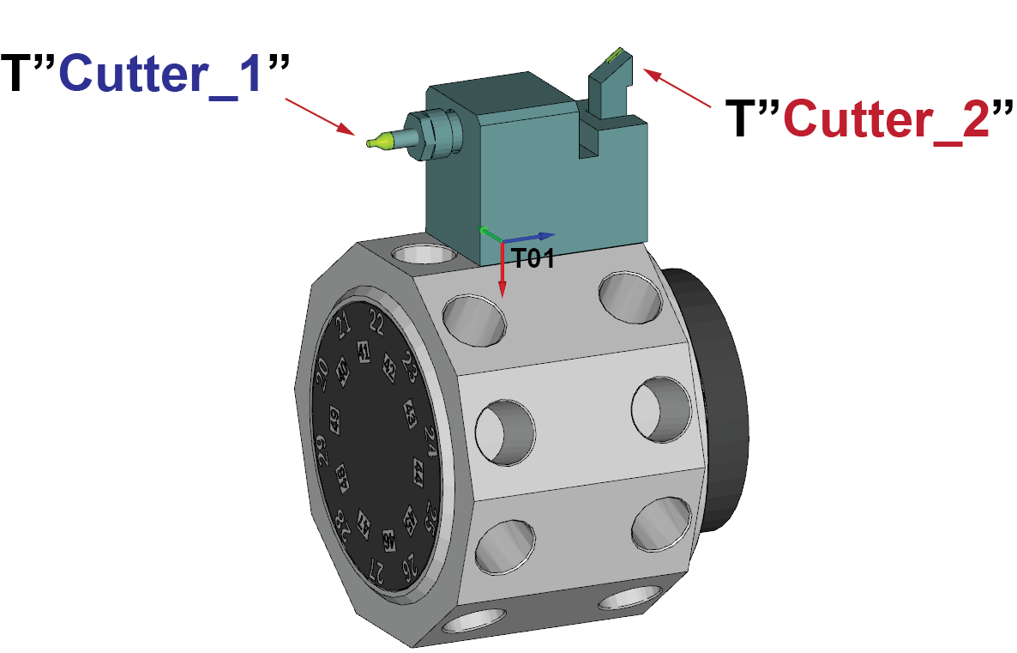
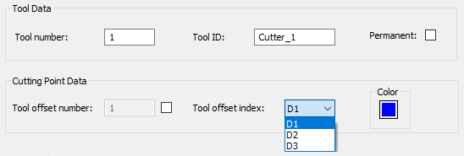
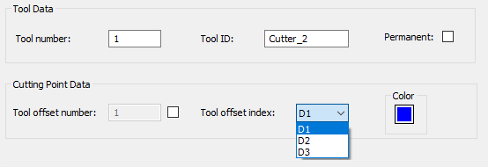
Multi-Cutter Tool Item = YES (Revolver)
Allows different Tool Number
Allows different Tool ID
Resets Tool offset index per cutter

Slide 11
Multi-Cutter Tool Item = YES (Revolver)
Cutter_1/2 – Tool ID (tool_id_string)
D – Offset Number
(tool_position)
(d_offset – T)
(tool_offset_number – M)

Slide 12
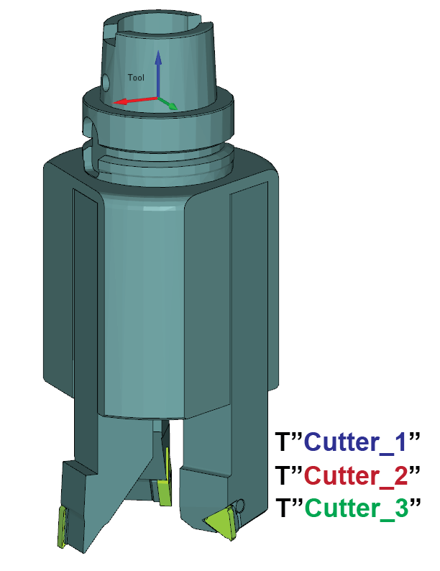
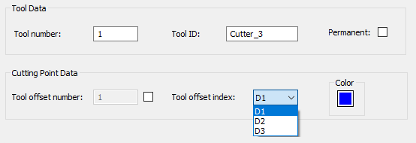
Multi-Cutter Tool Item = YES (Spindle)
Cutter_1/2 – Tool ID (tool_id_string)
D – Offset Number
(tool_position)
(d_offset – T)
(tool_offset_number – M)

Slide 13
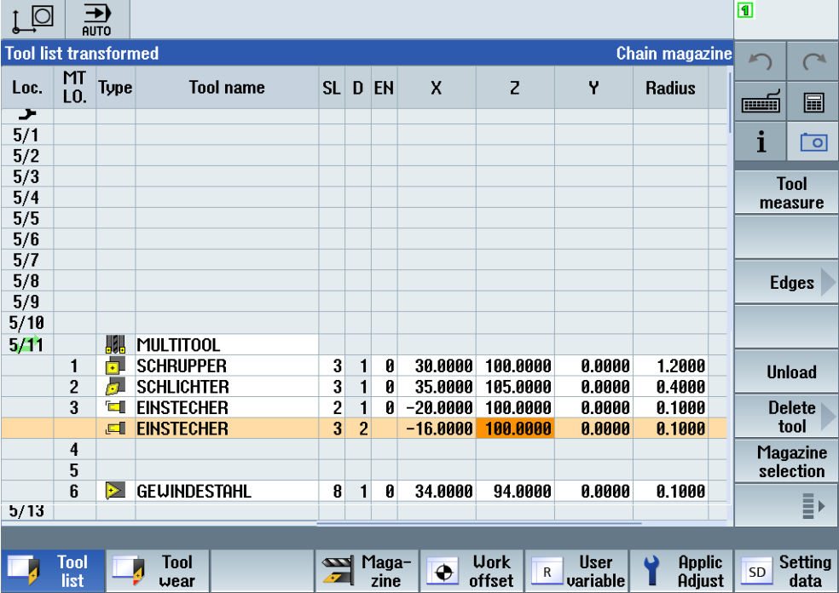
Multi-Cutter Tool Item = YES (Spindle)
Tool Number – 11
Tool ID – EINSTECHER D-Offset – D1/D2

Slide 14
Multi-Cutter Tool Item = YES (Spindle)
Tool Number – 11
Tool ID – EINSTECHER D-Offset – D1/D2

Slide 15
Multi-Cutter Tool Item = YES (Spindle)
Tool Number – 11
Tool ID – EINSTECHER D-Offset – D1/D2

Slide 16
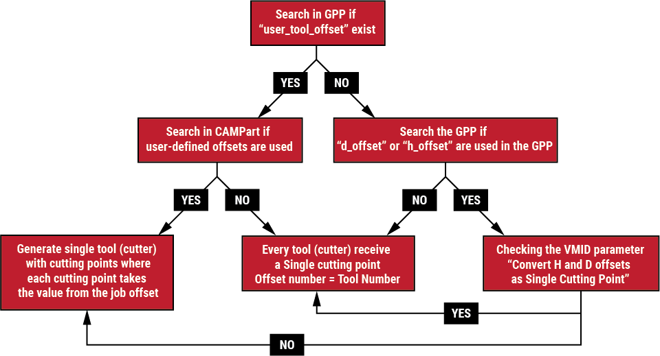
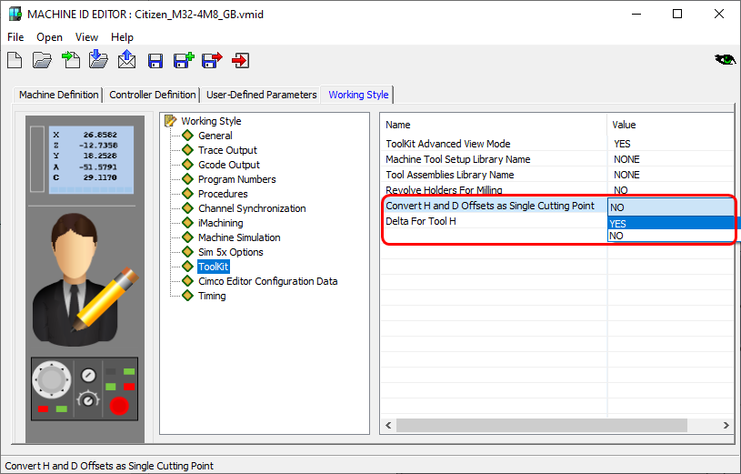
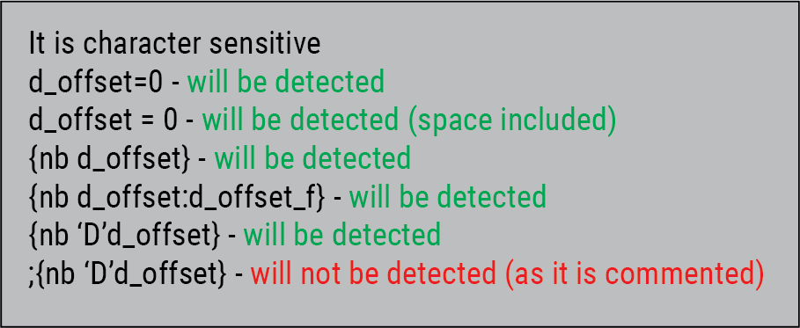
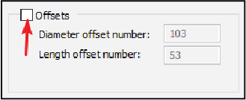
Conversion of Cutter cutting points from earlier versions

Slide 17
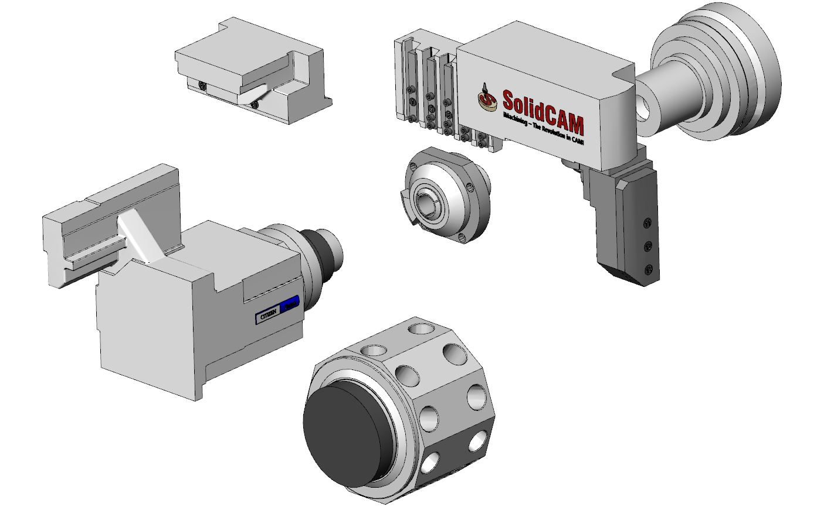
Machine Simulation: New .xml stucture
Case study: Citizen M32-4M8

Slide 18
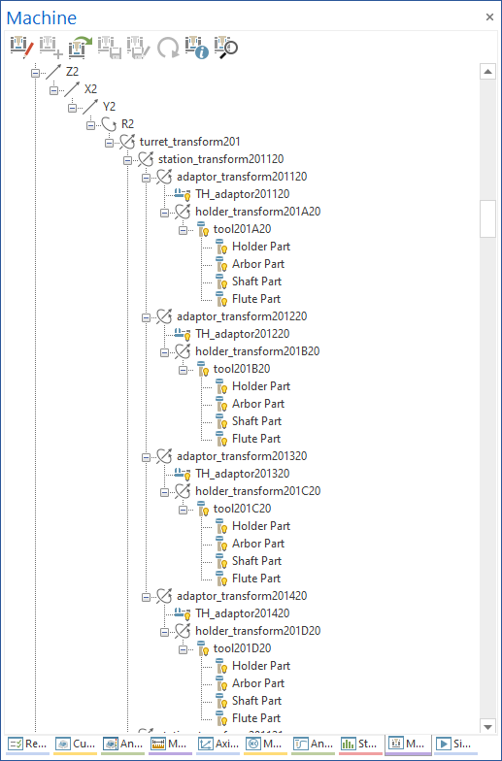
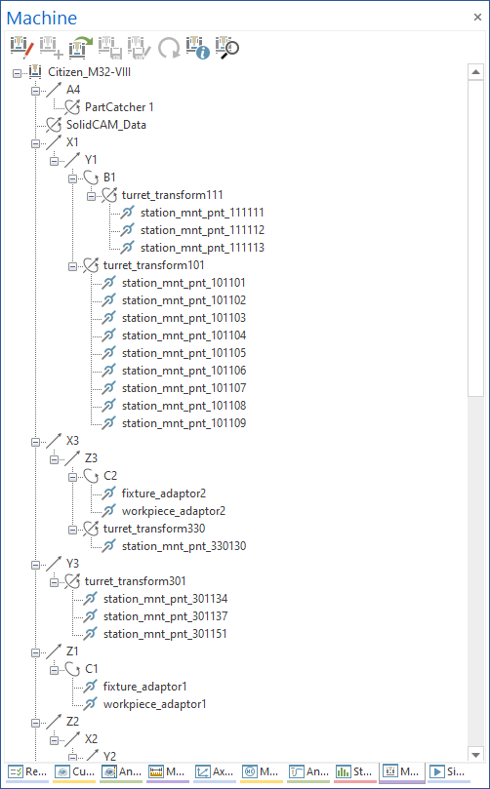
Machine Simulation: New .xml stucture
<SC2021 SP4
SC2021 SP4
Case study: Citizen M32-4M8
Reduced and simplified transformations
Eliminate limits with the number of used cutters in tool assembly
Added target_stock3/4/x in the case of multi-channel machines
Simplifies the collision definition and performance
Reduce the loading time of machine simulation
220KB
18KB

Slide 19
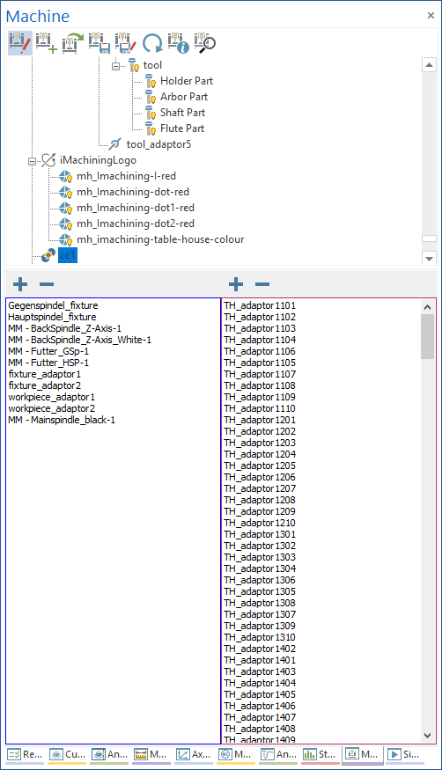
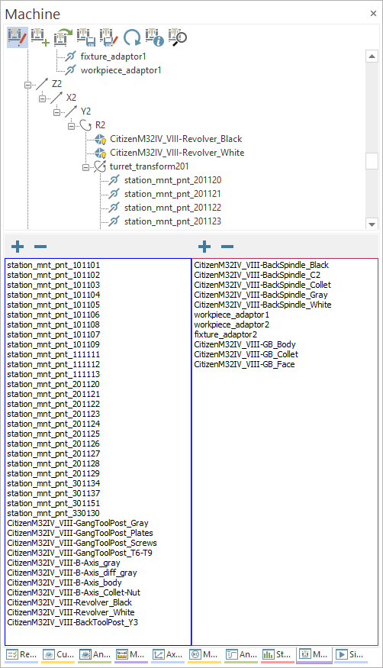
Machine Simulation: New .xml stucture
<SC2021 SP4
SC2021 SP4

