Slide 1
SolidCAM EdgeBreaking
9902045214 www.cadvintech.com

Slide 2
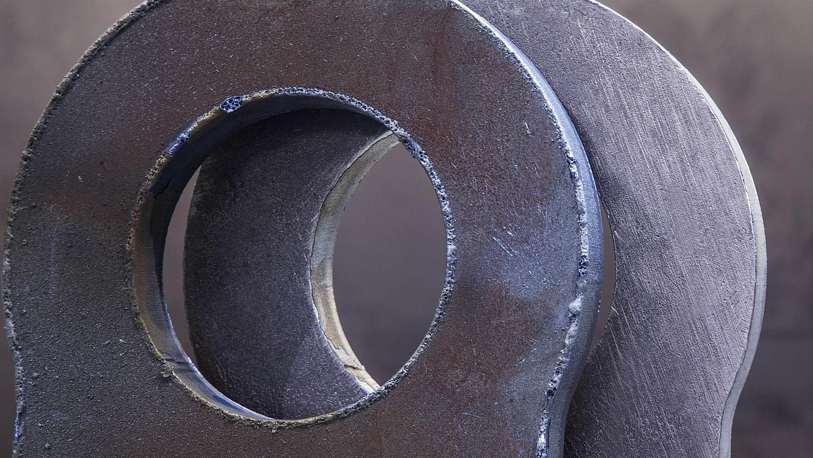
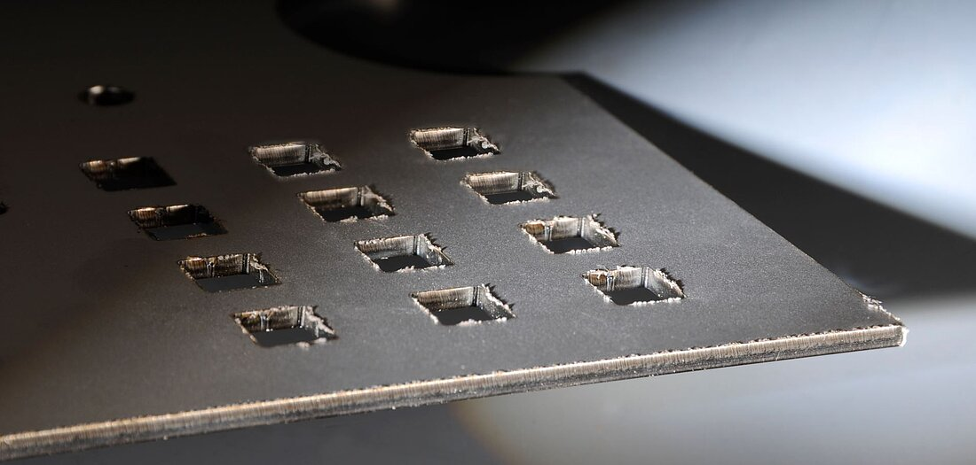
What is a Burr ?
Burr is a small raised edge or ridge of material that forms along the edge of a machined part during the machining process.
While burrs may seem like a small issue, they can cause significant problems in the production process and the final product.

Slide 3
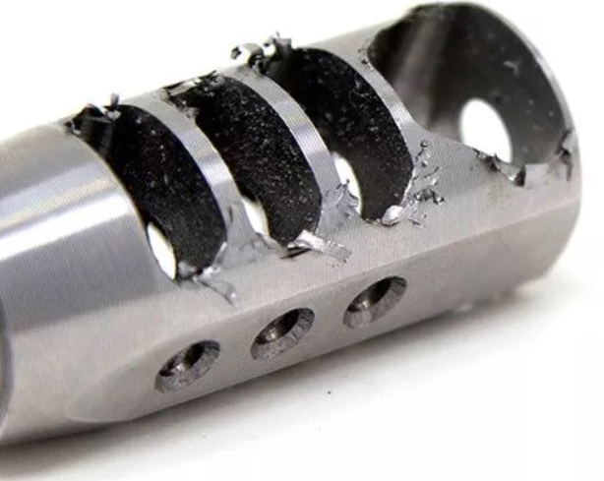
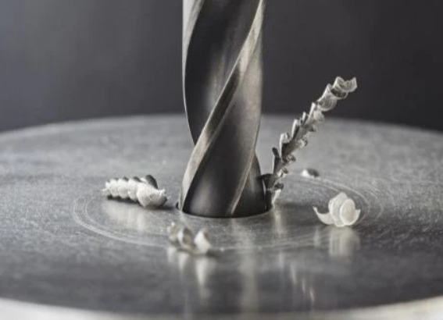
Potential Issues Caused by Burr
Safety Risks: Burrs can be sharp and can cause injury to workers during handling or assembly. They can also damage other parts or equipment during the production process.
Impaired functionality: Burrs can interfere with the proper functioning of a machined part by preventing parts from fitting together correctly. This can lead to issues with product quality and performance, resulting in costly rework or product recalls.
Reduced Durability: Burrs can cause stress concentration points on the surface of the machined part, leading to premature failure of the part in the long term.
Aesthetics: Burrs can also have an adverse impact on the appearance of the finished product, making it look rough and unrefined.
Increased manufacturing costs: Burrs can increase manufacturing costs by requiring additional processing to remove them or by causing the need for rework or scrap.

Slide 4
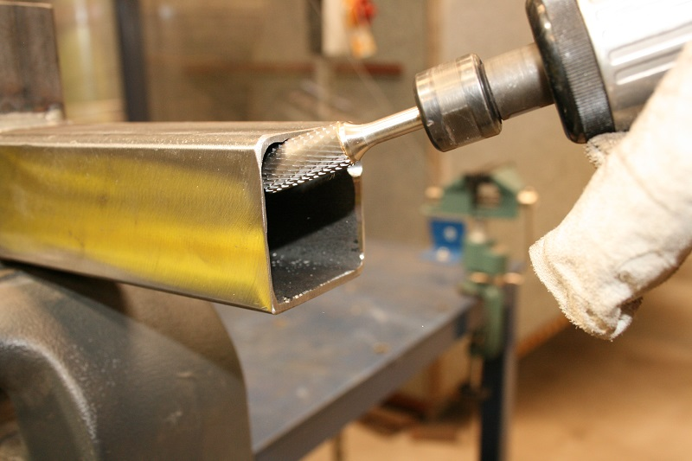
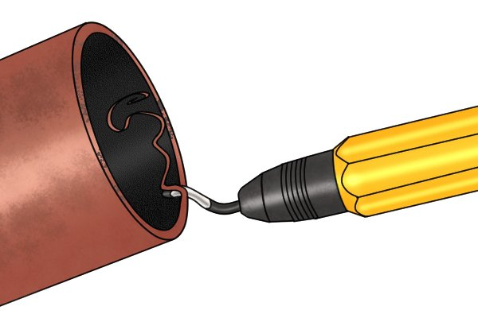
Potential Disadvantages of Edgebreaking Manually
Inconsistent results
Time-consuming
Labour-Intensive
Health and Safety risks
Inability to handle complex shapes
Inability to ensure accuracy

Slide 5
Edge Breaking in CAM: Development Challenges
CAM systems offer automated or semi-automated machining cycles that take into account factors such as collisions, residual stock material, and specialized tooling for different materials.
However, even with all these advancements, one issue still remains – the presence of burrs on parts after machining.
Despite the extensive automation of the machining process, burr removal remains a manual process that can take as long as programming the part in the first place.
Time taken to create a Edgebreaking program manually is always more than the time taken to program the entire part. Programmers leave it to manual deburring due to the time take to make such programs.
Addressing the burr issue is an important consideration in the ongoing development of advanced manufacturing technologies.
.

Slide 6
Transform Manufacturing with SolidCAM's Edge Breaking
can be achieved using a deburring module.

Slide 7
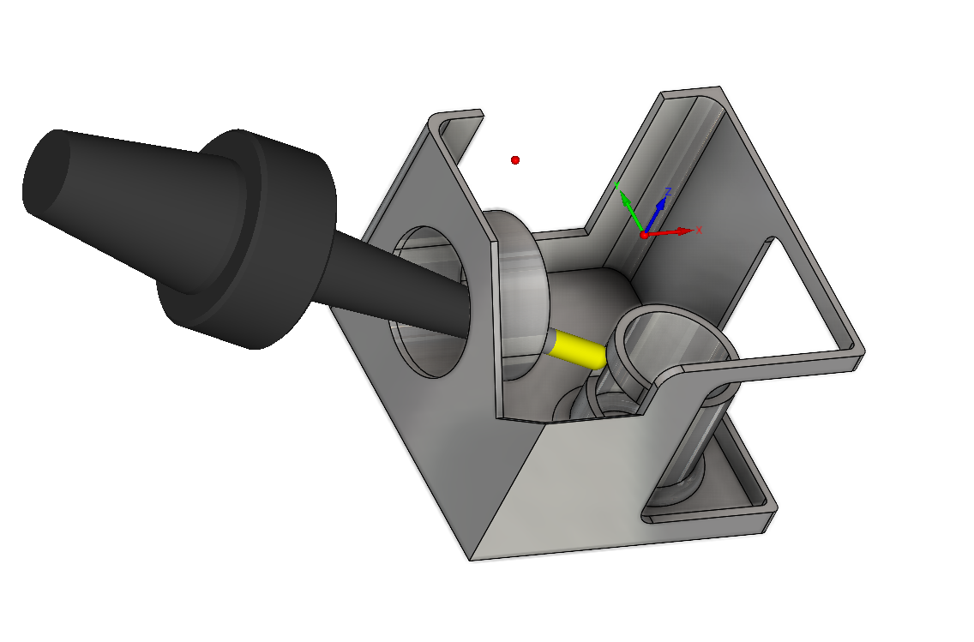
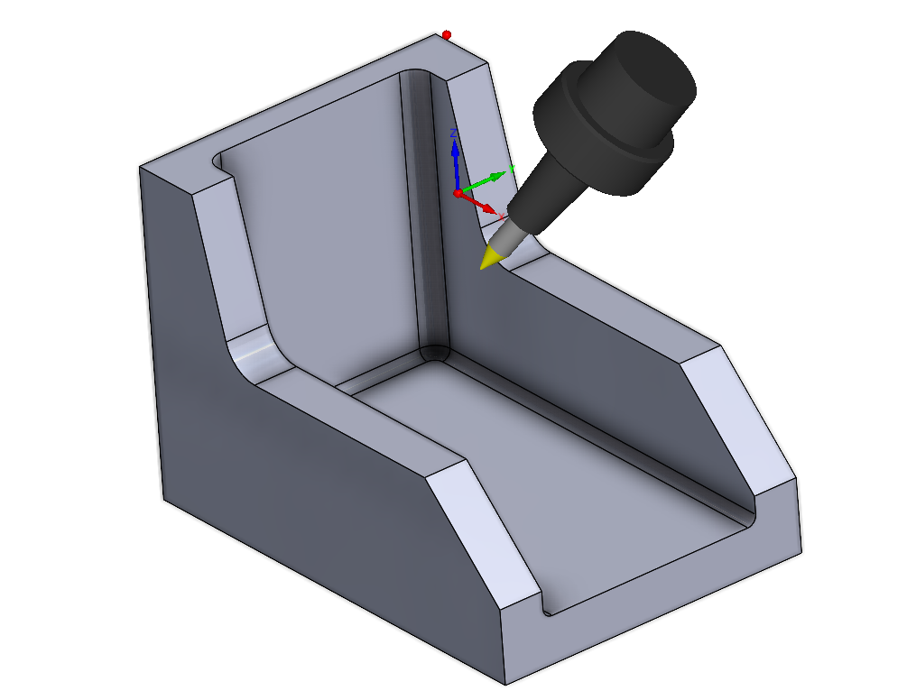
SolidCAM Edgebreaking – Automation at It’s Best
SolidCAM's Edge Breaking feature is an advanced functionality that automates the process of removing sharp edges from a workpiece to improve safety, aesthetics, and overall quality.
SolidCAM's Edge Breaking feature picks all the edges automatically or allows the user to define the edges that need breaking and choose from a variety of cutting tools to achieve the desired result.
The module's advanced algorithms enable it to detect and break even the most complex edges, ensuring that the final product meets or exceeds industry standards for safety, functionality, and aesthetics.
SolidCAM's Edge Breaking feature is part of a comprehensive suite of manufacturing tools that enable users to optimize their production processes and achieve greater efficiency and profitability.

Slide 8
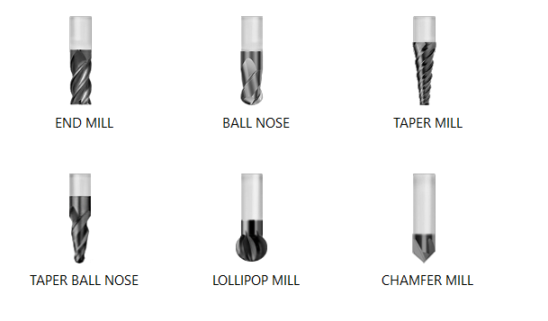
Standard tools such as End Mills, Ball Nose Mills, Taper Mills, Taper Ball Nose , Lollipop & Chamfer Mill Tools are supported.
Tools Supported

Slide 9
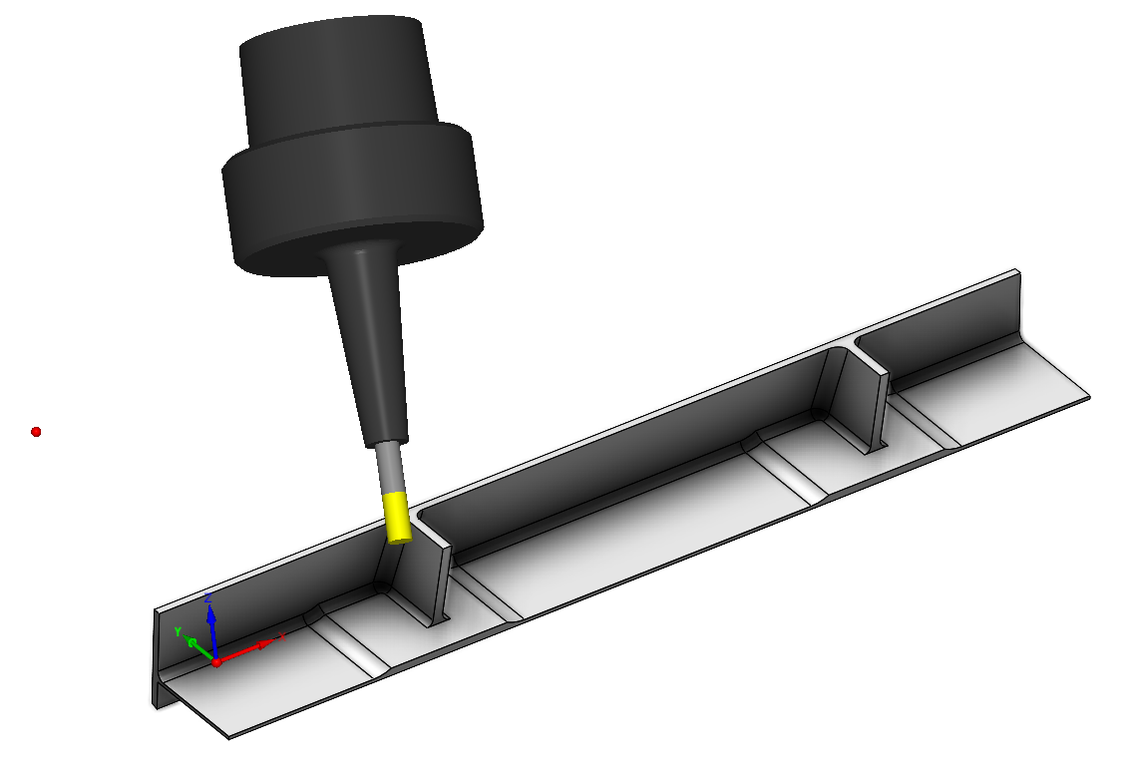
SolidCAM's Edge Breaking module offers a variety of cutting tool options, including flat end mills, ball nose mills, and chamfer mills, enabling users to achieve different edge-breaking effects such as direct chamfers, rounded edges, and chamfers in 3 or 5 axis.
Edgebreaking Styles

Slide 10
Conclusion
Sharp edges on machined parts can pose safety risks to workers, damage other machinery or equipment, and cause premature product failure due to stress concentration. SolidCAM's automated Edge Breaking feature addresses these issues and ensures that products meet or exceed industry standards.
SolidCAM Edge Breaking module offers significant benefits to manufacturers, including improved safety, enhanced aesthetics, increased functionality, and greater manufacturing efficiency.
The use of SolidCAM's Edge Breaking module also offers cost savings by reducing the need for manual edge-breaking methods and increasing manufacturing efficiency.
SolidCAM's Edge Breaking feature is highly customizable, enabling manufacturers to tailor the edge-breaking process to their specific needs and preferences by using different tools & different styles of Edgebreaking.
SolidCAM's Edge Breaking feature is a prime example of how technology can be leveraged to improve manufacturing processes and produce products that meet the highest standards of quality and safety.

Slide 11
Thank You !!

