Slide 1

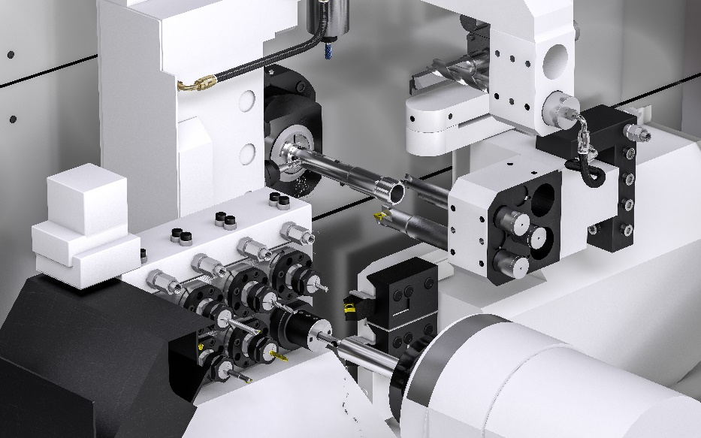

SolidCAM 2022
New Features
July 2022

Slide 2
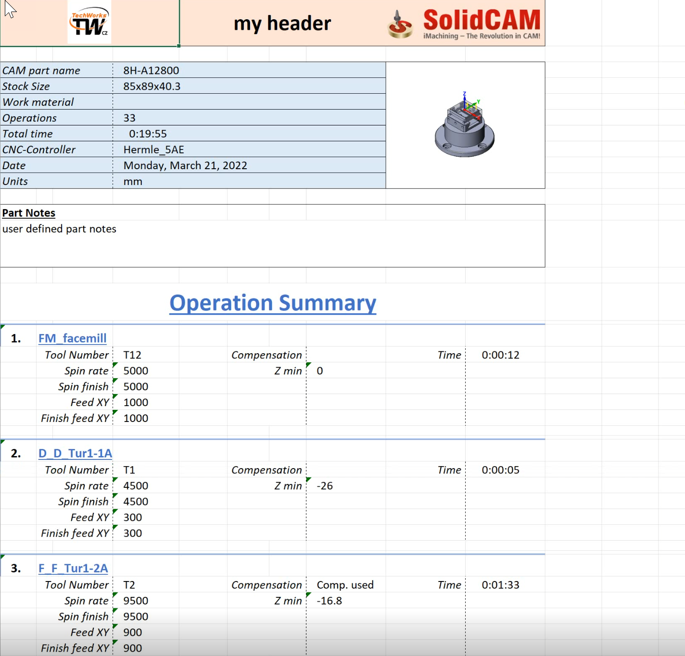
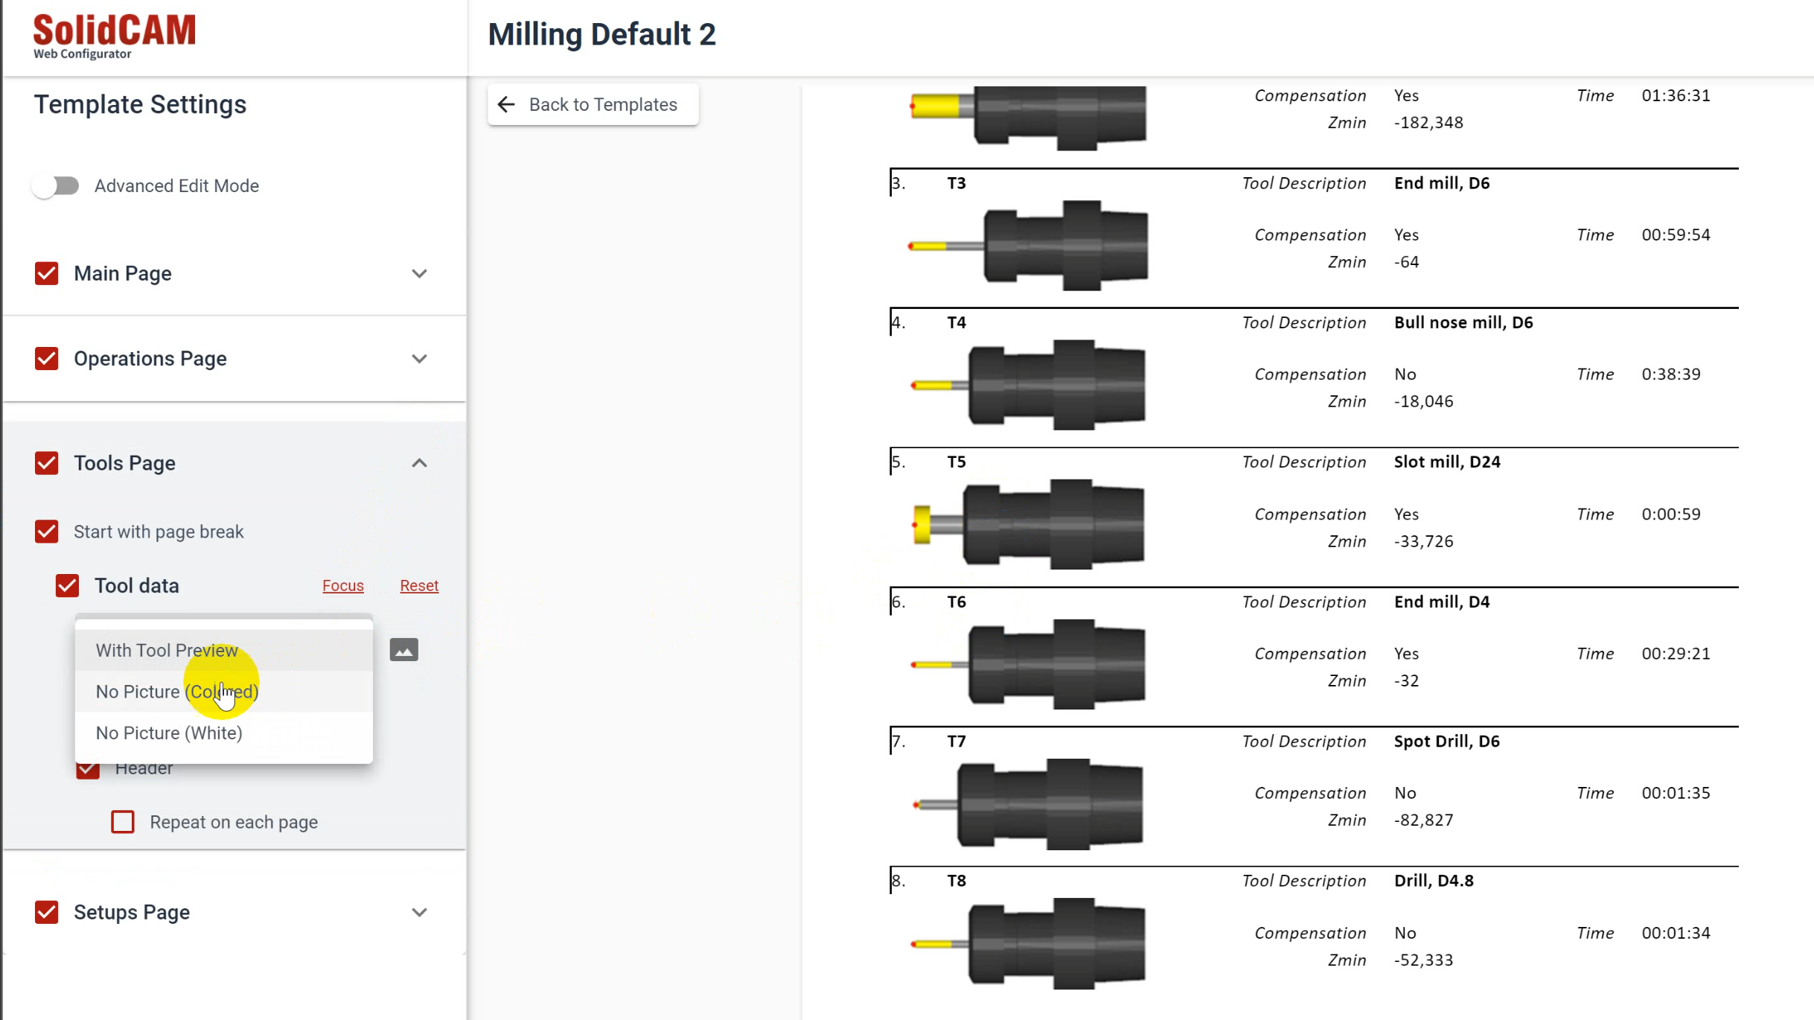
SolidCAM 2022 SP1- Setup Sheet Web-based template configurator
Setup Sheet WEB Configurator offers an online database of predefined templates.
The user can easily do template customizations, then download a customized template ready for use
Go to the configurator website – select a template
Configure the template on the cloud
Download to user Desktop
Install template in SolidCAM
Generate Setup Sheet with the new template

Slide 3
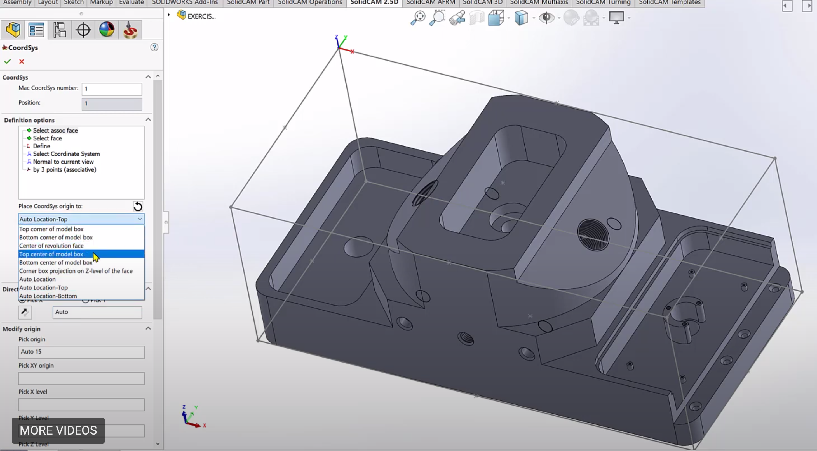
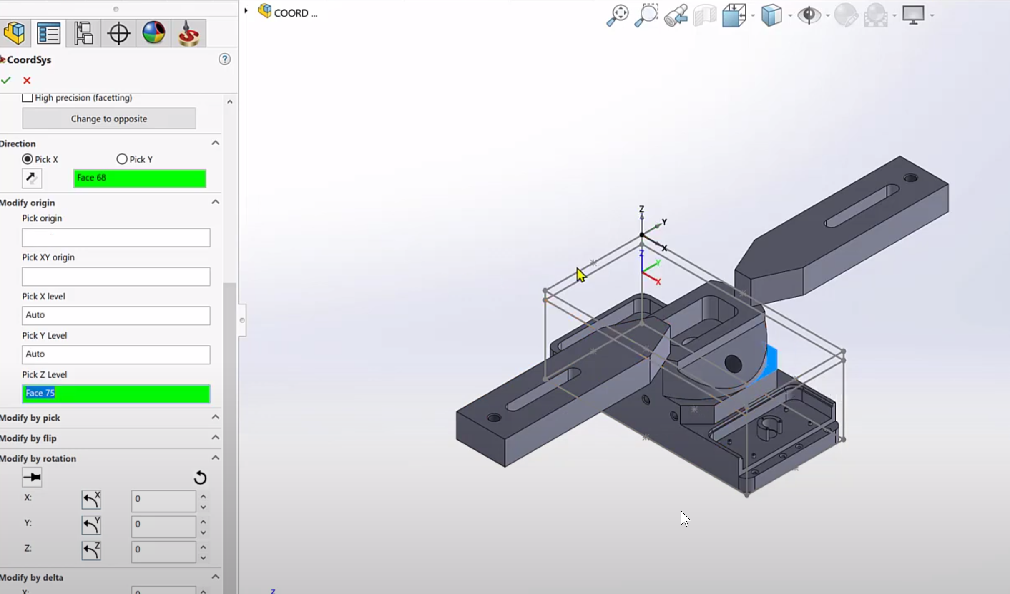
SolidCAM 2022 SP1– Associative Coordinate System
In SolidCAM2021, the Coordinate System is not associative - if you had a change in the part and the location of the coordinate system moved, you would have to redefine the Coordinate System.
If you want to make an edit to the location of the Coordinate System, you will have to restart from the beginning.
With the Associative Coordinate System in SolidCAM 2022, everything is associative, including the levels page - you can also edit the location, without having to recreate the Coordinate system from scratch.

Slide 4
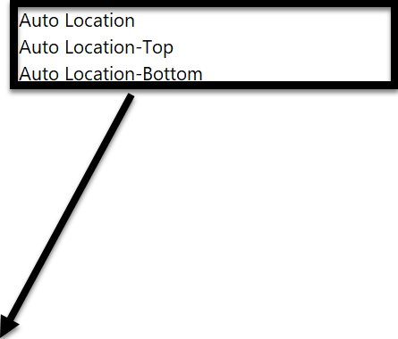
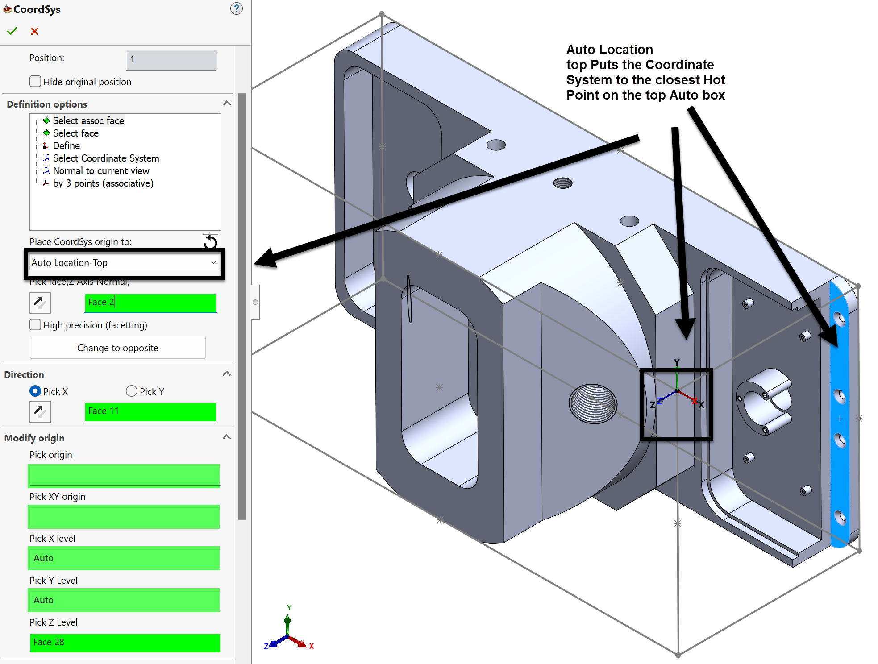
SolidCAM 2022 SP1– Associative Coordinate System
(Auto Location with Associative Fields)
When choosing a face to be used for the perpendicular Z direction, it will be automatically placed at the closest hot point on the automatic box:
Auto Location – The closest point on the Auto box
Auto Location - Top - The closest point on the top of the Auto box
Auto Location – Bottom - The closest point on the bottom of the Auto box
Picking a cylindrical surface with the Auto Locations will place the origin at the center axis of that cylinder

Slide 5
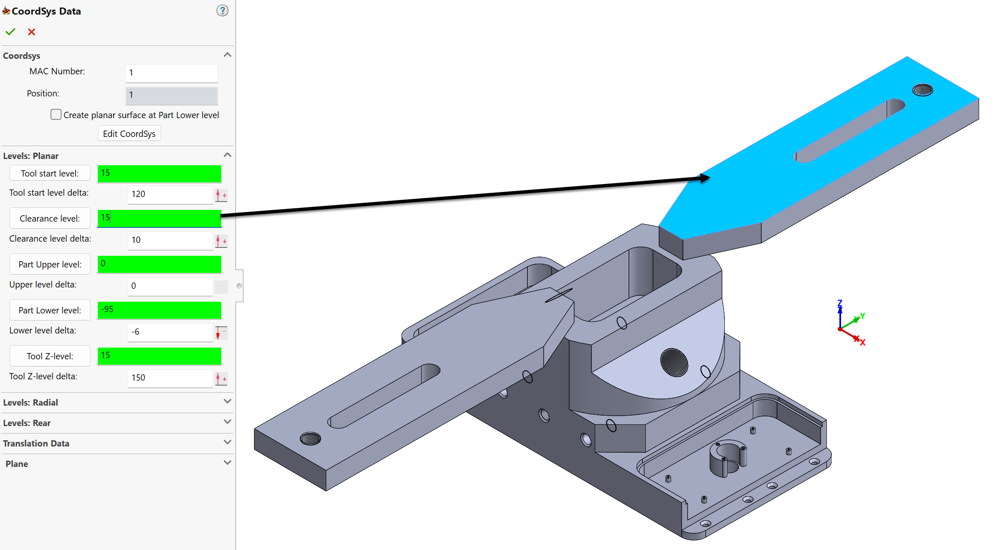
SolidCAM 2022 SP1– Associative Coordinate System
(Levels Page)
With the Associative Coordinate System Levels Page in SolidCAM 2022, everything is associative and has Delta fields.
You can for example pick the top of a clamp for the Clearance level and that value will appear in the field as associative - add a Delta value for the distance you want it above the clamp.
If the clamp changes, the ClearanceLevel will always be the delta value above the clamp.

Slide 6
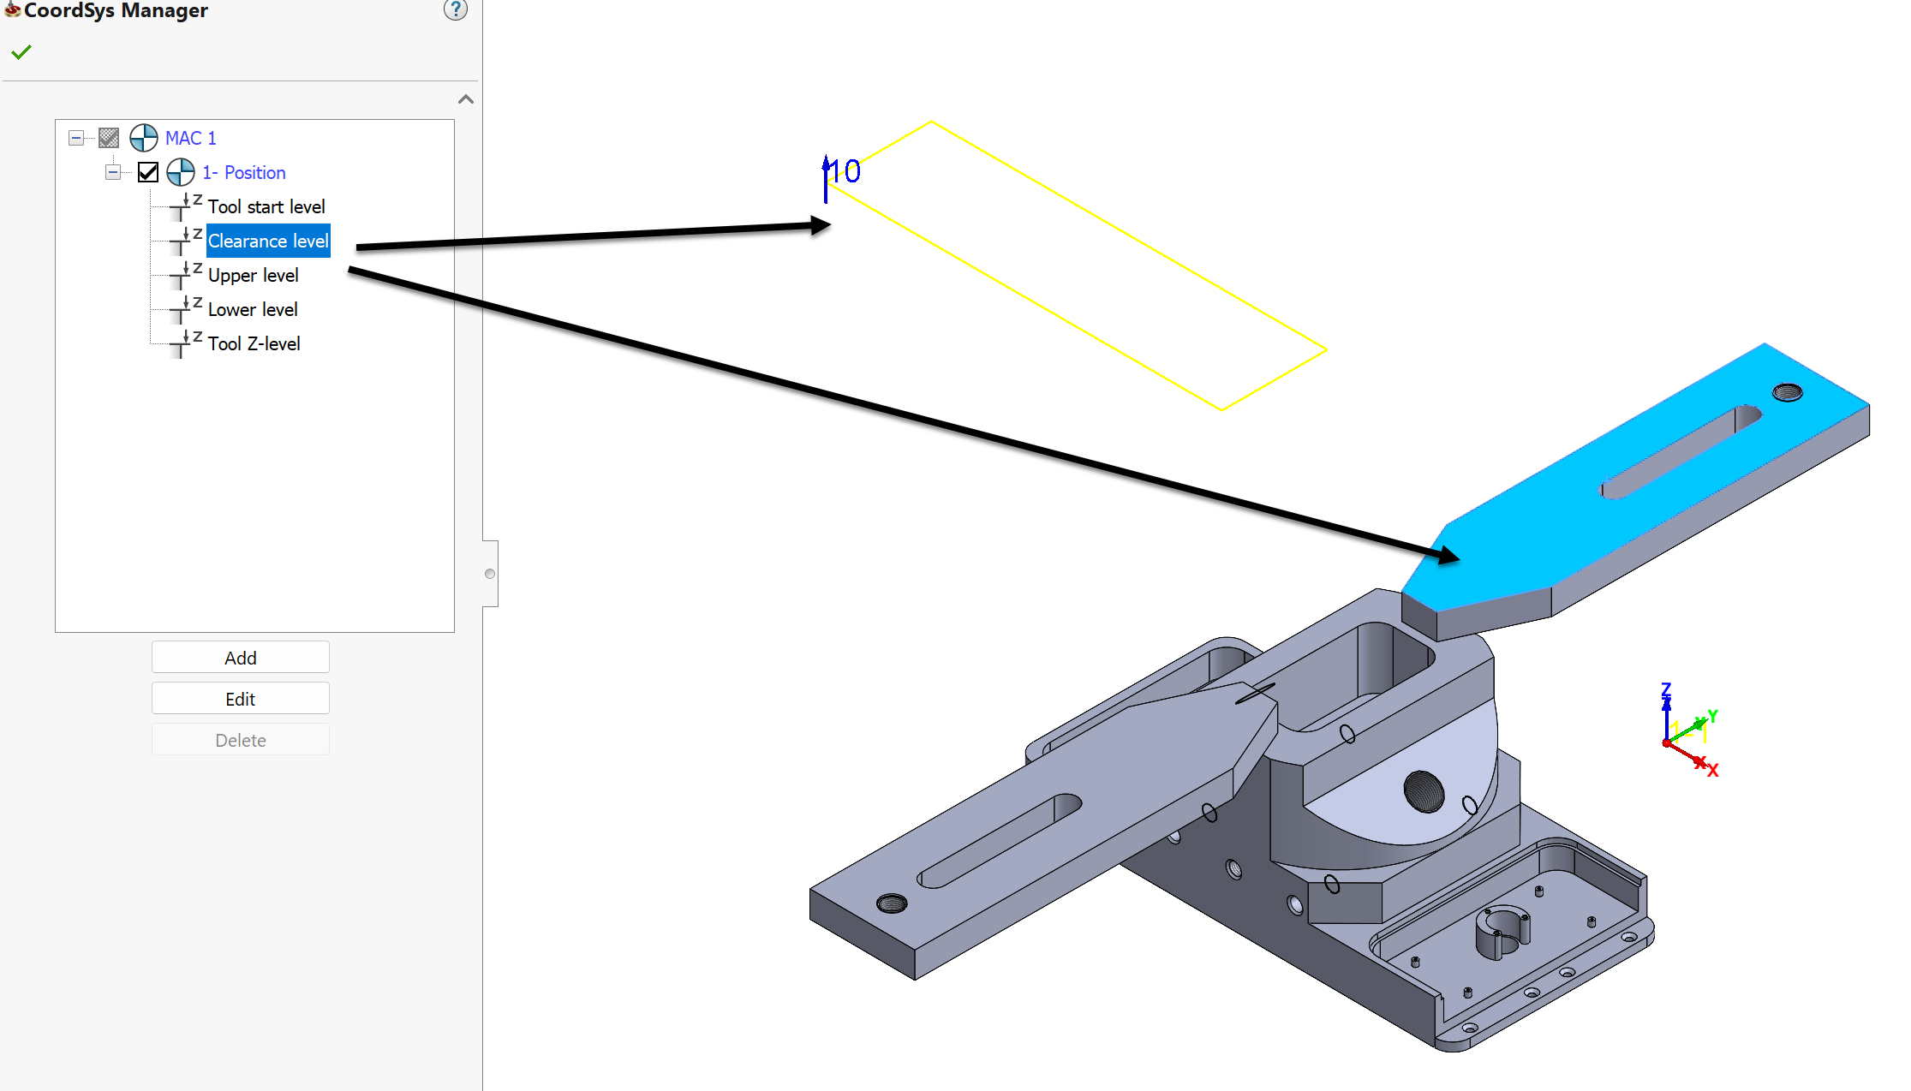
SolidCAM 2022 SP1– Associative Coordinate System
(CoordSys Manager)
With the CoordSys Manager Page in SolidCAM 2022, everything that is associative is also visible, including the Delta levels.
You can for example pick the Clearance level, and that will be highlighted on the appropriate face, as well as the Delta value.

Slide 7
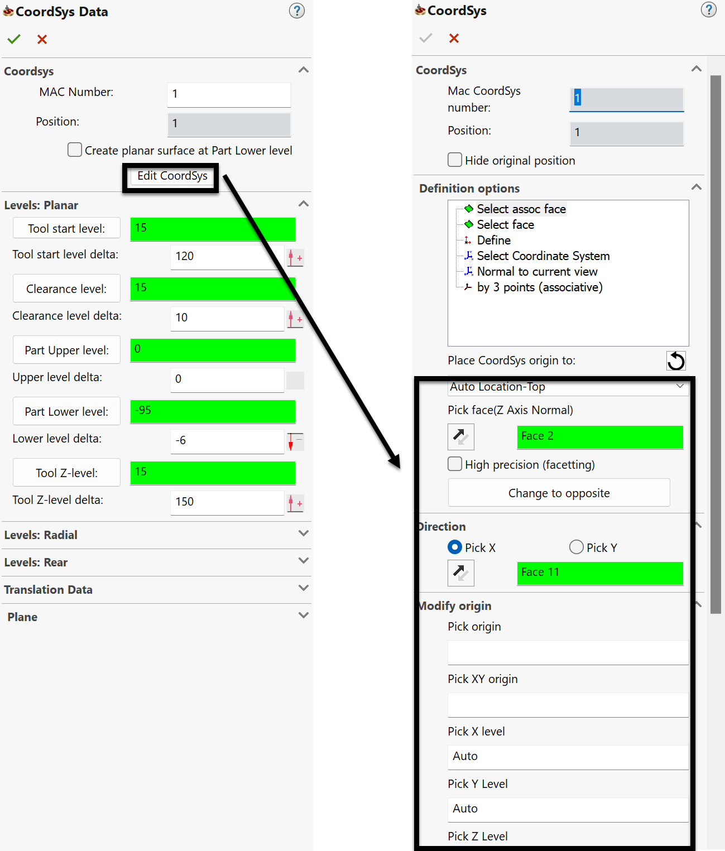
SolidCAM 2022 SP1– Associative Coordinate System
(Edit Coordinate System)
You can now Edit the Coordinate System, without having to rebuild the Coordinate system from scratch.
All the fields are open.

Slide 8
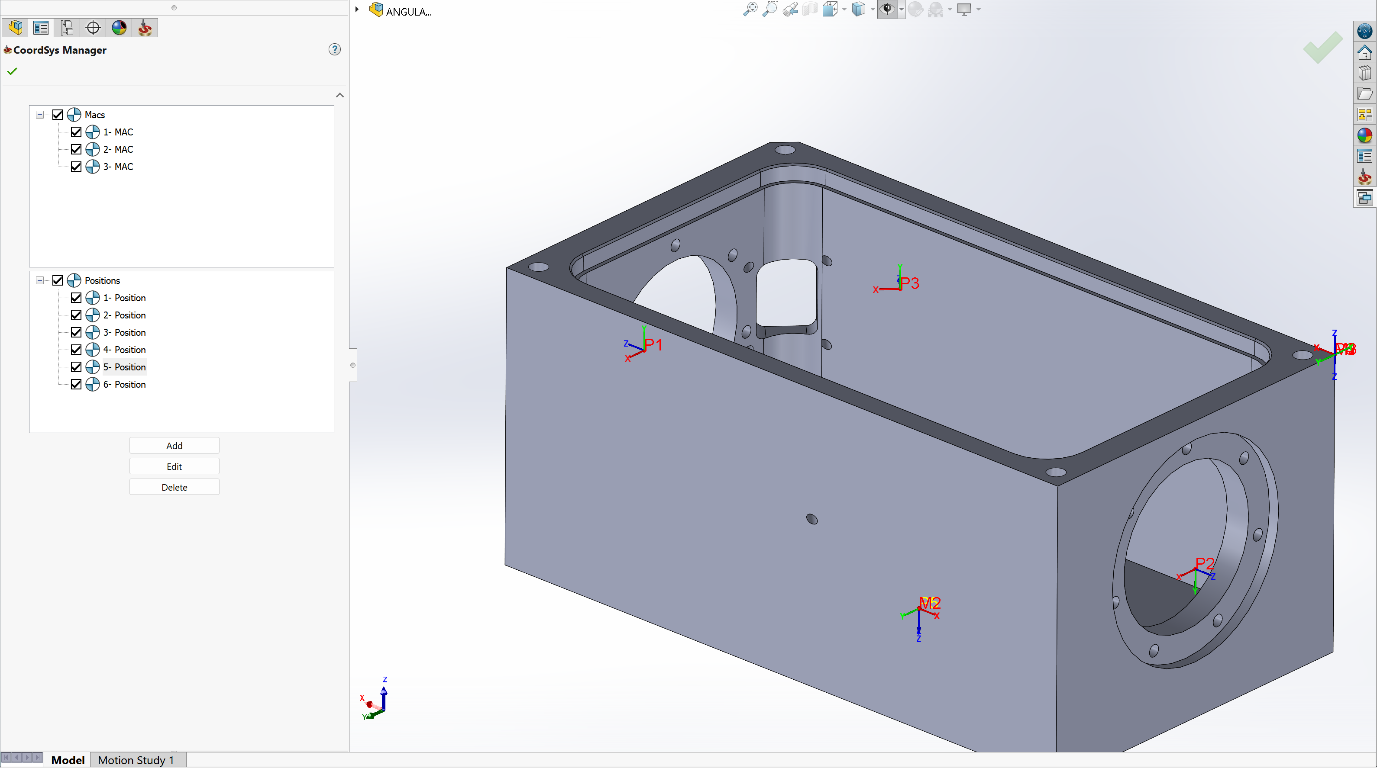
SolidCAM 2022 SP1– Position sharing between Coordinate systems
With the new style of Position definition in the Coordinate System Manager, you can now share a position among several different MACs.
You can easily change the MAC of the operation, without the need to redefine the Geometry.

Slide 9
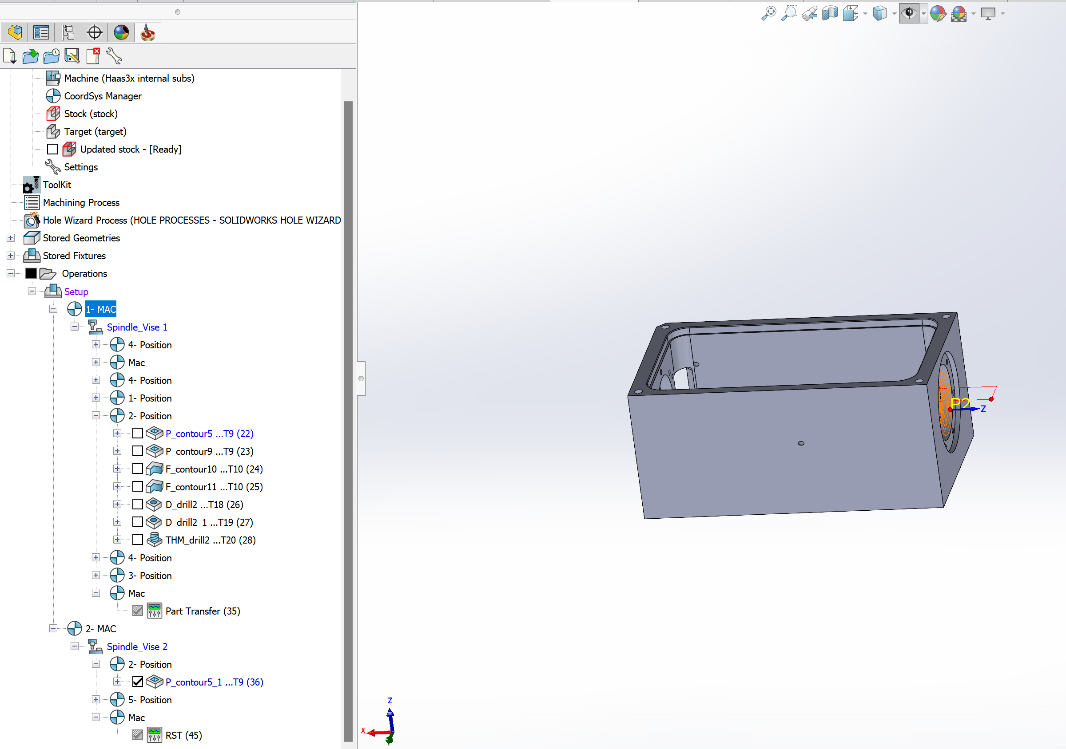
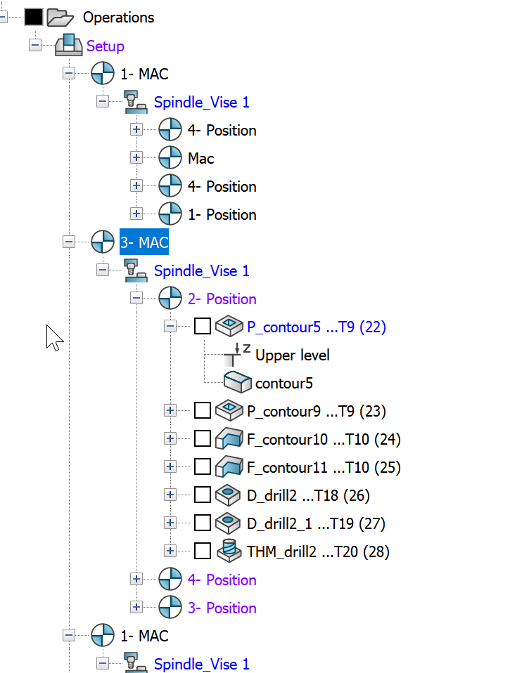
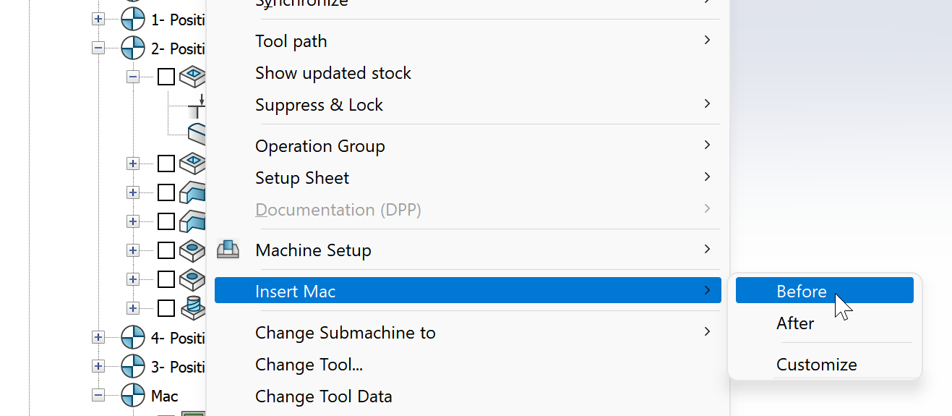
Changing the MAC for the operation
Simply Copy and Paste the operation to the different MAC – you will get the same operation and position, but in another MAC
Or add new MAC before the operation and select required MAC from the list

Slide 10
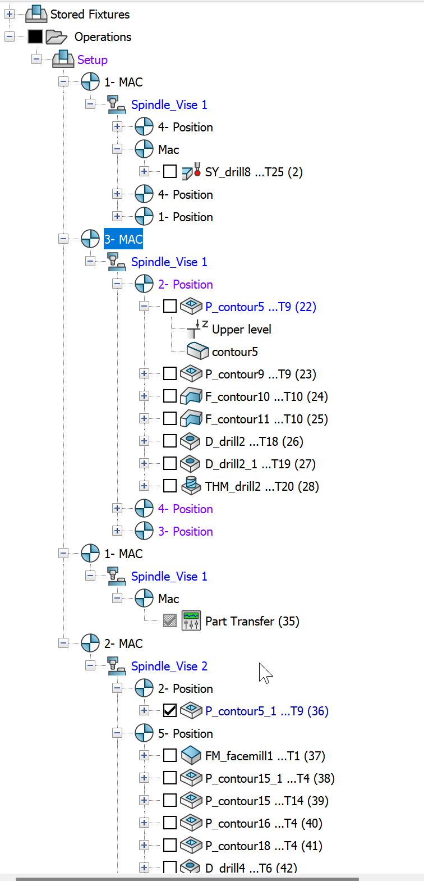
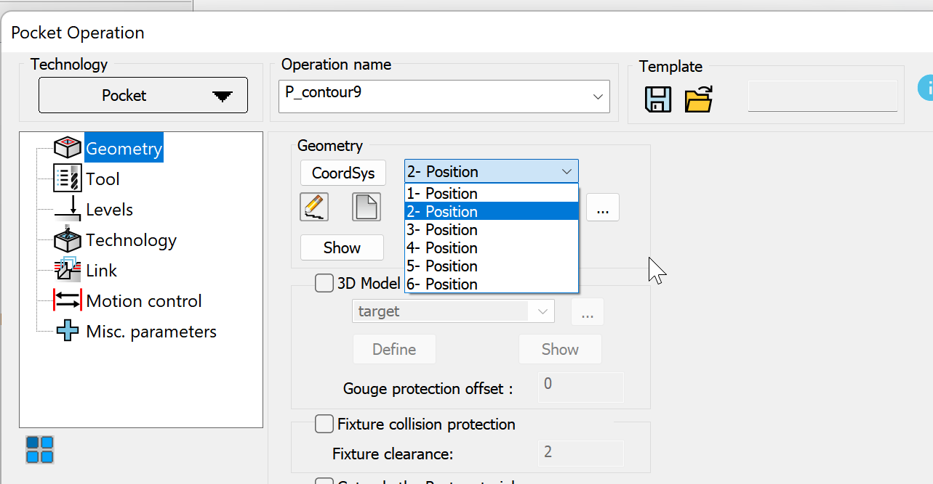
The CAM tree Structure is more flexible
With the new CAM Tree structure, the user can see the MAC–Position relation, drag operations between MACs, add MACs and more powerful features.
In the operation’s Coordinate System definition dialog, only position can be defined - it provides more flexible definition of the Coordinate System.

Slide 11
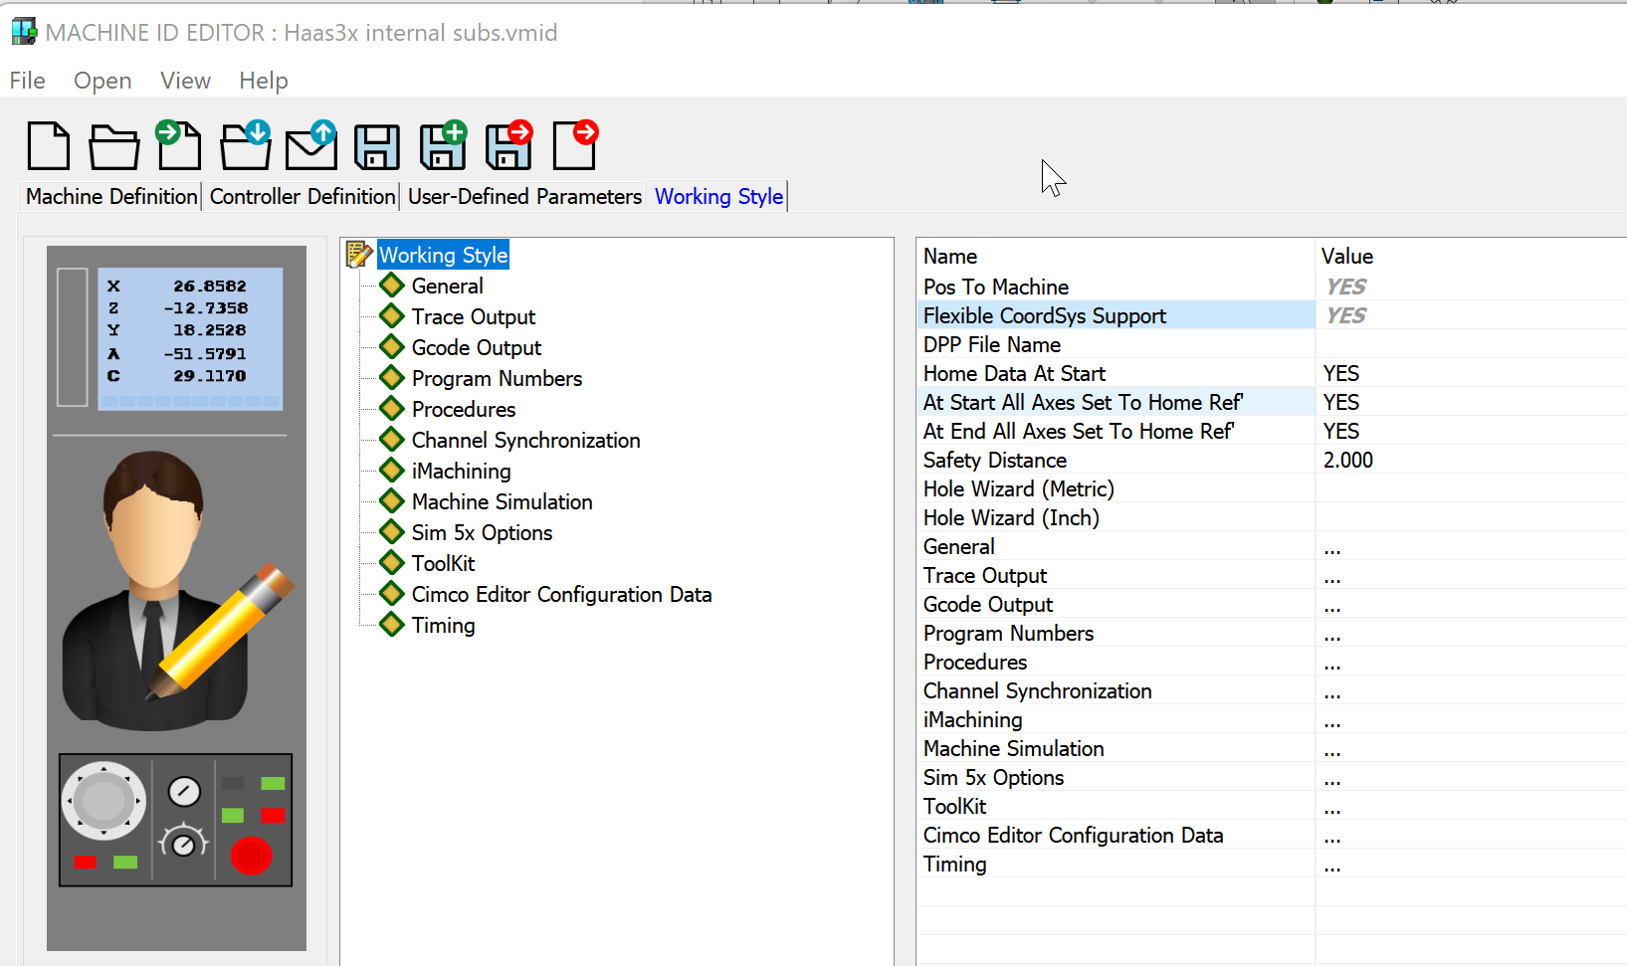
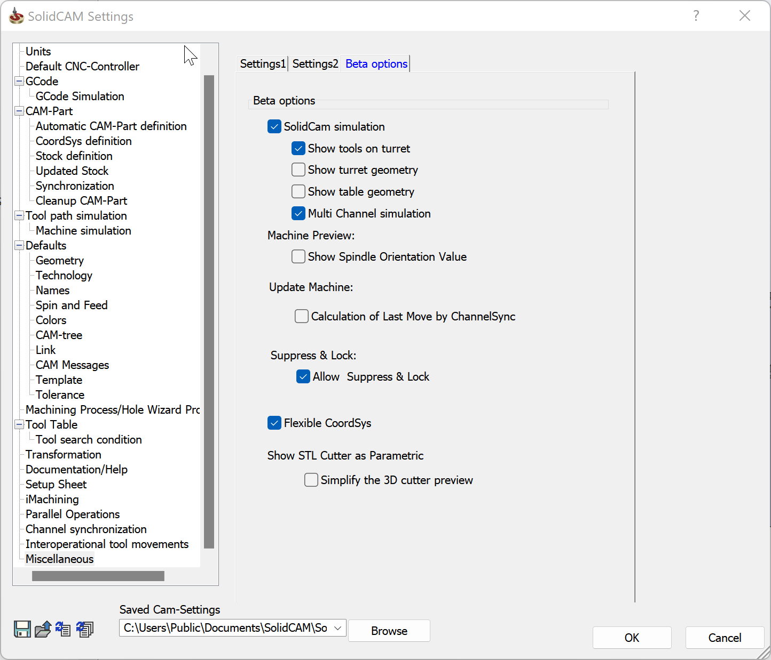
How to use the Shared Position feature
There is no need for special support of the Shared Position Feature in the Post processor
The Feature can be activated in the CAM Settings
After that, you can enable the Feature in the VMID
The CAM Part that was opened in the Shared Position mode, can’t be back converted - make sure you are creating backup for your part.

Slide 12
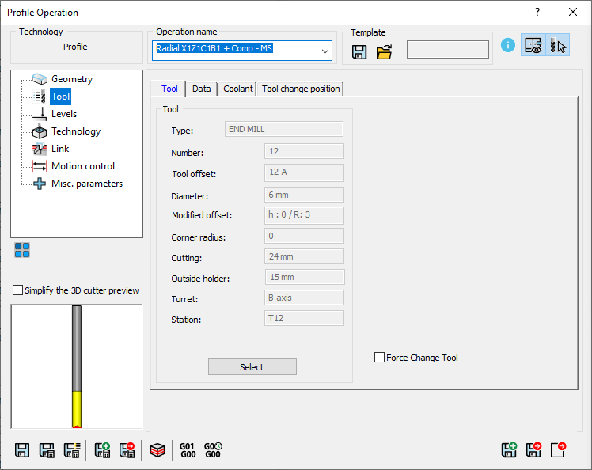
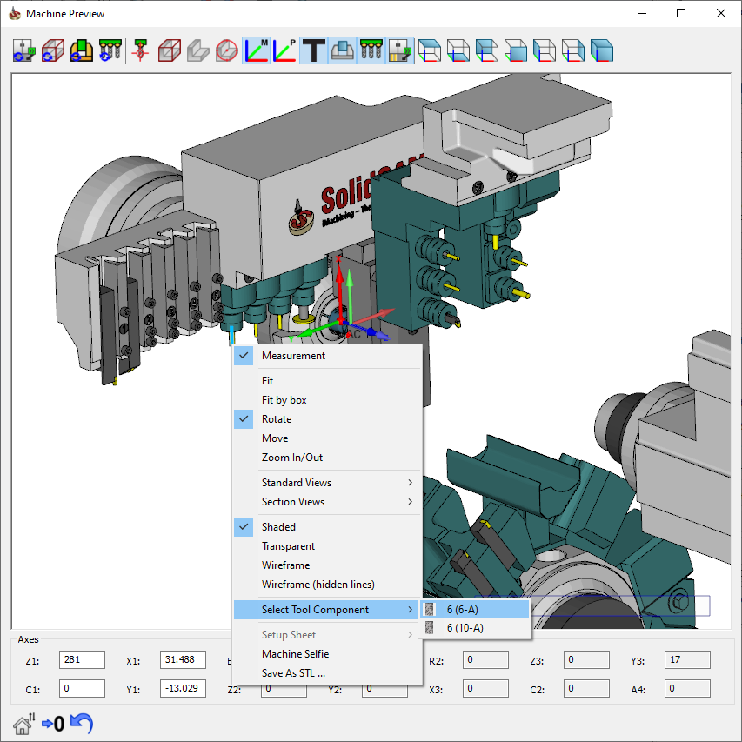
SolidCAM 2022 SP1– Select Tool from Machine Preview
In SolidCAM2022, it is possible to select the tool from the Machine Preview
Speed up the process of tool selection

Slide 13
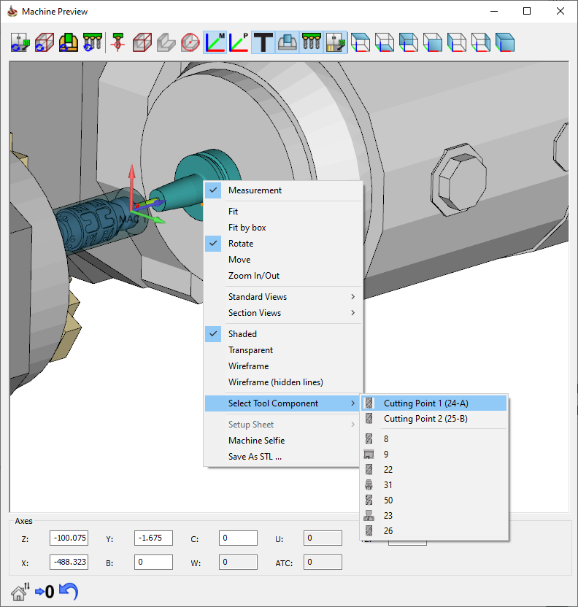
SolidCAM 2022 SP1– Select Tool from Machine Preview
For Spindle type turret, this feature displays all available tool cutting points, allowing fast switch between them
It also filters 10 recent tools, that can be used in the current job

Slide 14
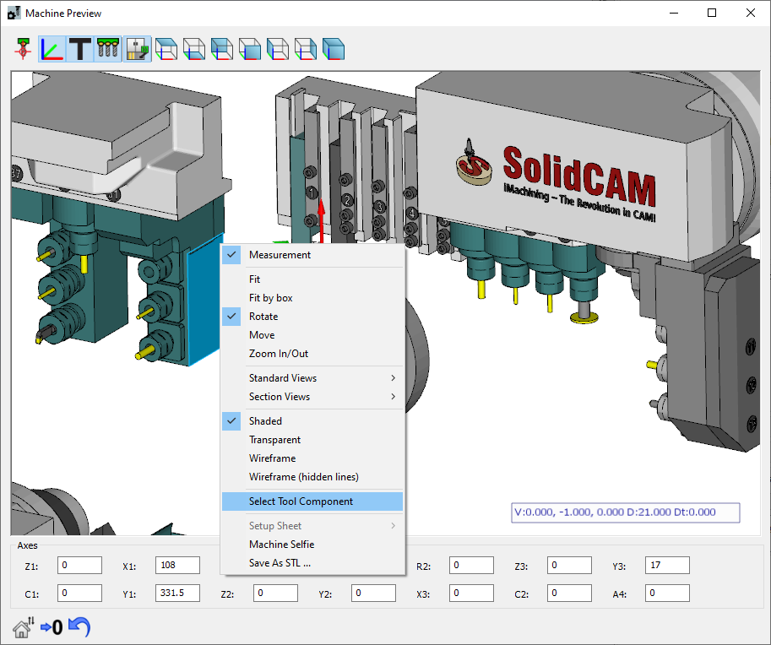
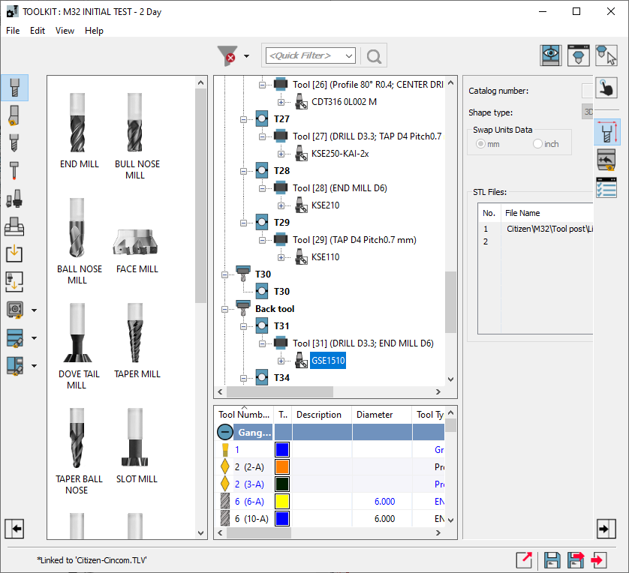
SolidCAM 2022 SP1 – ToolKit
Navigate Tool Component from the Machine Preview
Select and navigate the tool component, in ToolKit’s Machine Preview

Slide 15
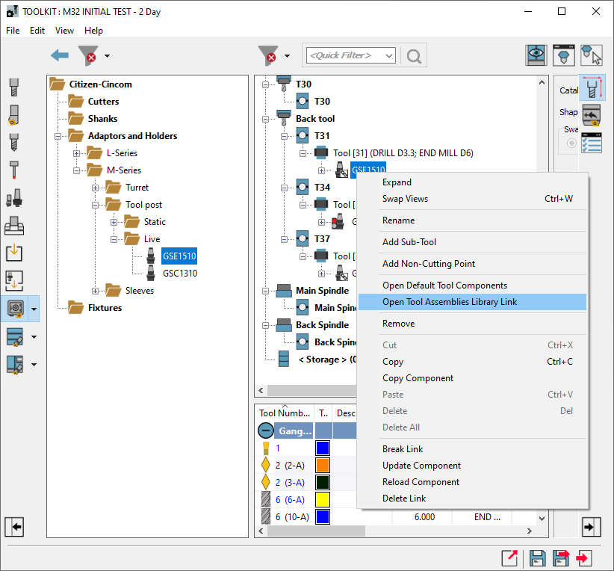
SolidCAM 2022 SP1 – ToolKit
Navigate the linked Tool Component in the library
If linked, the tool component or assembly can be navigated in the library
Speed up the process of adding or replacing other tool components from the same library

Slide 16
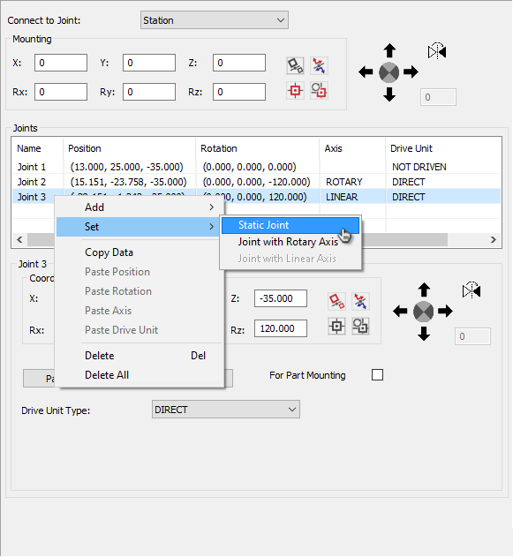
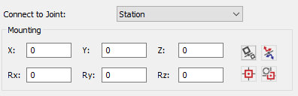
SolidCAM 2022 SP1 – ToolKit
Added new possibilities in the Connection page
Added possibility to add specific joint type
Added possibility to change the joint type
Implemented new icons for Mounting Tools

Slide 17
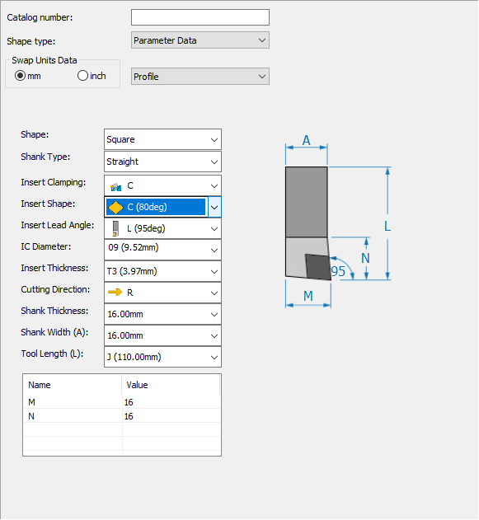
SolidCAM 2022 SP1 – ToolKit
Flexible data input for shank
Changing the insert shape doesn’t change the shank size anymore (Thickness, Width, Length, M and N parameters)

Slide 18
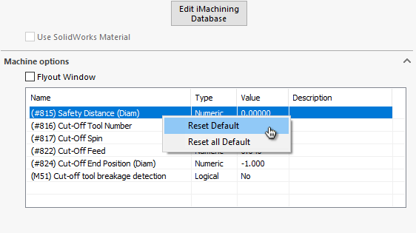
SolidCAM 2022 SP1– CAMPart
Added capability to reset Machine Options parameters
Added possibility to reset one, many or all parameters to their Default value
Selection of the multiple parameters can be done with CTRL+ or SHIFT+Click
The Description has been added to Machine Options

Slide 19
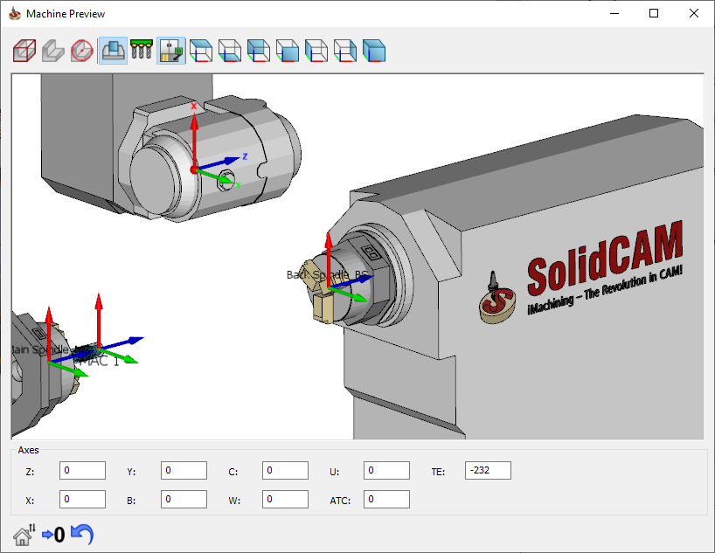
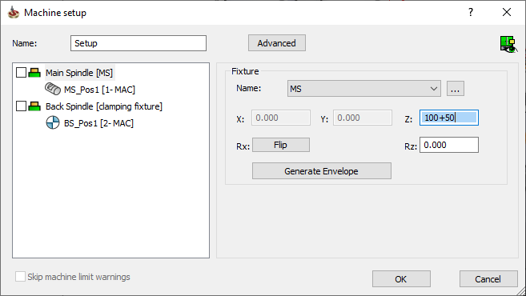
SolidCAM 2022 SP1– Machine Setup
Supports equations and added display filters to Machine Preview
Supports Equations in the matrix shifts values
Added display filters for Fixtures, Tools and Machine Housing int Machine Preview

Slide 20
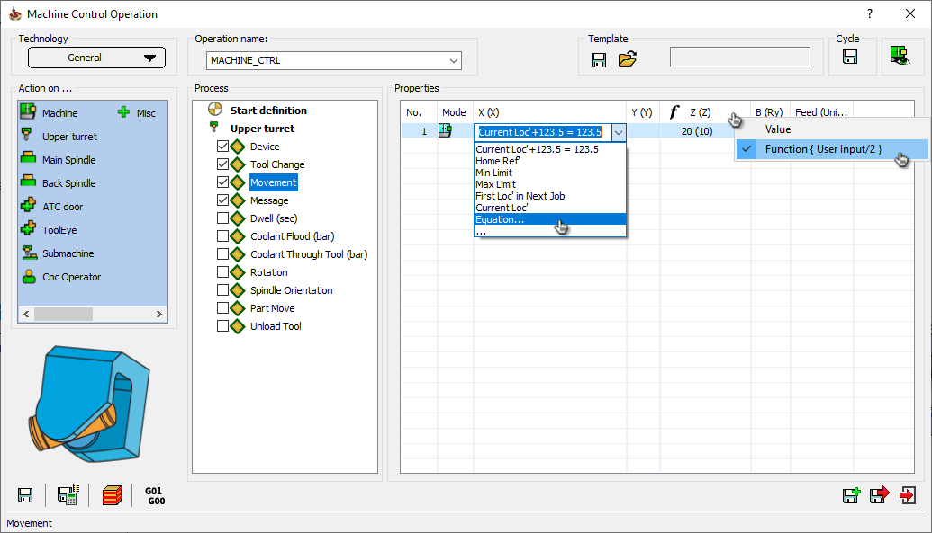
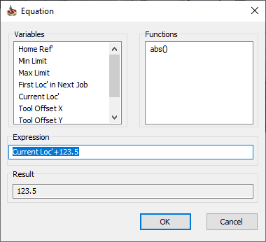
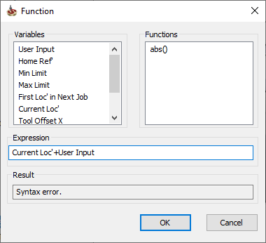
SolidCAM 2022 SP1– Machine Control Operation
Supports Functions and Equations
Added possibility to define Equation for movements
Movement input can be defined as Function supporting diameter input, relative input, etc.

Slide 21
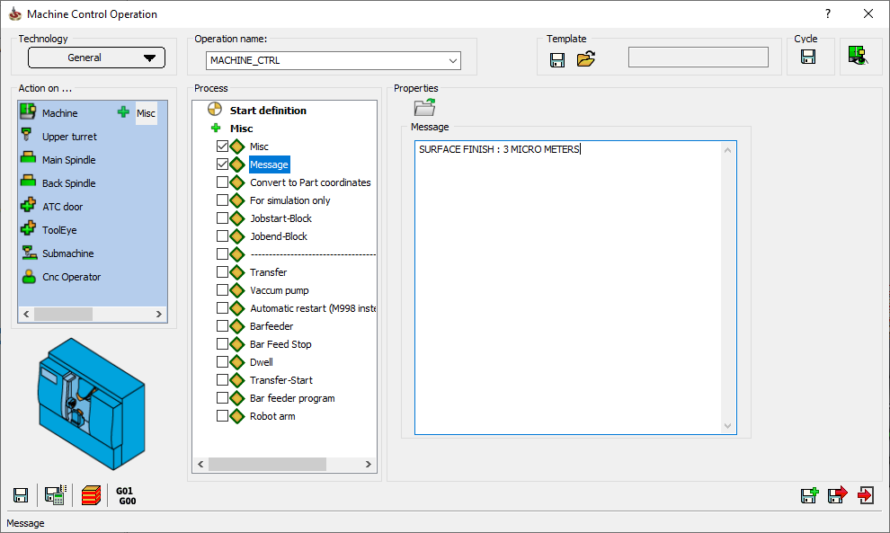
SolidCAM 2022 SP1– Machine Control Operation
Import custom message
Added possibility to import custom messages
MCO window is now resizable

Slide 22
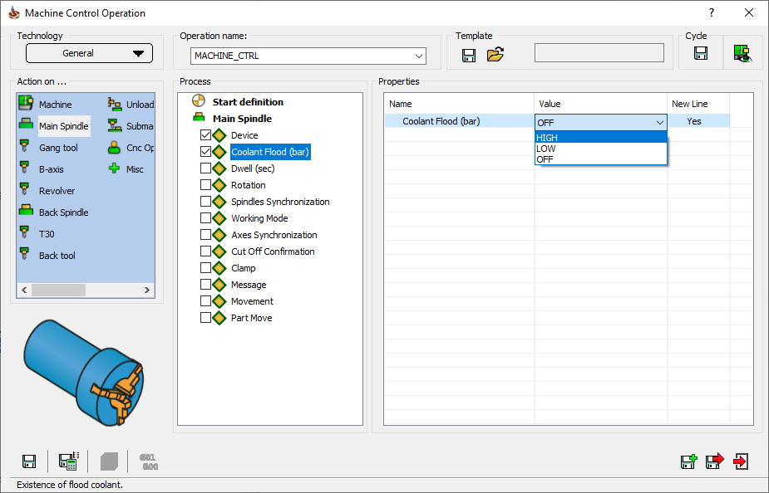
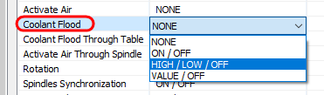
SolidCAM 2022 SP1– Machine Control Operation
Control Flood Coolant on Table
Added possibility to control Coolant Flood on Table device (if supported by machine)

Slide 23
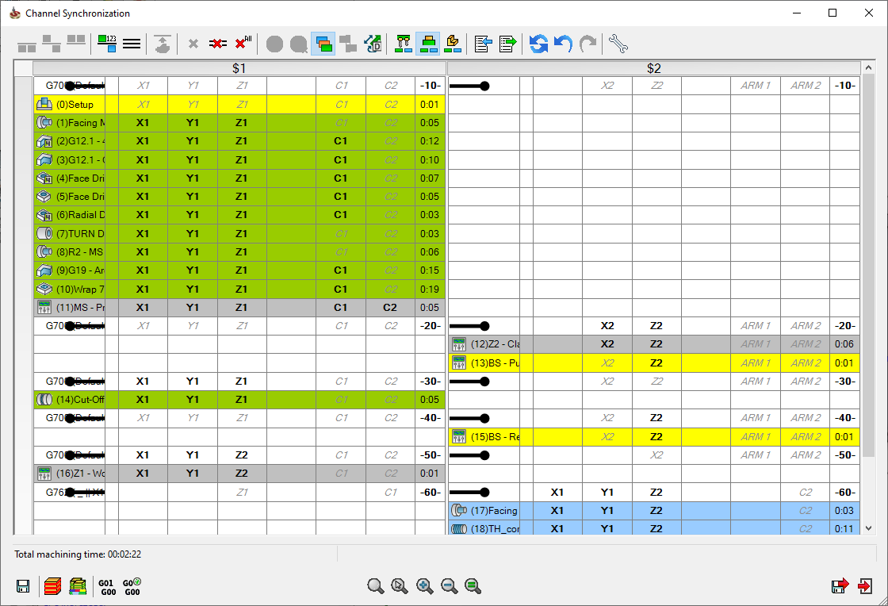
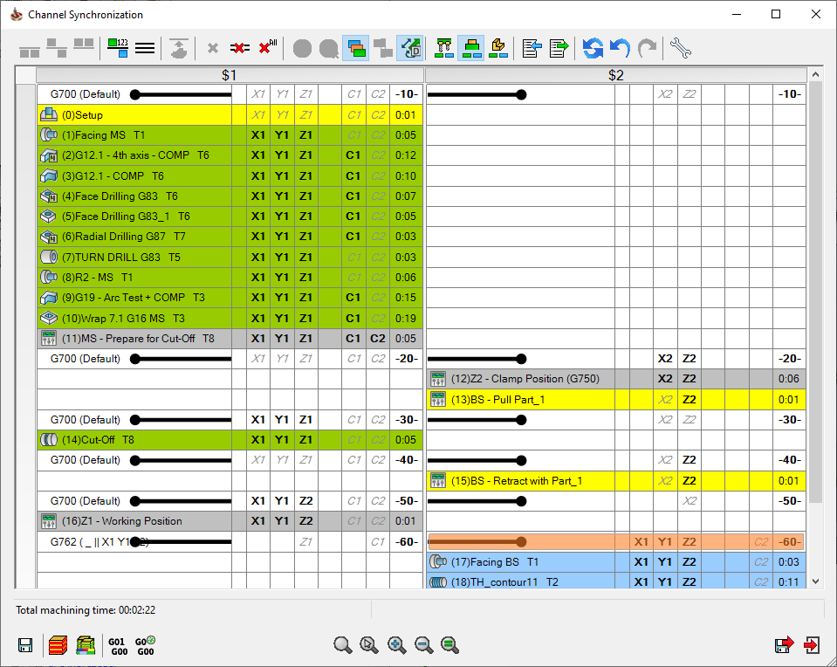
SolidCAM 2022 SP1– Channel Synchonization
Show/Hide Discrete axes
Added possibility to Show/Hide Discrete axes (if defined in VMID)

Slide 24
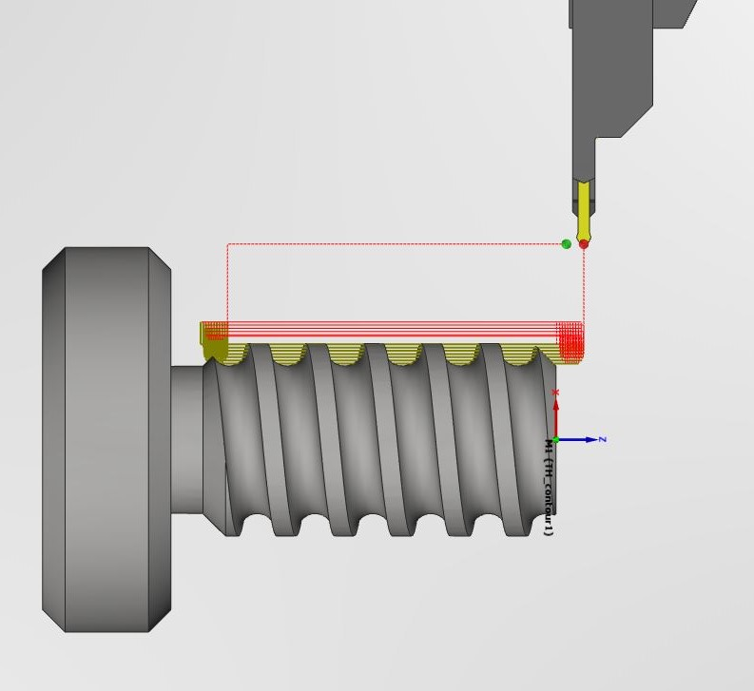
SolidCAM 2022 SP1 – Threading/Custom Shape Threading
A new feature of SolidCAM 2022 threading operation enables us to machine custom profile threads, using a variety of tool insert shapes.
We are able to set vertical and horizontal steps for roughing and the scallop for finishing, to reach the required result.
Perfect use for trapezoidal, buttress, and knuckle threads or screw conveyors, with any profile geometry.

Slide 25
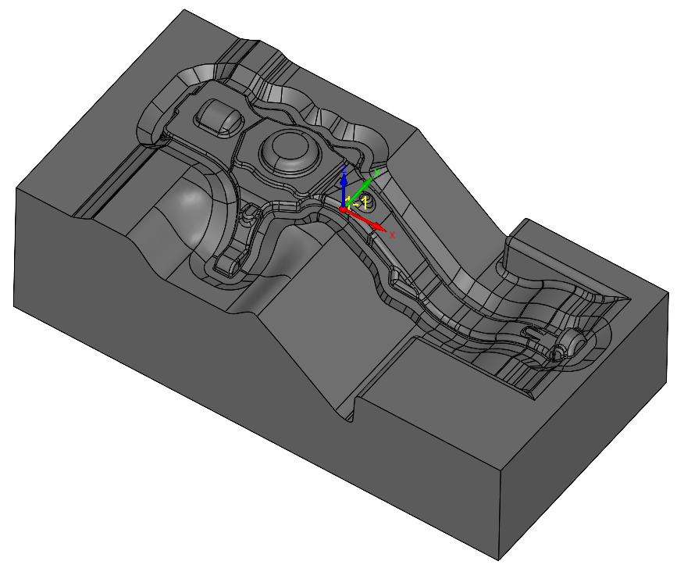
SolidCAM 2022 SP1 – THSR/Faster calculation time
SolidCAM 2021
Roughing – 20 Seconds
Rest Roughing – 66 Seconds
Rest Roughing – 40 Seconds
SolidCAM 2022
Roughing – 10 Seconds
Rest Roughing –16 Seconds
Rest Roughing – 15 Seconds
Much Faster Turbo HSR Calculation times!

Slide 26
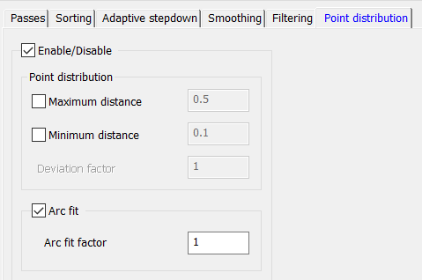
SolidCAM 2022 SP1 – THSR/THSM Arc Fit
Without ARCFIT
Roughing – 785970 Lines
Rest Roughing - 332635 Lines
Finishing – 2507440 Lines
With ARCFIT
Roughing – 464135 Lines
Rest Roughing - 121670 Lines
Finishing – 1441510 Lines
Turbo Roughing & Finishing now have the option to Fit Arcs.
This feature reduces the program size by over 50%, reduces machining time & improves surface quality.

Slide 27
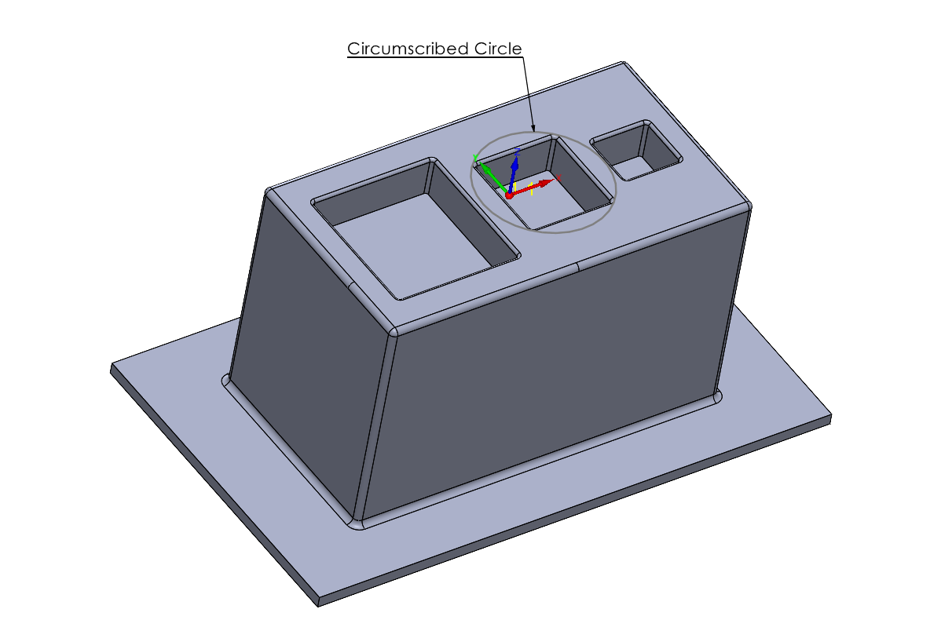
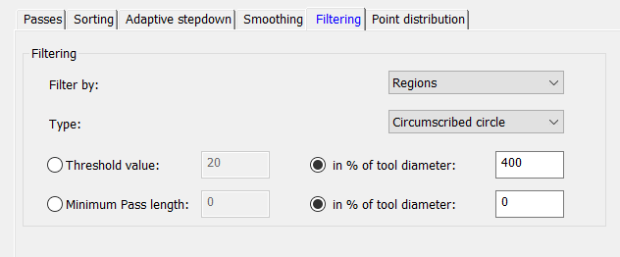
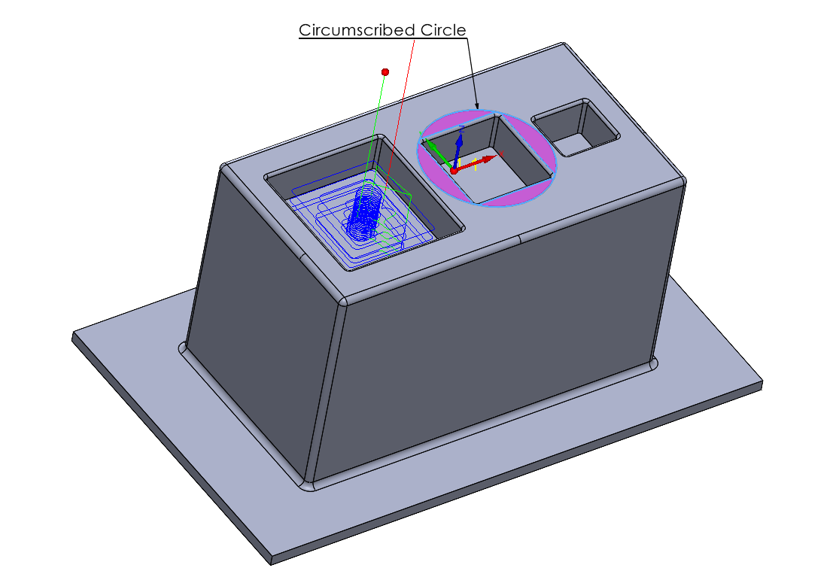
SolidCAM 2022 SP1 – THSR/Add Circumscribed Circle
Toolpaths are checked with a circumscribed circle, to detect and filter the slices that are smaller than the threshold value - this is very useful when working with Tools without Center cutting.

Slide 28
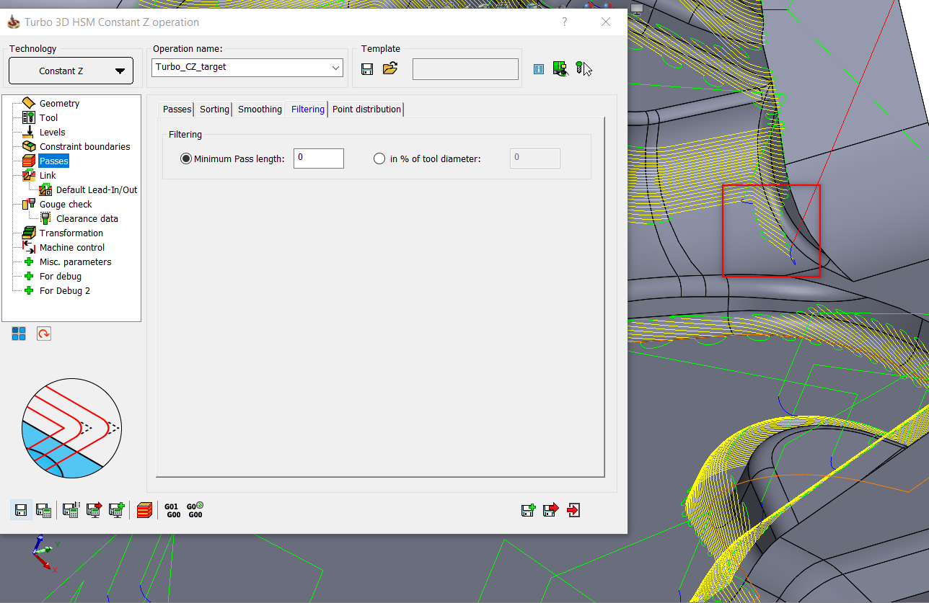
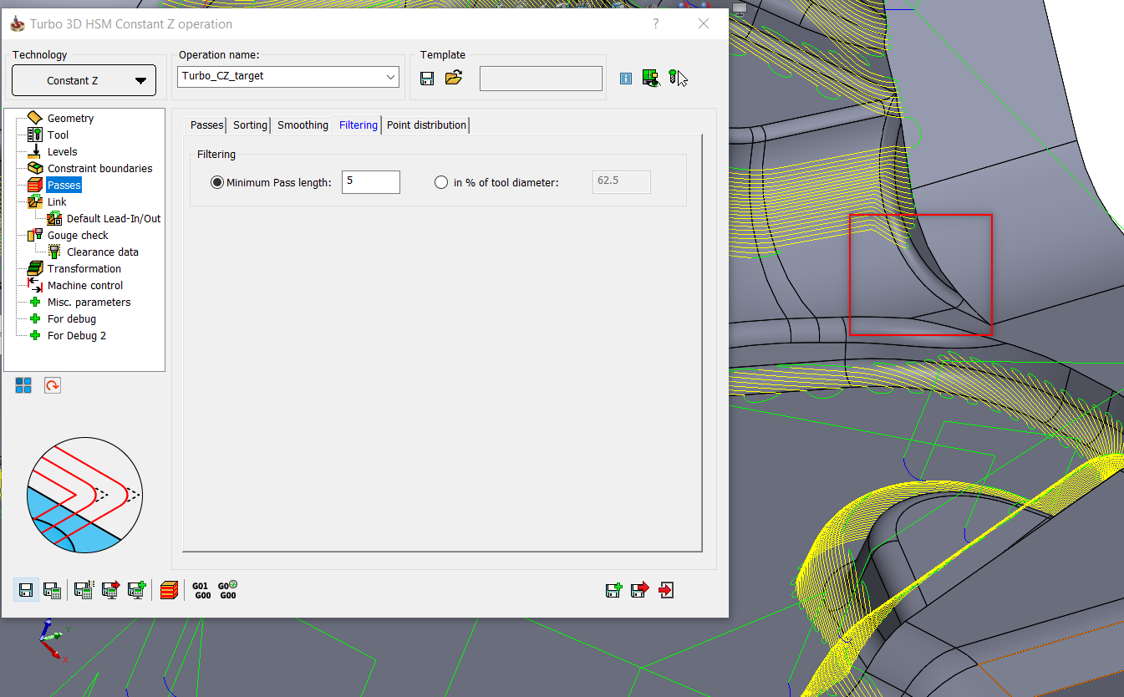
SolidCAM 2022 SP1 – THSR/THSM Filtering Moves
This option filters out toolpath segments, below the defined threshold value. This helps to eliminate small irrelevant moves in the toolpath & helps reduce machining time.

Slide 29
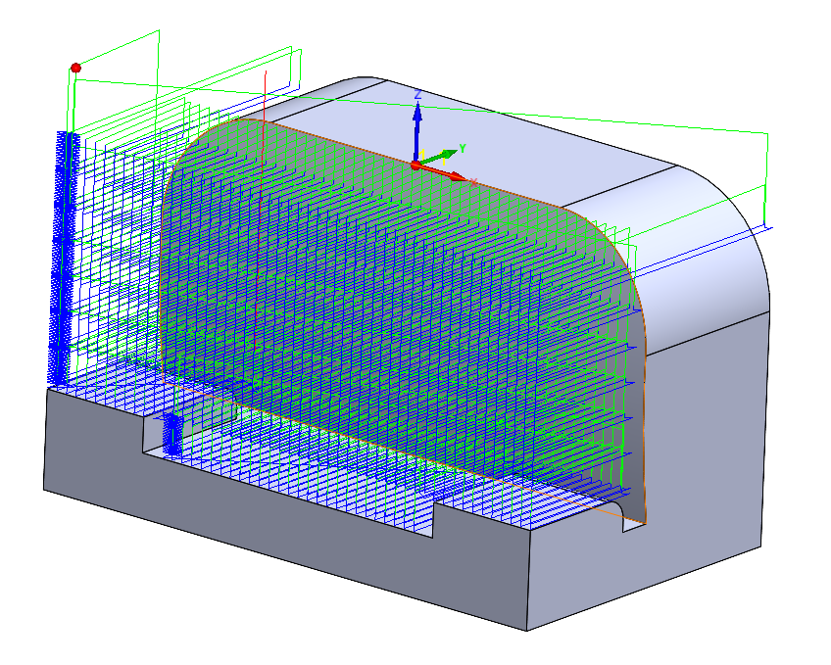
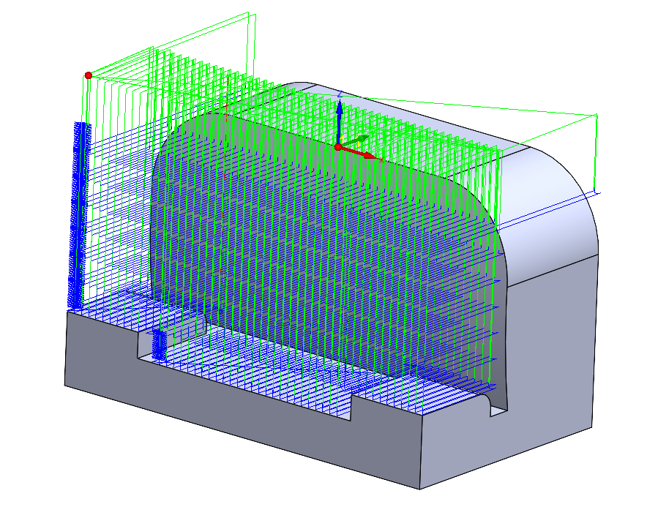
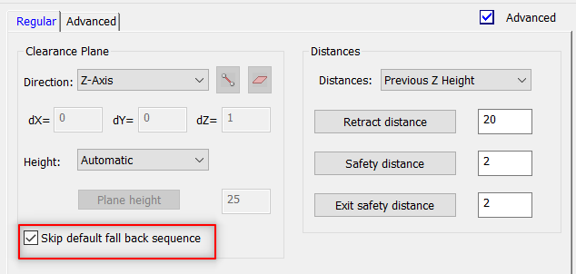
SolidCAM 2022 SP1 – THSR/Skip Fallback Sequence
This option enables the retract moves to the clearance area plane height, avoiding intermediate retractions to the feed, rapid distances, in case if the requested direct or blend spline area links within group, cannot be created.

Slide 30
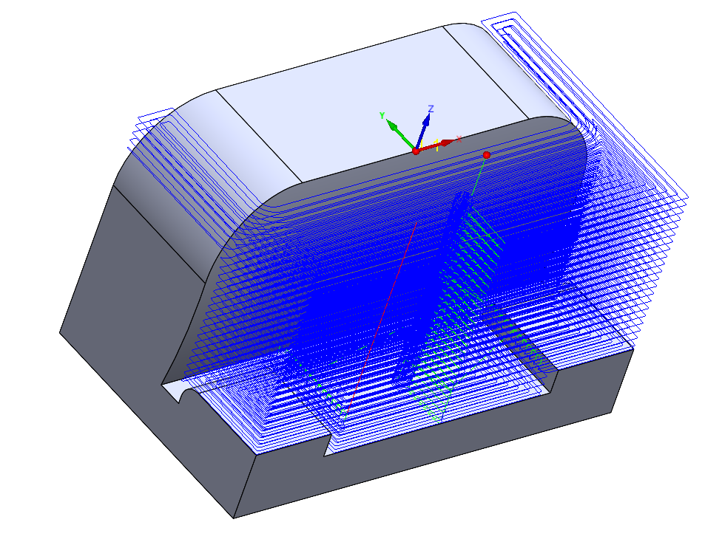


SolidCAM 2022 SP1 – THSR/Fixture Offset
Fixture offset can now be applied to the Fixture Curves.
Fixture curves eliminate the need to define a 3D model of the Fixture (Clamps etc.).

Slide 31



SolidCAM 2022 SP1 – THSM/Horizontal Machining
New option to create Horizontal Machining inside Turbo HSM
Hatch & Contour Patterns are available.

Slide 32



SolidCAM 2022 SP1 – Undercut Milling new features
Removing aircuts in Undercut milling, eliminates the Air Passes that are otherwise created to avoid Collision on the Arbor or Holder - this saves a lot of Machining time.

Slide 33


SolidCAM 2022 SP1 – Edge Deburring Recognition
Filter out unwanted chains
We can now modify a geometry to exclude chains that you do not want to machine, by simply unchecking the check box of the chains.

Slide 34

SolidCAM 2022 SP1 – Sim5X Edge Breaking/Tool types Support
Edge Breaking now supports 6 different types of tools.
Toolpaths can now be created for Flat End Mill, Ball Nose End Mill, Taper Mill, Taper Ball Nose Mill, Lollipop Mill & Chamfer Mill.

Slide 35


SolidCAM 2022 SP1 – Sim5X Edge Breaking/New features
Flat End Mills can be used to created the Chamfers directly.
The Contact point of the tool can be moved along the cutting length of the Tool, to enhance tool life.

Slide 36




SolidCAM 2022 SP1 – Sim5X Edge Breaking/New features
Edge breaking can now generate Chamfers or Fillets, using Multiple passes.
Ball Nose, Lollipop Mills & Taper Ball Nose Mills can be used to generate Fillets on edges.

Slide 37



SolidCAM 2022 SP1 – Multi Axis Machining/Wall & Floor finishing
Multiaxis Machining can now Finish Wall & Floor using Barrel Mills Automatically. User defines the Target, Wall & Floor Surfaces.
Rest Machining can also be performed by defining boundaries using Barrel Mills.

Slide 38

SolidCAM 2022 SPx – Mill 2.5D/New Pocket Geometries
The Pocket operation will now have all the advantages and options as we have in iMachining 2D.
This includes:
  Feature recognition by Faces
  Feature Recognition by Chains
  Outside Feature Recognition
  Chains without Feature Recognition

Slide 39


SolidCAM 2022 SPx – Hole Wizard Enhancements
Advanced Feature Recognition
  Recognize Once
  Use repeatedly
Feature Based Attributes
  Dimensional Tolerances
  Feature Color Attribute
  Logical Flags
Tool „Search Criteria“ Tolerancing

Slide 40





SolidCAM 2022 SPx – U-Axis support
New axis type “Sub Linear Axis” can be Simultaneous or Indexial
Tool vector for kinematic calculations is the Drive Unit Axis vector as normal to plane vector.
The tool tip point for positioning is the projection of the Cutting Point to the Turning Axis.

Slide 41




SolidCAM 2022 SPx– Collinear axes support
In order to support the CNC machines for heavy and gas & oil industries, we are implementing support of machines with collinear axes.
Those CNC machines are designed to hold heavy parts and make deep holes machining

Slide 42

SolidCAM 2022 SPx – iTurning
Enhanced Trochoidal turning toolpath
Supports all Insert shapes
Easier on machine-tools – always smooth, flowing motion
Increased tool life – eliminates over engagement and dwelling
Reduced machining loads – material entry and exit is always smooth, circular, and tangential

Slide 43

SolidCAM 2022 SPx – Ceratizit Free Turn
All familiar turning operations such as roughing, finishing, contour turning, facing and longitudinal turning are completed using just one tool.

Slide 44


SolidCAM 2022 SPx – Sandvik Prime Turning
PrimeTurning is a new methodology that enables you to do turning in all directions, in a much more efficient and productive way as compared to conventional turning.
Delivers a 50% increase in productivity.

Slide 45

SolidCAM 2022 SPx – Thread Whirling (SWISS type)
Thread Whirling is a form of the thread milling process. Inserts are mounted on the inside of a cutting ring that rotates around a cylindrical component to cut a thread.
It is a productive method often used on Swiss-type CNC machines for thread parts that need to be produced quickly and at tight tolerances or for threads with a high length-to-diameter ratio.
Typical parts for thread whirling are medical bone screws, implants, feed screws and other microcomponents.

Slide 46

SolidCAM 2022 SPx – Automatic Operation Defaults
For faster User working, we will generate an automatic template for each tool size, operation type, and type of stock material.
Next time the user adds an operation and chooses tool size, he can choose from the last three automatically saved templates, the one whose parameters he wants to use in the current operation.

Slide 47


SolidCAM 2022 SPx – SolidCloud
SolidCloud will provide synchronized Backup on the Cloud of all SolidCAM data:
SolidCAM settings
Post Processors
Machine simulations
Material and Machine Tool databases (for iMachining)
Global tool tables
SolidCAM CAM Parts
If the SolidCAM user computer has problems, he could simply reinstall SolidCAM software and can access all his data on the Cloud.
If the SolidCAM user wants to work from another computer, he can access all his data on the Cloud - any changes done on this computer will be synchronized to the cloud.
SolidCloud is based on Google Drive. https://cloud.google.com/
ttps://cloud.google.com/security?skip_cache=true

Slide 48

SolidCAM Maker Version
SolidCAM Maker Version will have the functionality of the Regular Version, except it will have only three built-in post processors:
  HAAS Milling post
  Mach3 Milling post
  HAAS Turning post
For Makers, Hobbyists and Students
CAM Parts built in the Maker version cannot be read in the Educational or Industrial versions.
SolidCAM Maker Version is downloaded for free from the SolidCAM website and will be updated, same as the latest Regular version.
.
ttps://cloud.google.com/security?skip_cache=true

Slide 49


"The best way to predict the future is to create it."
– Peter Drucker

Slide 50

THANKS FOR WATCHING

